Slide 2
Psychology: the scientific study of behavior and mental processes
What is the scope of contemporary psychology?
What roles did Wundt and James play in establishing psychology?
What were the early schools of thought and approaches in psychology, and how did their views differ?

Slide 3
Goals of Psychological Science
Describe behavior
Explain behavior
Predict behavior
Control or influence behavior

Slide 4
Introduction: The Origins of Psychology
Fundamental Issues
How should psychology be defined?
What is the proper subject matter of psychology?
Which areas of human experience should be studied?
What methods should be used to investigate psychological issues?
Should psychology include the study of nonhuman animal behavior?
Should psychological findings be used to change or enhance human behavior?

Slide 5
Influence of Philosophy
Aristotle
Impact of physiology on emergence of psychology
Scientific discoveries demonstrated that the scientific method could be applied to behavior and mental processes
René Descartes (1596–1650)—Interactive dualism
Mind and body are separate entities that interact to produce sensations, emotions, and other conscious experiences
Nature – Nurture Issue
Today, focus on interaction of environment and genetics

Slide 6
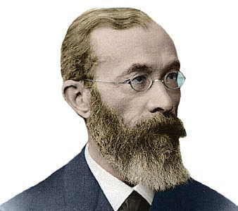
Founders of Psychology
Wilhelm Wundt (1832–1920) Founder of Psychology
1874—Landmark text Principles of Physiological Psychology
1879—First psychology lab at the University of Leipzig
Bettmann/Corbis

Slide 7
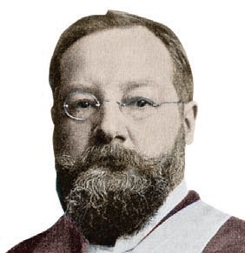
Founders of Psychology
First Major Psychological Schools
Edward Titchener (student of Wundt) developed approach called structuralism—involving introspection and study of basic components of conscious experiences
focused on basic sensory and perceptual processes
criticized for relying on introspection
Archives of the History of American Psychology, The University of Akron

Slide 8
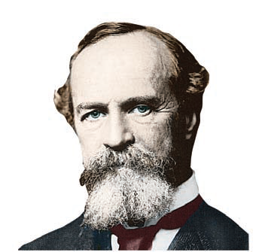
Founders of Psychology
First Major Psychological Schools:
William James and Functionalism
opposed Wundt and Titchener’s approach and shaped school of functionalism
Influenced by Darwin to focus on how behaviors help us adapt to the environment
Stressed the importance of how behavior functions to allow people and animals to adapt to their environments
Bettmann/Corbis

Slide 9
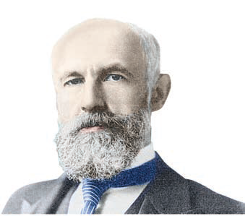
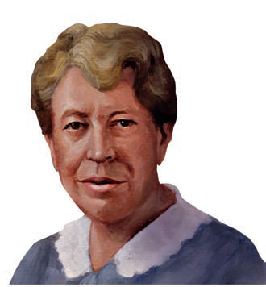
James’s Students
G. Stanley Hall (1844-1924)
First psychological lab in the U.S. at Johns Hopkins; founded the APA
Mary Whiton Calkins (1863-1930)
In 1905, Calkins was elected president of the American Psychological Association—the first woman, but not the last, to hold that position
Corbis

Slide 10
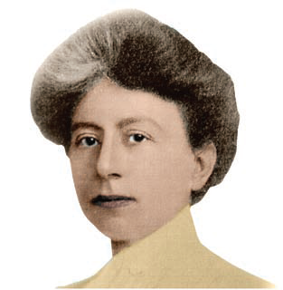
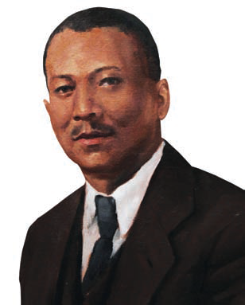
James’s Students
Margaret Floy Washburn (1871-1939)
First American woman to earn an official Ph.D. in psychology
Francis C. Sumner (1895-1954)
First African American to receive a Ph.D. in psychology, awarded by Clark University in 1920
Archives of the History of American Psychology,
The University of Akron

Slide 11
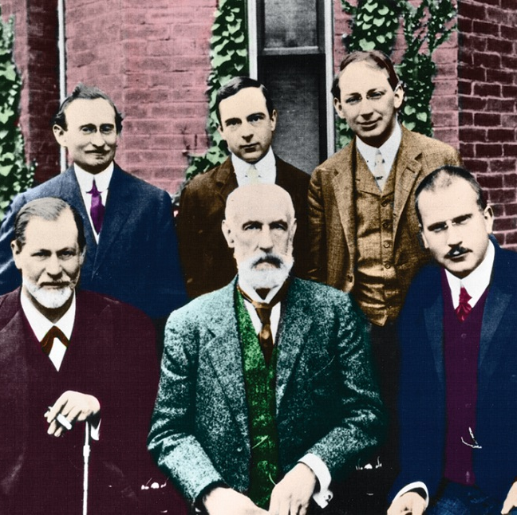
Sigmund Freud and Psychoanalysis
Challenged structuralism and functionalism
Started school of thought called psychoanalysis: Personality theory and form of psychotherapy
Suggests behavior and personality influenced by unconscious conflicts
Emphasizes the role of unconscious factors in personality and behavior
Emphasize sexual and aggressive nature of unconscious processes
Powerful influence on later theories of psychology
Clark University
Notes:
Austrian physician – not a psychologist

Slide 12
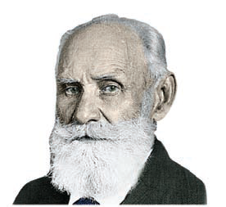
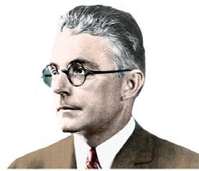
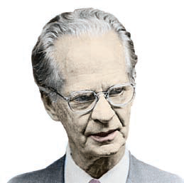
Other Pioneers of Psychology Behaviorism
Ivan Pavlov – Russian physiologist
Demonstrated that dogs could learn to associate a neutral stimulus, such as the sound of a bell, with an automatic behavior, such as reflexively salivating to food
John Watson
Posited that the goal of the behaviorists was to discover the fundamental principles of learning—how behavior is acquired and modified in response to environmental influences
B.F Skinner
Believed that psychology should restrict itself to studying outwardly observable behaviors that could be measured and verified in compelling experimental demonstrations..
Culver Pictures
Underwood & Underwood/Corbis
Archives of the History of American Psychology, The University of Akron
Notes:
Behaviorism
School of psychology and theoretical viewpoint that emphasizes the study of observable behaviors, especially as they pertain to the process of learning

Slide 13
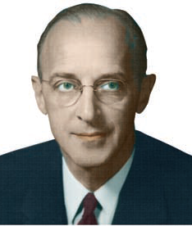
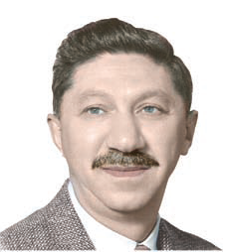
Other Pioneers of Psychology Humanistic Psychology
Carl Rogers
Emphasized the person’s conscious experiences, unique potential for psychological growth and self-direction, self-determination, free will, and the importance of choice in human behavior
Suggested humanistic psychology differs significantly from psychoanalysis and behaviorism
Abraham Maslow
In his theory of motivation, emphasized the importance of psychological growth
Special Collections, Donald C. Davidson Library/University of California, Santa Barbara
Courtesy of Robert D. Farber University
Archives at Brandeis University
Notes:
Humanistic Psychology
emphasizes each person’s unique potential for psychological growth and self-direction

Slide 14
Contemporary Psychology
Modern psychology has become more specialize and diverse with various perspectives
Today’s psychologists identify themselves according to
perspective they emphasize in investigating psychological topics
specialty area which they practice and have been trained in

Slide 15
Contemporary Psychology
How do the perspectives in contemporary psychology differ in emphasis and approach?
How do psychiatry and psychology differ, and what are psychology’s major specialty areas?

Slide 16
Major Perspectives in Psychology
Biological Perspective
Psychodynamic Perspective
Behavioral Perspective
Humanistic Perspective
Positive Psychology Perspective
Cognitive Perspective
Cross Cultural Perspective
Evolutionary Perspective

Slide 17
Perspectives in Psychology
Biological perspective
Physical basis of behavior
Neuroscience –study of physiological mechanisms in brain and nervous system that organize and control behavior
Focus may be at various levels
individual neurons
areas of the brain
specific functions like eating, emotion, or learning
Development of the PET scan, MRI scan, functional MRI (fMRI) scan, and other techniques has allowed scientists to study the structure and activity of the intact brain
Notes:
Interest in behavior distinguishes biological psychology from many other biological sciences
Advances in medicine and technology and the discovery of drugs that helped control the symptoms of severe psychological disorders sparked questions about the interaction among biological factors and human behavior, emotions, and thought processes

Slide 18
Perspectives in Psychology
Psychodynamic perspective
Based originally on Freud’s work
Emphasis on unconscious processes and early experience
Current psychologists with this perspective may or may follow Freud or psychoanalytic principles
Behavioral Perspective
Based on Watson, Pavlov, and Skinner
Study of how behavior is acquired and modified through experience and environment
Mental health professionals may emphasize the behavioral perspective in explaining and treating psychological disorders

Slide 19
Perspectives in Psychology
Humanistic perspective
Based on Maslow and Rogers
Focuses on personal growth , interpersonal relationships, and self-concept
Humanistic perspective is often emphasized among psychologists working in the mental health field
Positive psychology perspective
Based on Seligman and others
Studies how to contribute to optimal functioning and counterbalance traditional emphasis on problem and disorders
Topics under the umbrella of positive psychology include personal happiness, optimism, creativity, resilience, character strengths, and wisdom
Cognitive perspective
Focuses on mental process, memory, perception, language, problem solving, and thinking
Based on using computers as a model for human mental processing

Slide 20
Perspectives in Psychology
Cross-cultural perspective
Emerged in the 1980s
Emphasizes diversity of behavior across cultures and the fact that many earlier findings were not universal (e.g., study of social loafing)
Important cultural terms:
Ethnocentrism—belief that one’s own culture or ethnic group is superior to all others, and the related tendency to use one’s own culture as a standard by which to judge other cultures
Individualistic cultures—those that emphasize the needs and goals of the individual over the needs and goals of the group
Collectivistic cultures—those that emphasize the needs and goals of the group over the needs and goals of the individual

Slide 21
Perspectives in Psychology
Evolutionary perspective
Applies the principles of evolution to explain psychological processes
Most adaptive characteristics are perpetuated through natural selection
David Buss (2008): “An evolved psychological mechanism exists in the form that it does because it solved a specific problem of survival or reproduction recurrently over evolutionary history.”

Slide 22
Psychologists and Psychiatrists
Not all psychologists are clinicians
Clinical psychologists are trained in the diagnosis, treatment, causes, and prevention of psychological disorders; Ph.D. or Psy.D. degrees
Psychiatrists have medical degrees (M.D. or D.O.) followed by specialized training in the diagnosis, treatment, causes, and prevention of psychological disorders;
Emphasize biological factors and use biomedical therapies, such as prescription drugs, electroconvulsive therapy, and transcranial magnetic stimulation (TMS)

Slide 23
Major Specialties in Psychology
Specialty | Major Focus
Biological psychology | Relationship between psychological processes and the body’s physical systems; neuroscience refers specifically to the brain and the rest of the nervous system.
Clinical psychology | Causes, diagnosis, treatment, and prevention of psychological disorders.
Cognitive psychology | Mental processes, including reasoning and thinking, problem solving, memory, perception, mental imagery, and language
Counseling psychology | Helping people adjust, adapt, and cope with personal and interpersonal challenges; improving well-being, alleviating distress and maladjustment, and resolving crises.
Developmental psychology | Physical, social, and psychological changes that occur at different ages and stages of the life span.
Educational psychology | Applying psychological principles and theories to methods of learning.
Experimental psychology | Basic psychological processes, including sensory and perceptual processes, and principles of learning, emotion, and motivation.

Slide 24
Major Specialties in Psychology
Specialty | Major Focus
Health psychology | Psychological factors in the development, prevention, and treatment of illness; stress and coping; promoting health-enhancing behaviors.
Industrial/Organizational psychology | The relationship between people and work.
Personality psychology | The nature of human personality, including the uniqueness of each person, traits, and individual differences.
Social psychology | How an individual’s thoughts, feelings, and behavior are affected by their social environments and by the presence of other people.
School psychology | Applying psychological principles and findings in primary and secondary schools.
Applied psychology | Applying the findings of basic psychology to diverse areas; examples include sports psychology, media psychology, forensic psychology, rehabilitation psychology.

Slide 25
The Scientific Method
What assumptions and attitudes are held by psychologists?
What characterizes each step of the scientific method?
How does a hypothesis differ from a theory?

Slide 26
The Scientific Method
Step 1: Formulate a specific question that can be tested
Form a hypothesis: a tentative statement about the relationship between two or more variables; a testable prediction or question
Step 2: Design a study to collect relevant data
Use descriptive or experimental methodologies
Step 3: Analyze the data to arrive at conclusions
Use statistics to analyze, summarize, and draw conclusions about the data they have collected
Step 4: Report the results
The rationale for testing the hypothesis
Who participated in the study and how they were selected
How variables were operationally defined
What procedures or methods were used
How the data were analyzed
What the results seem to suggest
Notes:
Scientific Method
A set of assumptions, attitudes, and procedures that guide researchers in creating questions to investigate, in generating evidence, and in drawing conclusions.

Slide 27
The Scientific Method Basic Research Terms
Empirical evidence | Verifiable evidence that is based upon objective observation, measurement, and/or experimentation.
Hypothesis | A tentative statement about the relationship between two or more variables; a testable prediction or question.
Variable | A factor that can vary, or change, in ways that can be observed, measured, and verified.
Operational definition | A precise description of how the variables in a study will be manipulated or measured.
Statistics | A branch of mathematics used by researchers to organize, summarize, and interpret data.

Slide 28
The Scientific Method Basic Research Terms
Meta-analysis | A statistical technique that involves combining and analyzing the results of many research studies on a specific topic in order to identify overall trends.
Replicate | To repeat or duplicate a scientific study in order to increase confidence in the validity of the original findings.
Theory | A tentative explanation that tries to integrate and account for the relationship of various findings and observations.
Descriptive research methods | Scientific procedures that involve systematically observing behavior in order to describe the relationship among behaviors and events.
Notes:
Click to reveal each definition.

Slide 29
Building Theories
Theory
tentative explanation that tries to integrate and account for the relationship of various findings and observations
often reflect the self-correcting nature of the scientific enterprise
Conclusions of psychology rest on empirical evidence gathered using the scientific method; the same is not true of pseudoscientific claims.

Slide 30
Pseudoscience—The Warning Signs
Strategy 1: Testimonials rather than scientific evidence
Strategy 2: Scientific jargon without scientific substance
Strategy 3: Combining established scientific knowledge with unfounded claims
Strategy 4: Irrefutable or nonfalsifiable claims
Strategy 5: Confirmation bias
Strategy 6: Shifting the burden of proof
Strategy 7: Multiple outs

Slide 31
Research Strategies
Descriptive—strategies for observing and describing behavior
Naturalistic observation
Case studies
Surveys
Correlational methods
Experimental—strategies for inferring cause and effect relationships among variables

Slide 32
Descriptive Research
What are naturalistic observation and case study research, and why and how are they conducted?
What is a survey, and why is random selection important in survey research?
What are the advantages and disadvantages of each descriptive method?

Slide 33
Descriptive Research Methods
Describe a set of facts
Do not look for relationships between facts
Do not predict what may influence the facts
May or may not include numerical data

Slide 34
Naturalistic Observation
Researchers directly observe and record behavior rather than relying on subject descriptions
Goal of naturalistic observation is to detect the behavior patterns that exist naturally—patterns that might not be apparent in a laboratory
Allows researchers to study human behaviors that cannot ethically be manipulated in an experiment

Slide 35
Case Studies
Highly detailed description of a single individual
Generally used to investigate rare, unusual, or extreme conditions
Quite useful in clinical, neurological, and neuroscientific areas

Slide 36
Surveys
Designed to investigate opinions, behaviors, or characteristics of a particular group. Usually in self-report form
Problems
Do people answer honestly?
One strategy is to ask the same question in different manners
Computer surveys may elicit more honesty

Slide 37
Important Terms for Survey Design
Sample
A selected segment of the population used to represent the group that is being studied.
Representative Sample
Random Selection
A selected segment that very closely parallels the larger population being studied on relevant characteristics.
Process in which subjects are selected randomly from a larger group such that every group member has an equal chance of being included in the study

Slide 38
Correlational Studies
What is a correlation coefficient?
What is the difference between a positive correlation and a negative correlation?
Why can’t correlational studies be used to demonstrate cause-and-effect relationships?

Slide 39
Correlation
Correlational study: research strategy that allows the precise calculation of how strongly related two factors are to each other.
Correlation Coefficient: numerical indication of magnitude and direction of the relationship between two variables
Notes:
Correlation Coefficient:
Correlation coefficients always fall in the range from -1.00 to +1.00.
Correlation coefficient of +.10 or -.10 indicates the two factors seldom occur together.
The closer the absolute value of the correlation coefficient is to 1.00, whether it is positive or negative, the stronger the correlation or association is between the two factors
Correlation coefficient of +.90 or -.90 indicate two factors almost always occur together.
Correlation coefficient has two parts—the number and the sign. The number indicates the strength of the relationship, and the sign indicates the direc­tion of the relationship between the two variables.

Slide 40
Correlation and Causality
Even if two factors are very strongly correlated, correlation does not necessarily indicate causality. A correlation tells you only that two factors seem to be related or that they co-vary in a systematic way.
Only experiments allow for cause and effect statements.

Slide 41
Experimental Research
What roles do the independent variable and dependent variable play in an experiment?
What is the testing effect?
How can experimental controls help minimize the effects of confounding variables?

Slide 42
The Experimental Method
Used to demonstrate a cause-and-effect relationship between two variables.
Involves deliberately varying one factor, which is called the independent variable
Measures the changes, if any, that are produced in a second factor, called the dependent variable

Slide 43
The Experimental Method
Hypothesis | Specific question or prediction to be tested.
Main Effect | Any change that can be directly attributed to the independent or treatment variable after controlling for other possible influences.
Independent Variable | Purposely manipulated factor thought to produce change in an experiment. Also called the treatment variable.
Dependent Variable | Factor that is observed and measured for change in an experiment; thought to be influenced by the independent variable. Also called the outcome variable.
Extraneous Variable | A factor or variable other than the ones being studied that, if not controlled, could affect the outcome of an experiment. Also called a confounding variable.

Slide 44
The Experimental Method
Experimental group or experimental condition | Group of participants who are exposed to all experimental conditions, including the independent variable.
Random assignment | All participants have an equal chance of being assigned to any of the experimental groups or conditions. Random assignment helps ensure that any potential differences among the participants are spread out evenly across all experimental conditions.
Single-blind study | Researchers, but not the subjects, are aware of critical information.
Double-blind technique | Both the participants and the researchers interacting with them are blinded, or unaware of the treatment or condition to which the participants have been assigned.

Slide 45
Sources of Bias
Expectancy effects
Demand characteristics
Placebo
Placebo effect
Change in dependent variable produced by subject’s expectancy that change should happen
Subtle cues or signals by the researcher that communicate the type of responses that are expected
A fake substance, treatment, or procedure that has no known direct effects
Any change attributed to the person’s beliefs and expectations rather than to an actual drug, treatment, or procedure. Also called the expectancy effect

Slide 46
Ethics in Psychological Research
What are five key provisions of the APA ethics code for research involving humans?
Why do psychologists sometimes conduct research with nonhuman animal subjects?

Slide 47
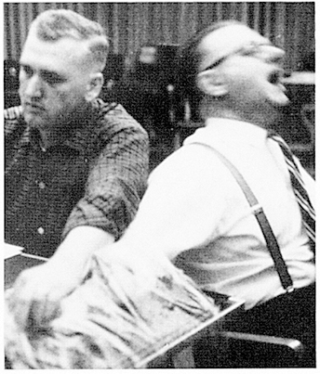
Ethical Guidelines
Psychological research conducted in the United States is subject to ethical guidelines developed by the American Psychological Association (APA).
There are 5 key provisions in the most recent APA ethical principles regulating research with human participants…
From the fi lm Obedience © 1968 by Stanley Milgram, © renewed 1993 by Alexandra Milgram; and distributed by Alexander Street Press

Slide 48
Informed consent and voluntary participation
Students as research participants
The use of deception Psychologists can use deceptive techniques if:
Confidentiality of information
Information about the study and debriefing
Psychologist must inform the participants of the purpose of the research, and any potential risks, discomfort, or unpleasant emotional experiences.
Participants are free to decline to participate or to withdraw from the research at any time.
When research participation is a course requirement or an opportunity for extra credit, the student must be given the choice of an alternative activity to fulfill the course requirement or earn extra credit.
it is not feasible to use alternatives that do not involve deception
the potential findings justify the use of deception because of their scientific, educational, or applied value.
In their writing, lectures, or other public forums, psychologists may not disclose personally identifiable information about research participants.
All participants must be provided with the opportunity to obtain information about the nature, results, and conclusions of the research.
Psychologists are also obligated to debrief the par­ticipants and to correct any misconceptions that participants may have had about the research.

Slide 49
Limitations of Experimental Designs
Often criticized for having little to do with actual behavior because of strict laboratory conditions
Ethical considerations in creating some more lifelike situations
May get more ecological valid insights from natural experiments
In a natural experiment, researchers carefully observe and measure the impact of a naturally occurring event or condition on their study participants

Slide 50
Animals in Psychological Research
90% of psychology research actually uses humans, not animals, as subjects
The American Psychological Association (2011) condones the use of animals in psychological research under certain conditions.
Research using animal subjects must have an acceptable scientific purpose.
There must be a reasonable expectation that the research will
increase knowledge about behavior
increase understanding of the species under study
produce results that benefit the health or welfare of humans or other animals
Courtesy of Zoo Atlanta
Notes:
What standards must psychologists meet in using animal subjects?
American Psychological Association publishes the Guidelines for Ethical Conduct in the Care and Use of Animals:
http://www.apa.org/science/leadership/care/guidelines.aspx
Why are animals used in psychological research?
Many psychologists are interested in the study of animal behavior for its own sake.
Animal subjects are sometimes used for research that could not feasibly be conducted on human subjects.

Slide 51
Psychological Research Using Brain Imaging
Types:
Positron Emission Tomography (PET)
Detects increased blood by increased utilization of radioglucose
Magnetic Resonance Imaging (MRI)
Analyzes molecular response of nervous tissue to magnetic fields
Functional MRI (fMRI)
Use magnetic fields to detect metabolic activity in nervous system and detail neural activity
Limitations of brain-imaging studies:
Usually have a small number of subjects
Focus on simple aspects of behavior
Localization of a process in the brain doesn’t explain it

