Slide 2
Sensation: The process of detecting a physical stimulus, such as light, sound, heat, or pressure.
Perception The process of integrating, organizing, and interpreting sensations.

Slide 3
Basic Principles of Sensation
All senses involve some common processes. Sensory receptors convert physical energy into electrical impulses through transduction.
Sensory receptors: Specialized cells unique to each sense organ that respond to a particular form of sensory stimulation.
Transduction: The process by which a form of physical energy is converted into a coded neural signal that can be processed by the nervous system.

Slide 4
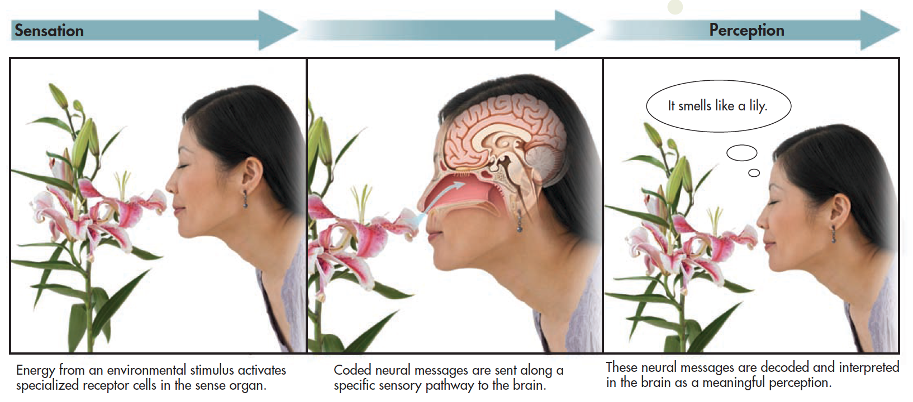
The Basic Steps of Sensation and Perception
Notes:
PLEASE INSERT 3.1 HERE

Slide 5
Sensory Thresholds
To be strong enough to be detected, a stimulus must be able to active a sensory receptor cell (threshold).
Each sense has two general threshold kinds.
Absolute threshold
See Table 3.1
Difference threshold
Just noticeable difference
Weber’s law
Sense | Absolute Threshold
Vision | A candle flame seen from 30 miles away on a clear, dark night
Hearing | The tick of a watch at 20 feet
Taste | One teaspoon of sugar in two gallons of water
Smell | One drop of perfume throughout a three-room apartment
Touch | A bee’s wing falling on your cheek from a height of about half an inch
Notes:
Absolute threshold: The smallest possible strength of a stimulus that can be detected half the time.
Difference threshold: The smallest possible difference between two stimuli that can be detected half the time; also
called just noticeable difference.
Absolute threshold table: Psychologist Eugene Galanter provided these classic examples of the absolute thresholds for our senses. In each case, people are able to sense these faint stimuli at least half the time.
Weber’s law (VAY-berz) A principle of sensation that holds that the size of the just noticeable difference will vary depending on its relation to the strength of the original stimulus.
Sensory adaptation involves a gradual decline in sensitivity to a constant stimuli. Mere exposure effect: The finding that
repeated exposure to a stimulus increases a person’s preference for that stimulus.

Slide 6
Absolute threshold: The smallest possible strength of a stimulus that can be detected 50% of the time.
Difference threshold: The smallest possible difference between two stimuli that can be detected 50% of the time; also called just noticeable difference.
Weber’s law (VAY-berz) A principle of sensation that holds that the size of the just noticeable difference will vary depending on its relation to the strength of the original stimulus.

Slide 7
Sensory adaptation involves a gradual decline in sensitivity to a constant stimuli.
Mere exposure effect: The finding that repeated exposure to a stimulus increases a person’s preference for that stimulus.

Slide 8
Subliminal Perception
Detection of a stimulus below a threshold level of conscious awareness
Flashed visual image, brief sound, faint odor, etc.
1957 New Jersey “Drink Coke” message

Slide 9
SCIENCE VERSUS PSEUDOSCIENCE Subliminal Perception
Do subliminal stimuli have any effect?
In 1957 Vicary claimed that concession sales were increased by flashing subliminal messages during a movie.
Although Vicary’s claims failed to be replicated, further research suggests that subliminal stimuli are effective only when these are relevant to observer-held goals.
Additionally, subliminal stimuli are transient and can only briefly influence attitudes, thoughts, preferences, and emotions.
Notes:
Subliminal perception refer to the detection of stimuli that are below the threshold of conscious perception and evoke a brain response.

Slide 10
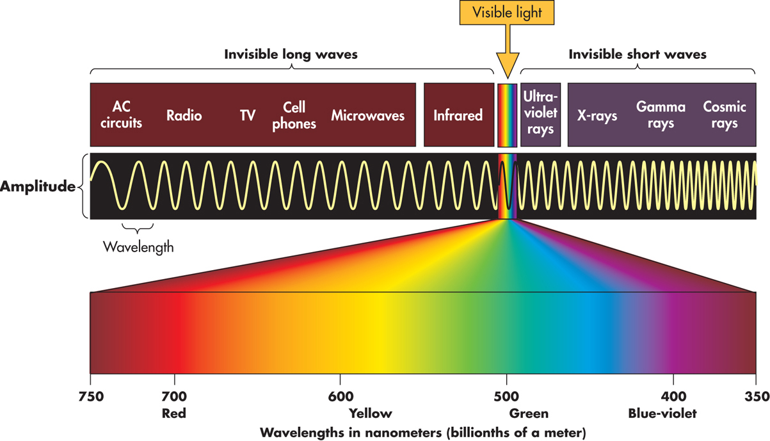
What We See THE NATURE OF LIGHT
Light is electromagnetic energy that can be described as waves and by its wavelength
Various types of electromagnetic energy differ in wavelength, which is the distance from one wave peak to another.
Notes:
The Electromagnetic Spectrum: We are surrounded by different kinds of electromagnetic energy waves, yet we are able to see only a tiny portion—less than one percent—of the entire spectrum of electromagnetic energy. Some electronic instruments, like radio and television, are specialized receivers that detect a specific wavelength range. Similarly, the human eye is sensitive to a specific and very narrow range of wavelengths. Note that as wavelength varies, color perception in humans varies.
Wavelength itself is not color – color is an interpretation of wavelength
Humans see in the 350 to 700 nanometer range.

Slide 11
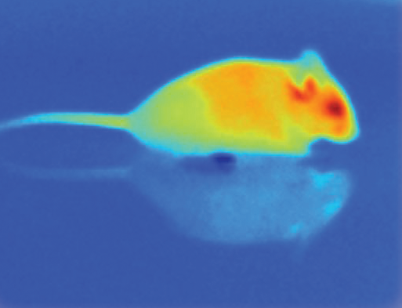
Electromagnetic Spectrum
Other animals can see in the infrared (pit vipers) and ultraviolet ranges (bees and some birds)
Julius Lab, UCSF
Notes:
The Electromagnetic Spectrum We are surrounded by different kinds of electromagnetic energy waves, yet we are able to see only a tiny portion—less than one percent—of the entire spectrum of electromagnetic energy. Some electronic instruments, like radio and television, are specialized receivers that detect a specific wavelength range. Similarly, the human eye is sensitive to a specific and very narrow range of wavelengths.

Slide 12
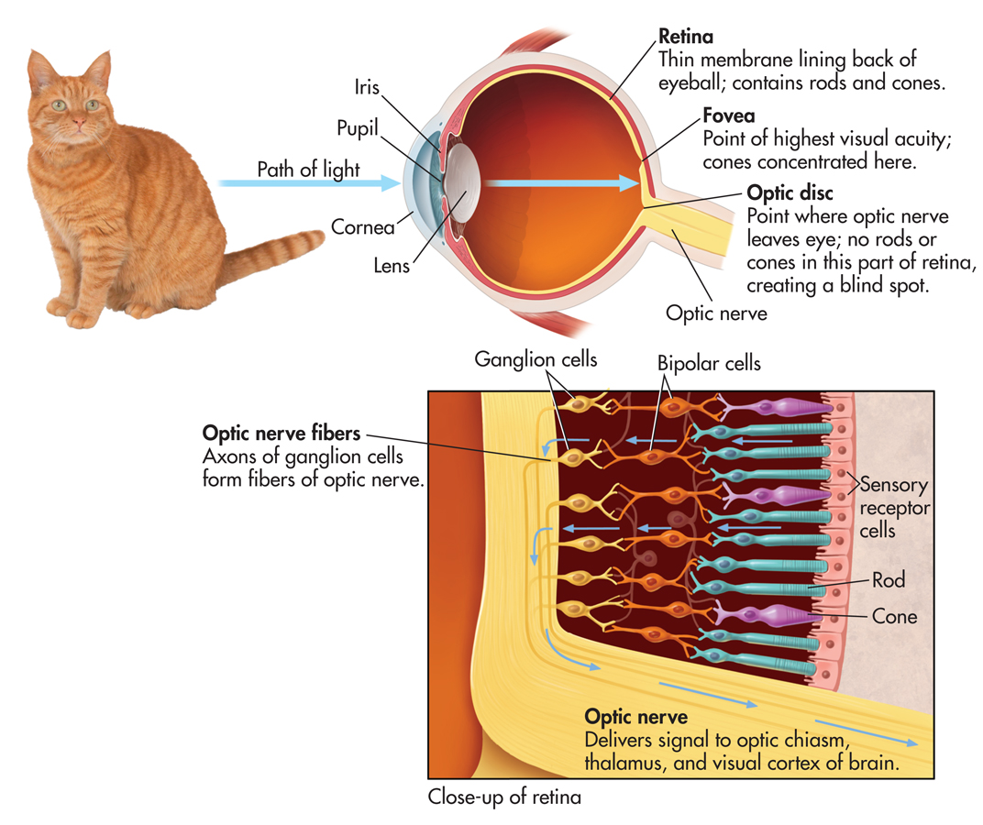
Path of Light in a Human Eye

Slide 13
Path of Light in a Human Eye
Light waves pass through the cornea, pupil, and lens.
The iris controls the amount of light entering the eye by controlling the size of the pupil.
The lens changes shape to focus the incoming light onto the retina. (acommodation)
As the light strikes the retina, the light energy activates the rods and cones.
Signals from the rods and cones are collected by the bipolar cells, which transmit the information to the ganglion cells.
The ganglion cell axons are bundled together to form the optic nerve which transmits the information to the brain.
The optic nerve leaves the eye at the optic disk, creating a blind spot in our visual field.
Notes:
Cornea
Pupil and Iris
Lens

Slide 14
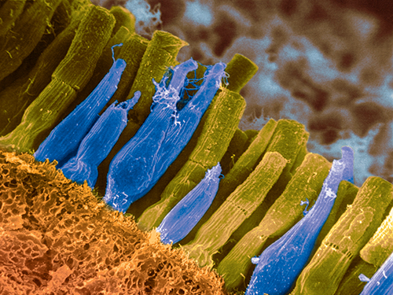
The Retina
Thin, light-sensitive membrane located at back of eye, contains sensory receptors for vision
Rods and cones: Sensory receptor cells that respond to light
Called photoreceptors
Exposed to light, rods and cones undergo chemical reactions that result in neural signals.
Getty Images/Corbis

Slide 15
The Blind Spot
The optic disc where ganglion nerve cells leave the retina
Contains no photoreceptors
Brain fills in the blind spot with the surrounding patterns

Slide 16
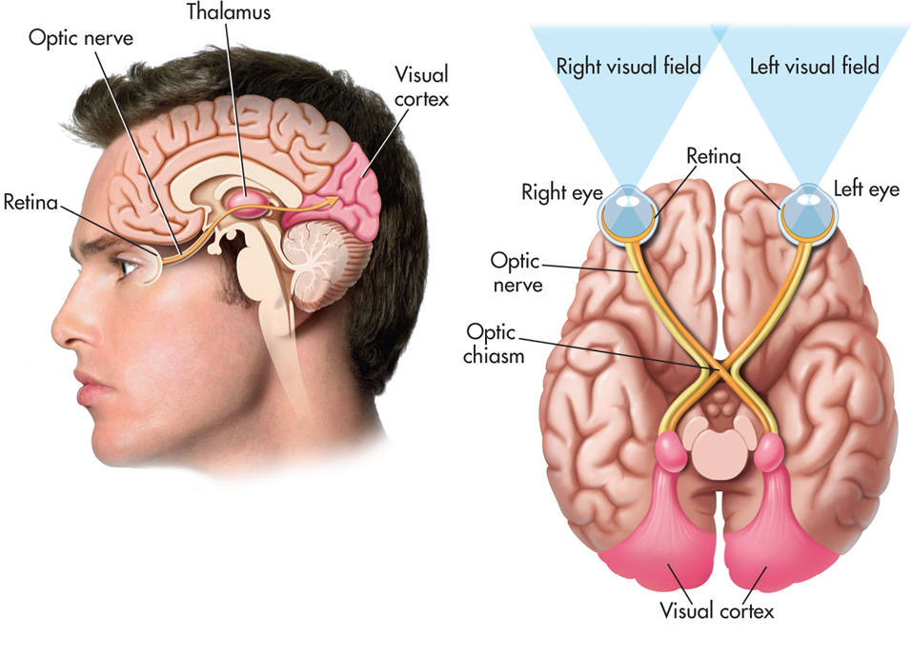
Neural Pathways from Eye to Brain
Optic nerve exits retina at optic disk
Optic nerves meet at optic chiasm and split apart
One set of nerve fibers crosses over and projects to opposite side of brain
Another set continues along same brain side
Most nerve fibers travel to thalamus and on to visual cortex of occipital lobe
Thalamus

Slide 17
Color Vision
Our visual system interprets differences in the wavelength of light as color.
Rods are color blind, but the cones allow us to see different colors.
This difference occurs because we have only one type of rod but three types of cones.
ROYGBIV
Wavelengths of about 400 nanometers are perceived as violet.
Wavelengths of about 700 nanometers are perceived as red.
In between are orange, yellow, green, blue, and indigo.
Terms to Learn
Hue
Saturation
Brightness
Notes:
Color: The perceptual experience of different wavelengths of light, involving hue, saturation (purity), and brightness (intensity).
Hue: The property of wavelengths of light known as color; different wavelengths correspond to our subjective experience of different colors.
Saturation: The property of color that corresponds to the purity of the light wave.

Slide 18
How We See Color
Trichromatic theory of color vision
Sensation of color results because cones in the retina are especially sensitive to red light (long wavelengths), green light (medium wavelengths), or blue light (short wavelengths)
Provides good explanation for red-green color blindness; does not explain afterimage
Notes:
Color blindness: One of several inherited forms of color deficiency or weakness in which an individual cannot distinguish between certain colors.
Afterimage: A visual experience that occurs after the original source of stimulation is no longer present.

Slide 19
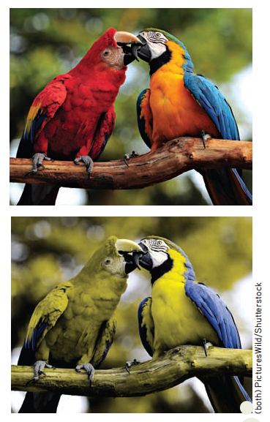
The Most Common Form of Color Blindness
To someone with the most common form of red–green color blindness, these two photographs look almost exactly the same.
People with this type of color blindness have normal blue sensitive cones, but their other cones are sensitive to either red or green.
Notes:
Because of the way red–green color blindness is genetically transmitted, it is much more common in men than in women. About 8 percent of the male population is born with red–green color deficiency, and
about a quarter of these males experience only the colors coded by the blue–yellow cones. People who are completely color blind and see the world only in shades of black, white, and gray are extremely rare
(Shevell & Kingdom, 2008).

Slide 20
How We See Color
Opponent-process theory
Color vision is the product of opposing pairs of color receptors.
This generates three systems: red–green, blue–yellow, and black–white.
When one member of a color pair is stimulated, the other member is inhibited.
This explains afterimages and color blindness.
Stare at the white dot in the center of this oddly colored flag for about 30 seconds, and then look at a white wall or white sheet of paper. What do you see?

Slide 22
Integrated Explanation of Color Vision
Current research has shown that both the trichromatic theory and the opponent process theory of color vision are accurate.
Can you explain why?
Notes:
Each theory correctly describes color vision at a different level of visual processing.

Slide 23
Characteristics of Sound
Loudness: The intensity (or amplitude) of a sound wave, measured in decibels.
Amplitude: The intensity (or amplitude) of a sound wave, measured in decibels.
Decibel: The intensity (or amplitude) of a sound wave, measured in decibels.
Frequency: The rate of vibration, or the number of sound waves per second – measured in Hertz (Hz)
Pitch: Relative highness or lowness of a sound, determined by the frequency of a sound wave.
Timbre: Distinctive quality of a sound, determined by the complexity of the sound wave.

Slide 24
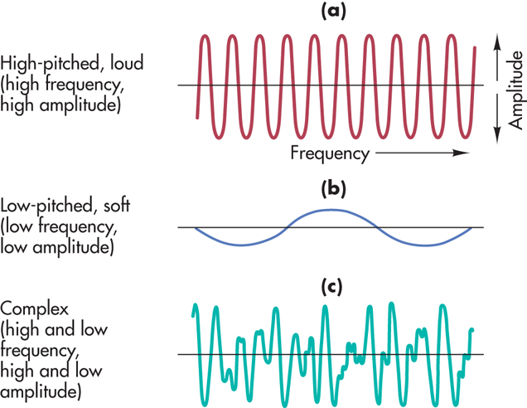
Hearing THE NATURE OF SOUND
From Vibration to Sound
Sound waves are produced by the rhythmic vibration of air molecules
Auditory perception occurs when sound waves interact with the structures of the ear
Notes:
Characteristics of Sound Waves
The length of a wave, its height, and its complexity determine the loudness, pitch, and timbre that we hear. The sound produced by (a) would be high-pitched and loud. The sound produced by (b) would be soft and low. The sound in (c) is complex, like the sounds we usually experience in the natural world.

Slide 25
How We Hear The Path of Sound
Sound waves are collected in the outer ear, amplified in the middle ear, and transduced, or transformed into neural messages, in the inner ear.
Outer ear
Pinna
Ear canal
Eardrum
Middle ear
Hammer
Anvil
Stirrup
Inner ear
Cochlea
Basilar membrane
Hair cells

Slide 26
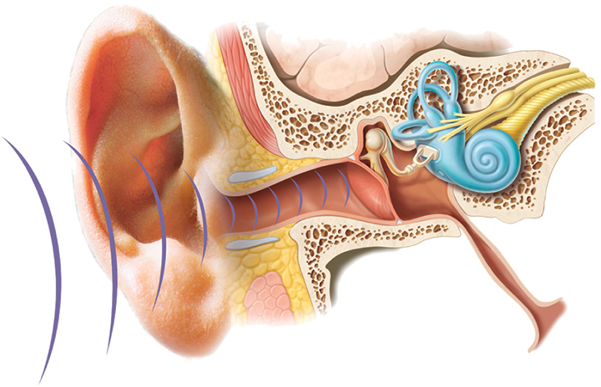
How We Hear The Path of Sound
Outer Ear: Collects sound waves; consists of pinna, ear canal, and eardrum (tympanic membrane)
Middle Ear: Amplifies sound waves; consists of three small bones (ossicles): hammer, anvil, and stirrup
Inner Ear: Where sound is transduced into neural impulses; consists of cochlea and semicircular canals
Notes:
The path that sound waves take through the major structures of the human ear is shown. After being caught by the outer ear, sound waves are funneled down the ear canal to the eardrum, which transfers the vibrations to the structures of the middle ear. In the middle ear, the vibrations are amplified and transferred in turn to the oval window and on to the fluid-filled cochlea in the inner ear

Slide 27
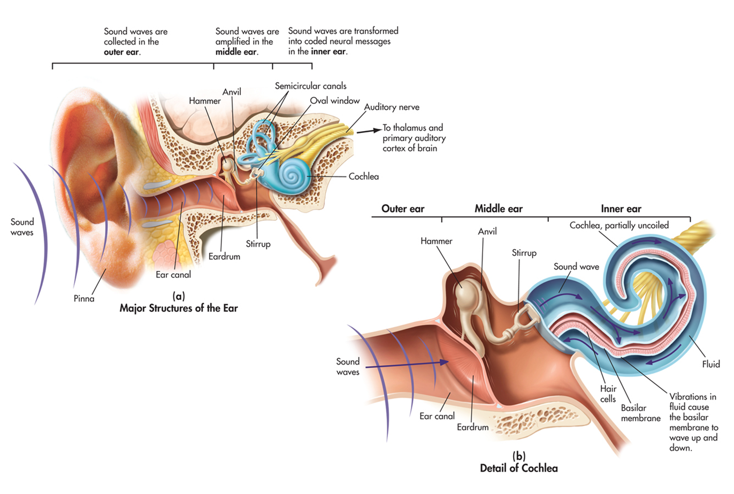

Slide 28
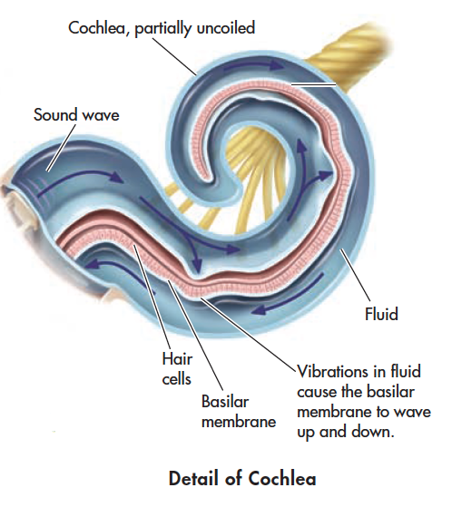
Path of Sound Through the Human Ear
Notes:
As the fluid in the cochlea vibrates, the basilar membrane ripples, bending the hair cells, which appear as rows of yellow tips in the top right section of the color-enhanced scanning electromicrograph (c). The bending of the hair cells stimulates the auditory nerve, which ultimately transmits the neural messages to the auditory cortex in the brain.

Slide 29
Decibel Levels of Some Common Sounds
Decibels | Examples | Exposure Danger
180 | Rocket launching pad | Hearing loss inevitable
140 | Shotgun blast, jet plane | Any exposure is dangerous
120 | Speakers at rock concert, sandblasting, thunderclap | Immediate danger
100 | Chain saw, pneumatic drill | 2 hours
90 | Truck traffic, noisy home appliances, lawn mower | Less than 8 hours
80 | Subway, heavy city traffic, alarm clock at 2 feet | More than 8 hours
70 | Busy traffic, noisy restaurant | Critical level begins with constant exposure
60 | Air conditioner at 20 feet, conversation, sewing machine
50 | Light traffic at a distance, refrigerator
40 | Quiet office, living room
30 | Quiet library, soft whisper
0 | Lowest sound audible to human ear
Notes:
Noise exposure, not age, is the leading cause of hearing loss. Many adolescents and young adults are unaware of the potential for permanent hearing loss due to exposure to loud noise. Damage to the delicate hair cells of the inner ear is cumulative. One survey found that 12–15% of schoolage children have some hearing deficits due to noise exposure (Harrison, 2012). While rock concerts have long been known for excessively loud music, people are also exposed to unhealthy levels of noise in restaurants, athletic stadiums, and in spin and other exercise classes. iPods and other personal music players can also expose the
listener to dangerously high levels of noise (Breinbauer & others, 2012). As a general rule, if other people can hear what you are listening to, the sound is turned up too high.

Slide 30
How We Hear
Two complementary theories describe the role of the basilar membrane in the transmission of differently pitched sounds.
Humans can hear 20 to 20,000 Hz
Frequency theory: Basilar membrane vibrates at the same frequency as the sound wave; discrimination of lower pitched sounds
ie. 100 hertz = 100 times per second
Hair cells always fire in volleys (Volley principle)
Place theory: Different frequencies cause larger vibrations at different locations along the basilar membrane; discrimination of higher pitched sounds
Both theories are involved for intermediate frequencies of midrange pitches
Notes:
A sound wave of about 100 hertz would excite each hair cell along the basilar membrane to vibrate 100 times per second, and neural impulses would be sent to the brain at the same rate. However, there’s a limit to how fast neurons can fi re. Individual neurons cannot fi re faster than about 1,000 times per second.

Slide 31
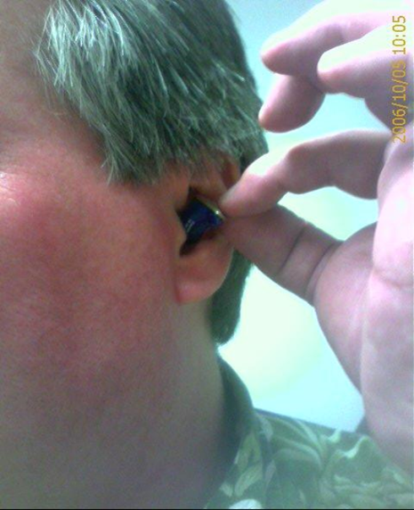
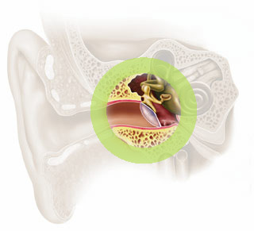
D. Hearing Disorders
Hammer, Anvil and Stirrup
Conductive deafness
Surgery
Hearing Aids
Injury, brittleness etc.

Slide 32
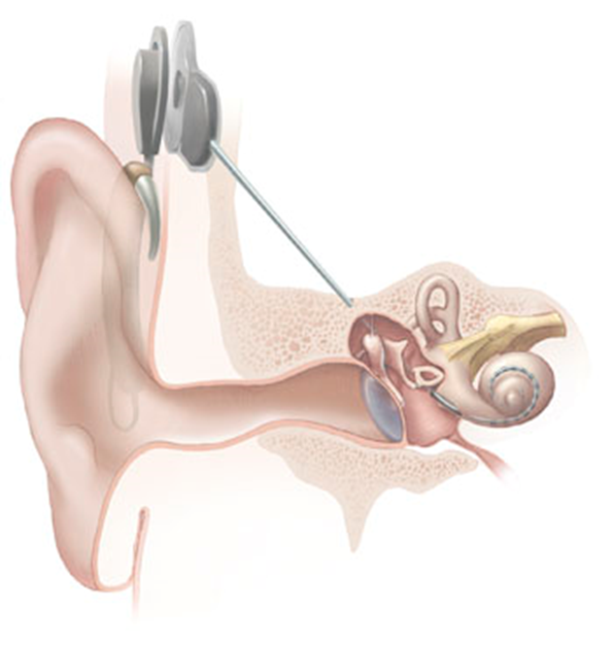
D. Hearing Disorders
Cochlea: Cochlear Implants
For damage to the cochlea or nerve deafness
Does not amplify sound
Stimulates auditory nerves with electrical impulses
Does not transmit all sounds
Controversial

Slide 33
D. Hearing Disorders
Auditory Nerve
Not much that can be done (nerve deafness)
Causes:
Loud noises (too loud and over an extended period of time)
Earphones, concerts, machinery
TURN DOWN YOUR MUSIC

Slide 34
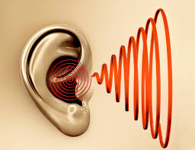
D. Hearing Disorders
Tinnitus
Persistent ringing in the ears
Causes: Loud noises, damage to Organ of Corti

Slide 35
The Chemical and Body Senses
Olfaction (Sense of smell)
Gustation (Sense of taste)
Touch and temperature
Pain
Kinesthetic (Location of body)
Vestibular (Balance)
Ken Seet/age fotostock
Notes:
Sensory receptors for taste and smell are specialized to respond to different types of chemical substances.
pheromones Chemical signals released by an animal that communicate information and affect the behavior of other animals of the same species.

Slide 36
IN FOCUS Do Pheromones Influence Human Behavior? p. 103
Pheromones: Chemical signals that provide information to members of the same species
For many animals, pheromones mark territories, serve as warning signals to other members of the same species, and regulate sexual attraction and reproductive behavior.
What about humans?
McClintock and colleagues identified human chemosignals in chemicals found in steroid compounds located in sweat & blood, etc.
There is also evidence that human chemosignals are involved in communication emotional states, including stress, anxiety, and fear.
Notes:
Pheromones: Chemical signals that provide information about social and sexual status to other members of the same species

Slide 37
How We Smell (Olfaction)
Olfactory nerves directly connect to the olfactory bulb in the brain, which is actually the enlarged ending of the olfactory cortex at the front of the brain.
Axons from the olfactory bulb form the olfactory tract.
These neural pathways project to different brain areas, including the temporal lobe and structures in the limbic system.
The projections to the temporal lobe are part of the neural pathway involved in conscious recognition of smells; projections to limbic system are thought to regulate emotional response to odors.
Olfactory function declines with age and some diseases.
Notes:
Hundreds of different odor receptors identified
Different combinations of olfactory receptors produce sensation of distinct odors
Brain identifies odor by interpreting pattern of stimulated olfactory receptors
How are olfactory receptor cells unique?
Direct connection to cortex and limbic system, bypassing thalamus processing
Only direct link to brain and outside world

Slide 38
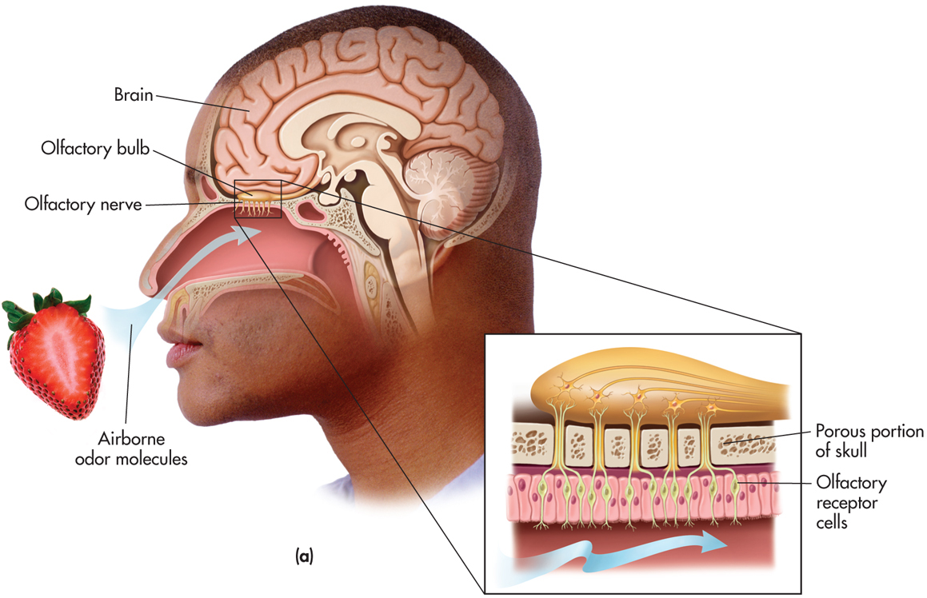
The Olfactory System
Airborne molecules→Inhaled through nose or mouth →travel to the top of nasal cavity and stimulate
olfactory receptors →communicated to neural messages to olfactory bulb located in olfactory cortex of
the brain

Slide 39
Loss of Olfactory Function
Anosmia: loss of ability to detect odor
65 to 80 year olds: about 50%
Due to air pollution, smoking
Can also be due to Parkinson’s, schizophrenia, multiple sclerosis, Alzheimer’s
(Dogs: 200 million olfactory receptors, Humans: 12 million)

Slide 40
Sense of Taste or Gustation
Tongue covered with little bumps and grooves lined with taste buds.
Each taste bud contains 50 receptors for 5 basic tastes.
These tastes aid us in seeking nutrient-rich food and avoiding hazardous substances.
Sweet
Sour
Salty
Bitter
Umami – monosodium glutamate

Slide 41
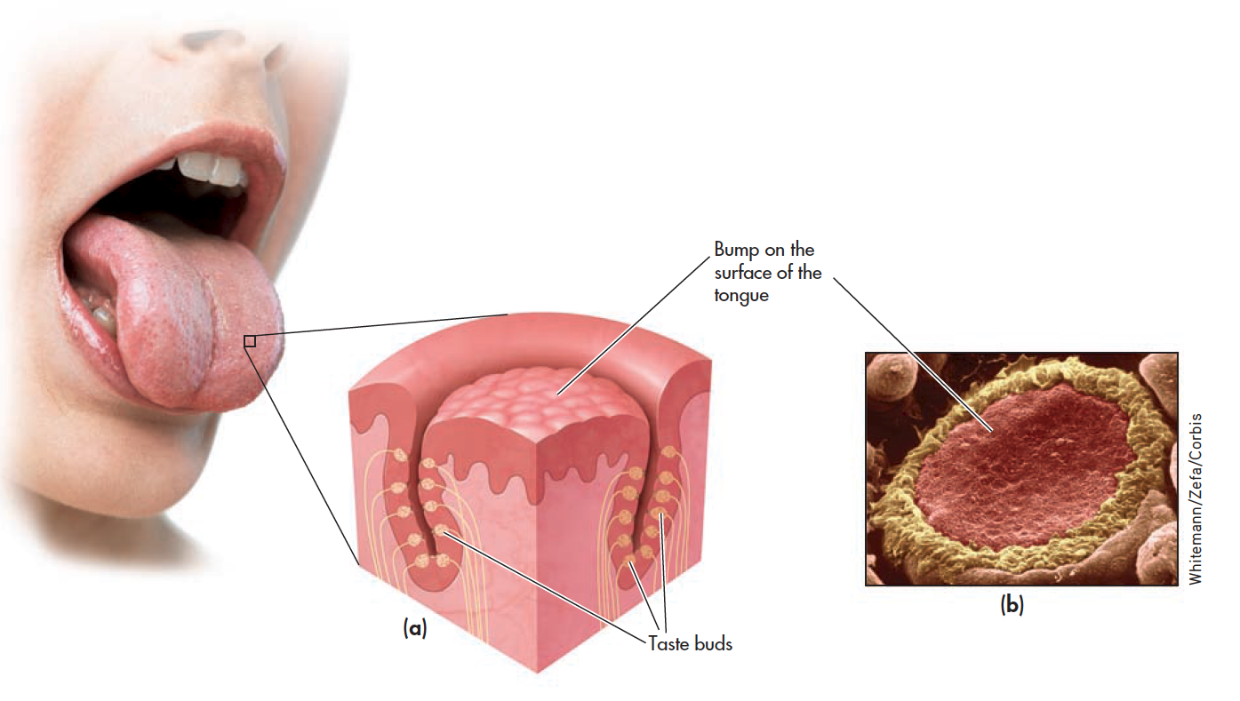
Sense of Taste or Gustation
Notes:
Taste is just one aspect of flavor, which involves several sensations, including the aroma, temperature, texture, and appearance of food.
Embedded in the surface of the tongue are thousands of taste buds, the sensory receptor organs for taste. Taste buds are located in the grooves of the bumps on the surface of the tongue. Each taste bud contains an average of 50 taste receptor cells. When activated, the taste receptor cells send messages to adjoining sensory neurons, which relay the information to the brain. Taste buds, like the olfactory neurons, are constantly being replaced. The life expectancy of a particular taste bud is only about 10 days. (b) The photograph shows the surface of the tongue magnified hundreds of times.

Slide 42
Skin and Body Senses
Skin is largest and heaviest sense organ that contains many kinds of sensory receptors
20 square feet/6 pounds
Some specialized receptors respond to one stimulus, others responds to more than one.
Sensory receptors distributed unevenly among different body areas
Pacinian corpuscle located beneath skin and sends neural message to brain when stimulated; sensory adaptation occurs when pressure is constant.

Slide 43
Skin and Body Senses
Skin: Temperature (warm & cold), Pressure, Pain

Slide 44
The Skin and Body Senses
Pain
Defined as unpleasant sensory and emotional experience associated with actual or potential tissue damage
Nociceptors (free nerve endings)
Are small sensory fibers in skin, muscles, and internal organs
Pain systems
Fast pain receptors: A-delta fibers
Thalamus to Somatosensory cortex of brain
Slow pain receptors: C fibers and substance P
Limbic system (Hypothalamus, Thalamus, Amygdala)

Slide 45
Gate-Control Theory of Pain
According to the gate-control theory of pain, pain experience is interpreted by the brain which sends signals down the spinal cord
Open pain gateways = pain experienced or intensified
Closed pain gateways = pain reduced
Through sensitization, pain pathways become more responsive. (Pain is increased.)
Notes:
Gate-control theory of pain The theory that pain is a product of both physiological and psychological factors that cause spinal gates to open and relay patterns of intense stimulation to the brain, which perceives
them as pain.

Slide 46
Factors That Influence Pain “Gates”
Considerable variation in pain experience occurs as sensory pain signals is integrated with psychological and situational information.
Intensifying pain experience
Anxiety, fear, sense of helplessness
Depression and sadness
Negative mood
Social and situational factors
Reducing pain experience
Sense of control
Positive mood
Endorphins and enkephalins
Social and situational factors

Slide 47
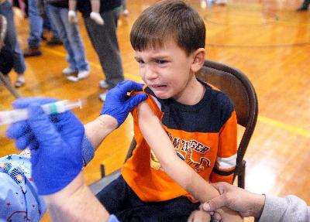
Individual Differences in Pain Perception and Tolerance
People respond to pain very differently.
Phantom limb pain: Pain in a limb that has been amputated
Endorphins & Enkephalins: Chemicals that serve as the body’s natural pain killers
Expectations can have an effect on pain as well
(beliefs, social expectations, etc.)
Notes:
Such differences appear to reflect cultural beliefs about the meaning of pain, social expectations about how people express their experience of pain, and actual physiological differences among ethnic groups

Slide 48
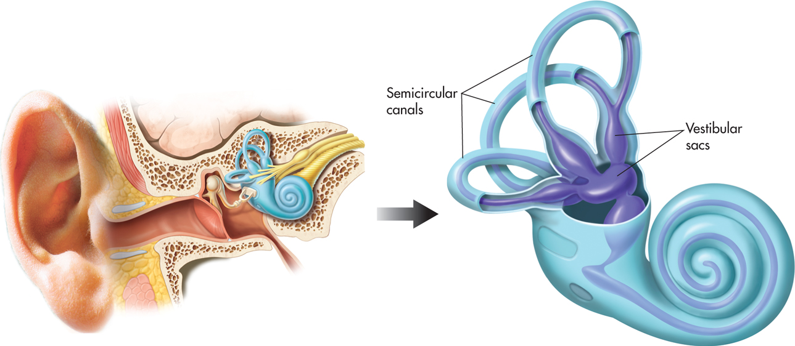
Movement, Position, and Balance
Kinesthetic Sense: Technical name for the sense of location and position of body parts in relation to one another
Proprioceptors: sensory receptors, located in the muscles and joints, that provide information about body position and movement
Vestibular Sense: Sense of balance, or equilibrium, by responding to changes in gravity, motion, and body position.
Sources of vestibular sensory information – semicircular canals and vestibular sacs, located in ear
Notes:
See Table 3.4 for Summary Table of the Senses

Slide 49
Extrasensory Perception
Telepathy: Direct communication between the minds of two individuals
Clairvoyance: The sensing of a remote object or event
Psychokinesis: The ability to influence a physical object without touching it
Precognition: The ability to predict future events

Slide 50
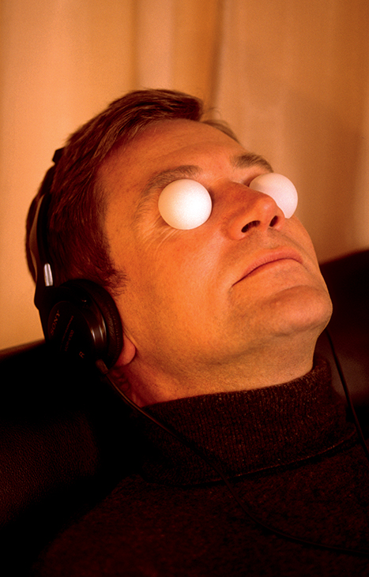
ESP: Can Perception Occur Without Sensation?
ESP, or extrasensory perception: detection of information by some means other than through the normal processes of sensation.
Parapsychology: scientific investigation of claims of various paranormal phenomena. Contrary to what many people think, very few psychologists conduct any kind of parapsychological research
Ongoing controversy: Majority of scientifically oriented psychologist are very skeptical of reports of ESP
Fortean/TopFoto/The Image Works
Ganzfeld Technique

Slide 51
Perception
Process of integrating, organizing, and interpreting sensory information into meaningful representations.
Two Major Processes in Perceptual Processing
Bottom-up processing: Emphasizes the importance of sensory receptors in detecting the basic features of a stimulus; moves from part to whole; also called data-driven processing
Top-down processing: Emphasizes importance of observer’s cognitive processes in arriving at meaningful perceptions; moves from whole to part; also called conceptually driven processing
The use of either can be influenced by cultural differences or nuances, such as found in collectivist vs. individualistic societies

Slide 52
Perception of Shape WHAT IS IT?
How are perceptions organized so that an object is seen as separate from other objects?
Gestalt psychologists identified important perceptual principles.
Gestalt psychology
Founded by German psychologist Max Wertheimer in the early 1900s (Wertheimer, 1923).
Emphasized that we perceive whole objects or figures (gestalts) rather than isolated bits and pieces of sensory information.
Figure–Ground Relationship
The separation of a scene into figure and ground is not a property of the actual elements of the scene at which you’re looking. Rather, your ability to separate a scene into figure and ground is a psychological accomplishment
Demonstrated in Figure-Ground Reversal

Slide 53
Figure-Ground: Face-Vase Illusion

Slide 54
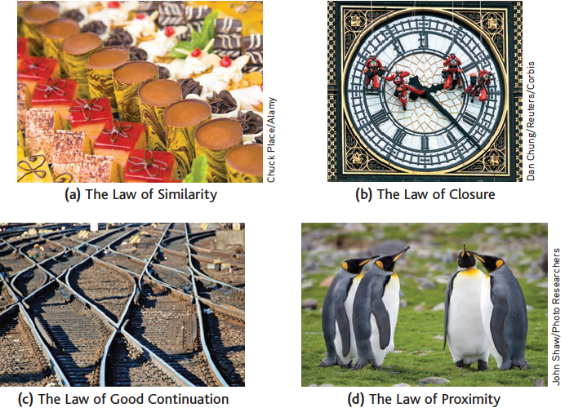
Perception of Shape WHAT IS IT?
Gestalt principles of organization
Notes:
(a) The law of similarity is the tendency to perceive objects of a similar size, shape, or color as a unit or figure. Thus, you perceive organized rows of chocolates and truffles rather than a mixed array.
(b) The law of closure is the tendency to fill in the gaps in an incomplete image. Thus, you perceive the curved lines on the clock as smooth, continuous circles, even though they are interrupted by
workers and the clock’s hands.
(c) The law of good continuation is the tendency to group elements that appear to follow in the same direction as a single unit or figure. Thus, you tend to see the curved sections of rails as continuous
units, and the straight sections as other continuous units.
(d) The law of proximity is the tendency to perceive objects that are close to one another as a single unit. Thus, you perceive these four penguins
as two sets of penguin couples rather than as a single group of four penguins.

Slide 55
Gestalt Grouping Principles
General principle of law of Prägnanz, or the law of simplicity:
When several perceptual organizations of an assortment of visual elements are possible, the perceptual interpretation that occurs will be the one that produces the “best, simplest, and most stable shape”

Slide 56
Depth Perception
Monocular cues
Overlap
Aerial perspective
Relative size
Linear perspective
Aerial perspective
Motion parallax
Texture gradient
Monocular cues
Monocular cues
Motion parallax
Accommodation
Notes:
Texture Gradient, Overlap, and Aerial Perspective Monocular cues are used to gauge distance of objects in a photograph.
The rows of tulips appear crisp in the foreground but become increasingly fuzzy in the background, an example of texture gradient. Similarly, the rows of tulips at the top of the image are just blurs of color, creating an impression of even greater distance through aerial perspective. And, the yellow tulips are perceived as being closer than the gravel pathway and green stems that they overlap.
Relative Size, Linear Perspective, and Aerial Perspective Several monocular depth cues are operating in this photograph. Relative size is particularly influential: The very small image of the jogger and the decreasing size of the street lamps contribute to the perception of distance. Linear perspective is evident in the apparent convergence of the walkway railings. Aerial perspective contributes to the perception of depth from the hazy background.
Motion Parallax This photograph of waiters in India passing a tray from one train car to the next captures the visual flavor of motion parallax. Objects that whiz by faster are perceptually judged as being closer, as in the case here of the blurred ground and bushes. Objects that pass by more slowly are judged as being farther away, as conveyed by the clearer details of buildings and more distant objects.

Slide 57
Binocular Cues
Binocular (Retinal) disparity
Because our eyes are set a few inches apart, a slightly different image of an object is cast on the retina of each eye.
These distances are interpreted as depth.
3D movies present you with slightly different images in each eye and when fused give you a powerful sense of depth.
A stereogram is a picture that uses the principle of binocular disparity to create perception of a 3D image.
An early problem with vision can cause this ability not to develop correctly if the eyes don’t work together.
Convergence: Degree to which muscles rotate your eyes to focus on an object
Notes:
Convergence: Degree to which muscles rotate your eyes to focus on an object

Slide 58
The Perception of Motion WHERE IS IT GOING?
How do we perceive motion?
When retinal image of an object enlarges, we perceive object as moving toward us.
Perception of the speed of the object’s approach is based on our estimate of the object’s rate of enlargement
Some neurons are specialized to detect motion in one direction but not in opposite direction.
Other neurons are specialized to detect motion at one particular speed.

Slide 59
Stroboscopic motion
First studied by Gestalt psychologist Max Wertheimer in the early 1900s, stroboscopic motion creates an illusion of movement with two carefully timed flashing lights
If the time interval and distance between the two flashing lights are just right, a very compelling illusion of movement is created.
Basis of movies, TV and computer displays
Induced motion
Duncker (1929) had subjects sit in a darkened room and look at a luminous dot that was surrounded by a larger luminous rectangular frame. When the frame slowly moved to the right, the subjects perceived the dot as moving to the left.
Was first studied by Gestalt psychologist Karl Duncker in the 1920s

Slide 60
Perceptual Constancies
Tendency to perceive objects, especially familiar objects, as constant and unchanging despite changes in sensory input is called perceptual constancy.
Size constancy is the perception that an object remains the same size despite its changing image on the retina.
Shape constancy is the tendency to perceive familiar objects as having shape regardless of image cast on the retinas.
How many right angles do you see?
Notes:
Perceptual constancy: tendency to perceive objects, especially familiar objects, as constant and unchanging despite changes in sensory input
Most people find 12 right angles in this drawing of a slightly tilted cube. But look again. There are no right angles in the drawing.
Shape constancy leads you to perceive an image of a cube with right angles, despite the lack of sensory data to support that perception.

Slide 61
Perceptual Illusions
Are misperception of true characteristics of an object or an image
Underscore the idea that perceptual representations are active construction of the world according to psychological principles.
The Escher’s Waterfall
Based on visual riddles that capitalize on tendency to organize visual elements into a meaningful scene
Impossible Figure
The Moon Illusion
Based in part on the fact that people perceive objects on the horizon as farther away than objects that are directly overhead in the sky, leading to misjudging size

Slide 62
Escher’s Waterfall

Slide 63
The Müller-Lyer Illusion Based on interpreting the angles of lines as depth cues. The inward arrows mean the line is close and thus smaller for is retinal image

Slide 64
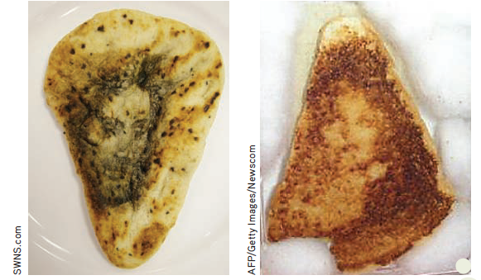
Effects of Experience on Perceptual Interpretations
There is a tendency to perceive objects or situations from a particular frame of reference (perceptual set).
Perceptual sets usually lead to accurate conclusions.
Human tendency to see faces in ambiguous stimuli may contribute to false positives.
Neural tendencies
The $28,000 Grilled Cheese Sandwich
What do you see?
Notes:
Educational, cultural, and life experiences shape perceptions.
Is that Jesus’s face on a piece of Indian nan (left)? Or Marlene Dietrich on that grilled cheese sandwich (right)? Ten years after she first noticed what she thought was the face of the Virgin Mary on her grilled cheese sandwich,
Diana Duyser auctioned it off on eBay. The winning bid? Duyser got $28,000 for her carefully preserved (and partially eaten) relic. Why are we so quick to perceive human faces in ambiguous stimuli?

Slide 65
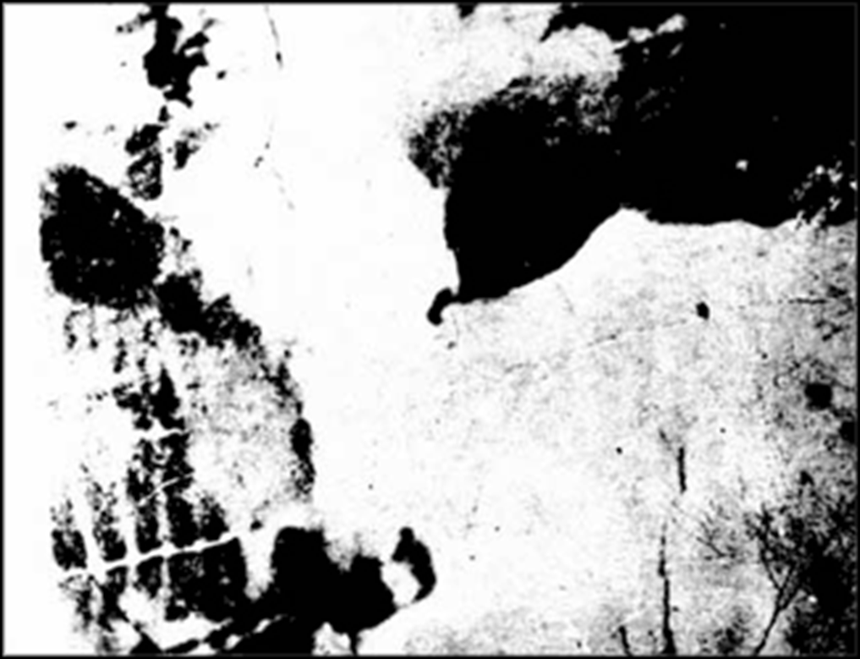
Ambiguous Stimuli

Slide 66
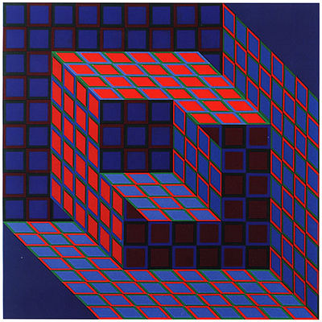
Reversible Figure

Slide 67
Reversible Figure

Slide 68
Perception of Motion: Induced Motion

Slide 70
Perception of Motion: Stroboscopic Motion http://emvergeoning.com/wp-content/uploads/2009/01/lilac-chaser1.gif

Slide 71
CULTURE AND HUMAN BEHAVIOR Culture and the Müller-Lyer Illusion
Carpentered-world hypothesis
People in industrialized societies are far more susceptible to the Müller-Lyer illusion than are people in some nonindustrialized societies
May be due to the carpentered-world hypothesis (Seagall) that posits that people living in urban, industrialized environments have a great deal of perceptual experience in judging lines, corners, edges, and other rectangular, objects
A Noncarpentered Environment
People who live in a noncarpentered environment, like the village shown above, have little experience with right angles and perfectly straight lines (Phillips, 2011). Are people who grow up in a noncarpentered environment equally susceptible to the Müller-Lyer illusion?
Notes:
People who live in urban, industrialized environments have a great deal of perceptual experience with straight lines, edges, and right angles.

Slide 72
Strategies to Control Pain
In addition to hypnosis, painkilling drugs, biofeedback, and acupuncture, there are several simple techniques for coping with minor pain.
Distraction
Imagery
Relaxation and meditation
Positive self-talk and reappraisal

