Slide 2
Biological psychology: the specialized branch of psychology that studies the relationship between behavior and bodily processes and systems; also called biopsychology or psychobiology.
Neuroscience: the scientific study of the nervous system

Slide 3
Introduction: Neuroscience and Behavior
Sample questions studied by neurosciences
How do you tell the difference between red and blue, sweet and sour, loud and soft?
What happens in the brain when you sleep, dream, or meditate?
What exactly is a memory, and how are memories stored in the brain?
Why do you get hungry? How do emotions occur?
How do emotions and personality factors affect your vulnerability to infection and disease?
How does heredity influence your development? What role does genetics play in personality traits and psychological disorders?
What role does abnormal brain chemistry play in psychological disorders? How do medications alleviate the symptoms of serious psychological disorders?

Slide 4
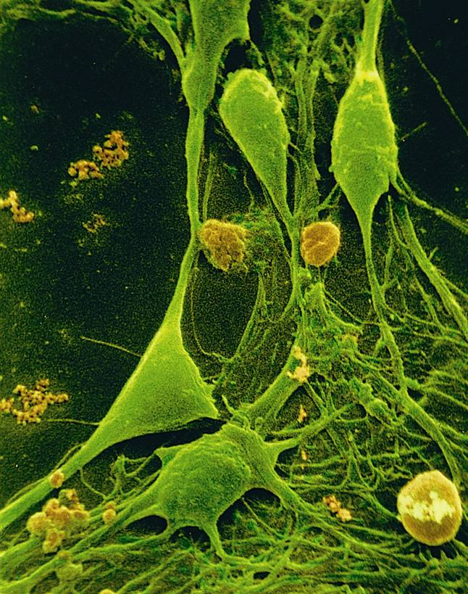
The Neuron: Basic Unit of Communication
Smallest unit of the nervous system
Specialized to transmit and receive information from one part of the body to another
100 billion neurons (nerve cells) in the human brain

Slide 5
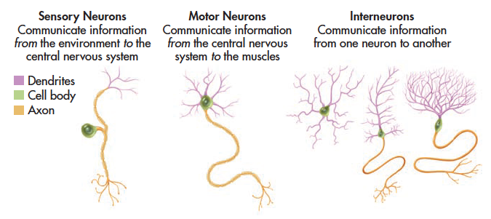
Types of Neurons
Neurons differ in size, shape, and complexity. The distinctive shapes of neurons reflect their specialized functions.
Shown here are a few representative neuron types. Virtually all neurons have three basic parts: a cell body, an axon, and dendrites. In most neurons, the dendrites project from the cell body, but in sensory neurons, the dendrites extend from the opposite end of the axon, as shown above.

Slide 6
Sensory Neurons: Afferent (input)
Motor Neurons: Efferent (output)
SAME

Slide 7
Mirror Neurons
Mirror neurons
Are not structurally different from other motor neurons
Become activated both when individuals perform a motor act and when they observe the same motor act done by another individual

Slide 8
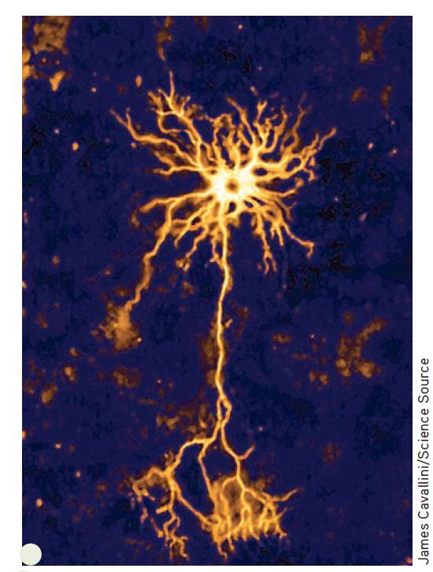
A Characteristics of the Neuron
Most neurons have three basic components
Cell body (soma): nucleus, chromosomes
Dendrites (Receives)
Axon (Sends)
The Parts of a Typical
The photograph above, made with a specialized microscope, clearly shows multiple dendrites and a single long axon projecting from the cell body.
Notes:
Neuron: A highly specialized cell that communicates information in electrical and chemical form; a nerve cell.
Sensory neuron: The type of neuron that conveys information to the brain from specialized receptor cells in sense organs and internal organs.
Motor neuron: The type of neuron that signals muscles to relax or contract.
Interneuron: The type of neuron that communicates information from one neuron to the next.
Cell body: The part of a cell that processes nutrients and provides energy for the neuron to function; contains the cell’s
Nucleus; also called the soma.
Dendrites: The multiple short fibers that extend from a neuron’s cell body and receive information from other neurons or from sensory receptor cells.
Axon: The long, fluid-filled tube that carries a neuron’s messages to other body areas.

Slide 9
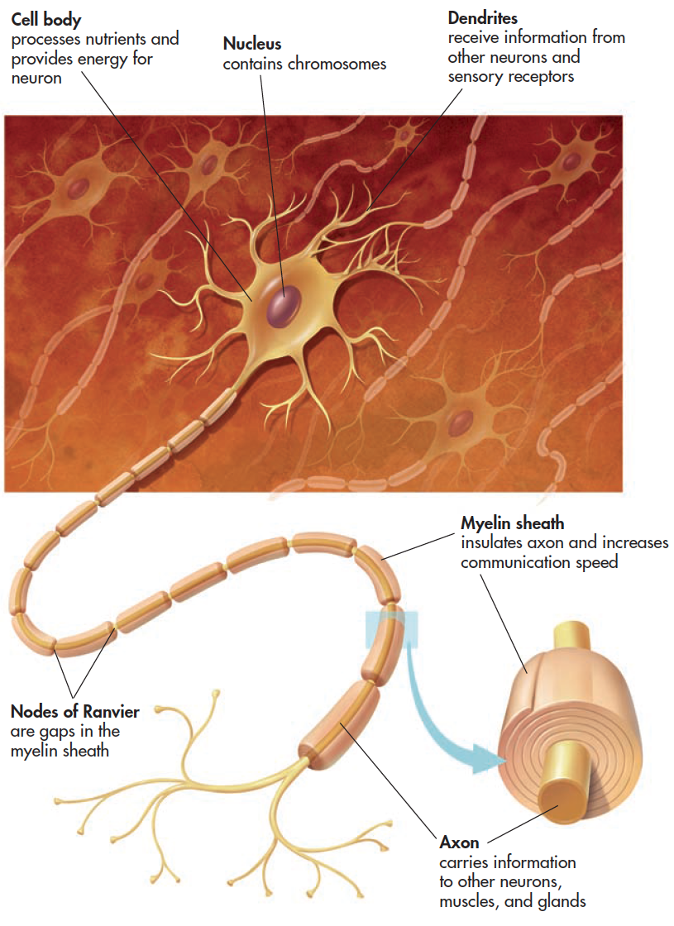
A Typical Neuron

Slide 10
Myelin Sheath
White fatty casing on axon
Acts as an electrical insulator
Not present on all cells
When present, increases the speed of neural signals down the axon
Multiple Sclerosis (MS) is a disease that involves the degeneration of patches of the myelin sheath

Slide 11
Part 1:Communication within the Neuron
Neurons communicate by means of an electrical signal called the action potential (within the neuron)
Action potentials are based on the movements of ions between the outside and inside of the cell
When an action potential occurs, a molecular message is sent to neighboring neurons

Slide 12
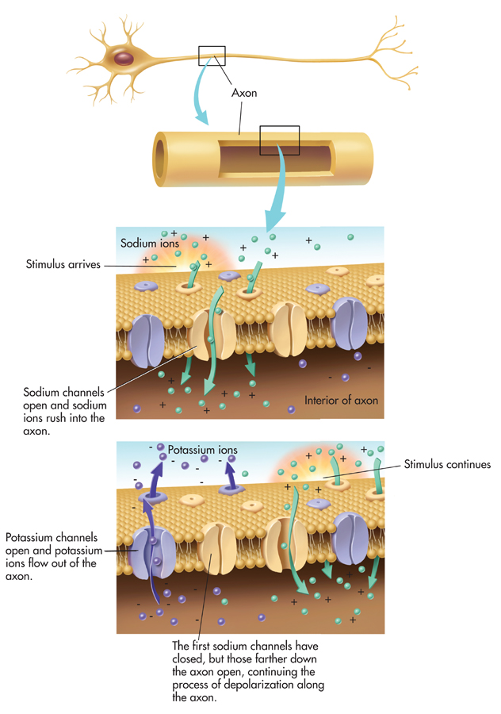
1. Resting Potential Within a Neuron
Ions: Electrically
charged particles
move across cell
membrane
While waiting for
stimulus from another
Cell: polarized
Positive Ions on
outside of cell
membrane
Sodium (Na) +
and
Potassium (K) --
+
---

Slide 13
2. Action Potential Within a Neuron
Brief electrical
Impulse by which
Information is
Transmitted along
The axon of a neuron
When sufficiently
stimulated
by another
cells: depolarized
positive ions inside
of the cell
Sodium (Na) +
and
Potassium (K) --
---
+

Slide 14
Communication Within the Neuron THE ACTION POTENTIAL
Action potential is produced by movement of electrically charged particles (ions) across the axon membrane.
Some ions are negatively charged; others positively charged.
Resting potential is the state in which a neuron is prepared to activate and communicate its message if it receives sufficient stimulation.
Stimulus threshold is the minimum level of stimulation required to activate a particular neuron.
Notes:
Each neuron requires a minimum level of stimulation from other neurons or sensory receptors to activate it. This minimum level of stimulation is called the neuron’s stimulus threshold. While waiting for sufficient stimulation to activate it, the neuron is said to be polarized. This means that
there is a difference in the electrical charge between the inside and the outside of he axon.
More specifically, there is a greater concentration of negative ions inside the neuron. Thus, the axon’s interior is more negatively charged than is the exterior fluid surrounding the axon. The negative electrical charge is about –70 millivolts (thousandths of a volt). The –70 millivolts is referred to as the neuron’s resting potential.

Slide 15
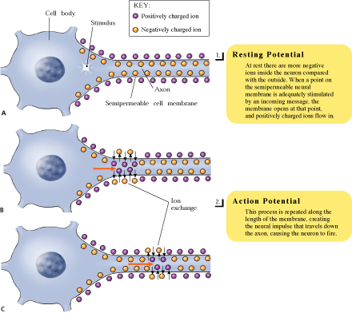

Slide 16
All-or-None Law
A neuron either fires or it does not
When it does fire, it will always produce an impulse of the same strength
Intensity of a stimulus is coded by the frequency of action potentials
“Strong” = fires a lot

Slide 17
3. Refractory Period of a Neuron
Absolute refractory period
Period immediately after an action potential when another action potential cannot occur
(Cannot fire again)
Relative refractory period
Period following absolute refractory period when a neuron will only respond to a stronger than normal impulse
(May or may not fire)

Slide 18
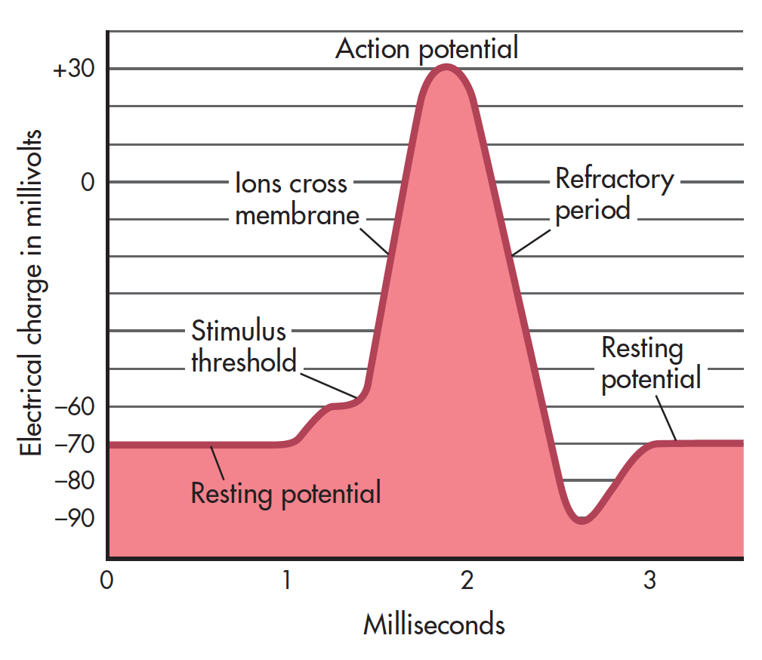
Electrical Changes During an Action Potential
This graph shows the changing electrical charge of the neuron during an action potential.
When the neuron depolarizes and ions cross the axon membrane, the result is a brief positive electrical impulse of +30 millivolts—the action potential.
During the refractory period, the neuron reestablishes the resting potential negative charge of −70 millivolts and then is ready to activate again.
Notes:
Terms to review
Self-sustaining
All-or-none law
Refractory period
Resting potential

Slide 19
Sequence of the firing of a neuron
Resting potential
(neurons are polarized)
Action potential
(neurons are depolarizing)
Refractory period
(neuron hyperpolarizes, repolarizes)
Then back to resting potential

Slide 20
Part 2: Communication Between Neurons
Synapse is communication point between two neurons separated by the synaptic gap.
Presynaptic neuron = sending
Postsynpatic neuron = receiving
Activated presynaptic neuron generates an action potential that travels to axon terminals which contain synaptic vesicles holding neurotransmitters.
Neurotransmitters are reabsorbed and recycled (reuptake) or destroyed by enzymes.

Slide 21
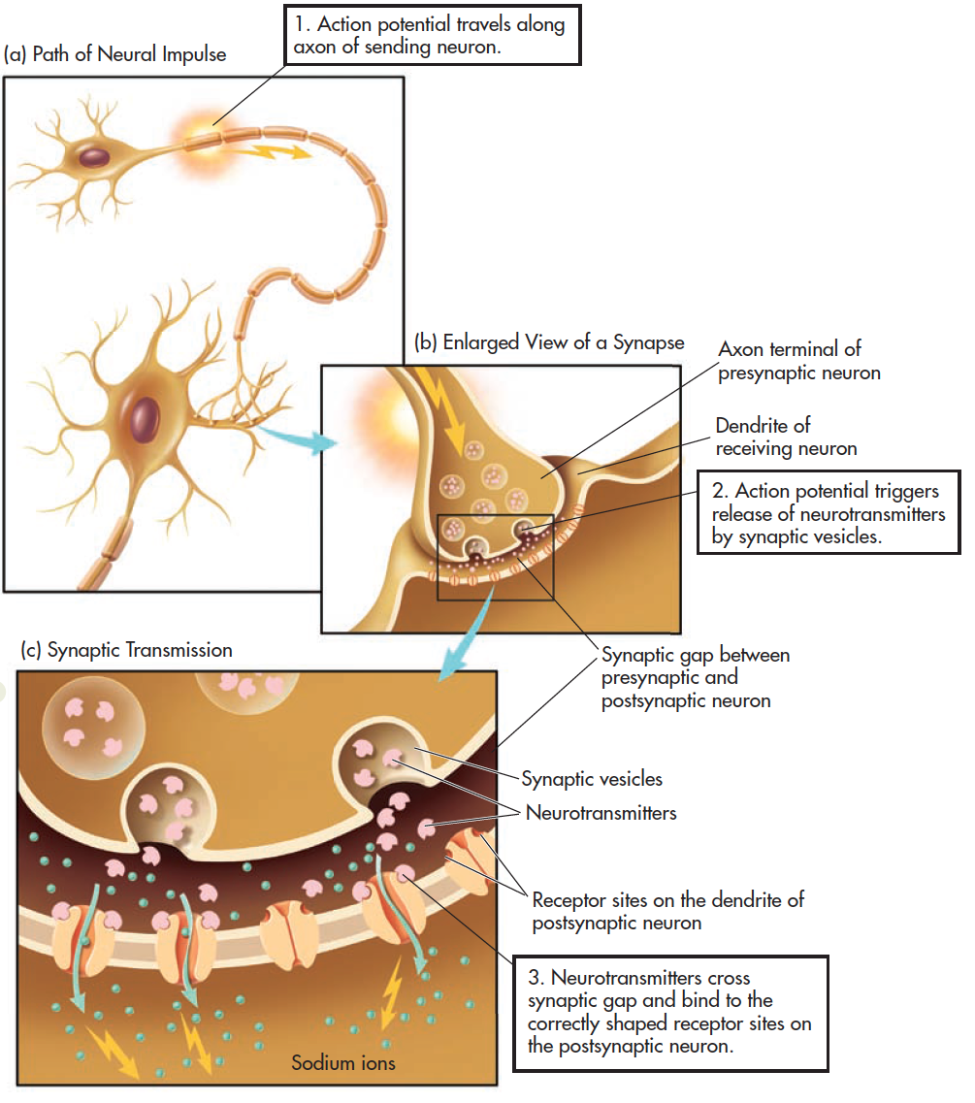
The Process of Synaptic Transmission
Notes:
As you follow the steps in this progressive graphic, you can trace the sequence of synaptic transmission in which neurotransmitters are released by the sending, or presynaptic, neuron,
cross the tiny fluid-filled space called the synaptic gap, and attach to receptor sites on the receiving, or postsynaptic, neuron.

Slide 22
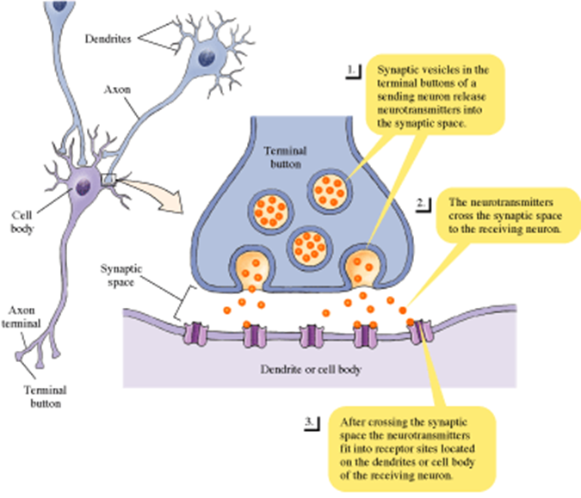
The Synapse

Slide 23
Excitatory and Inhibitory Messages
Excitatory message—increases the likelihood that the postsynaptic neuron will activate
Inhibitory message—decreases the likelihood that the postsynaptic neuron will activate
NT can have an excitatory message to one neuron and an inhibitory message to another

Slide 24
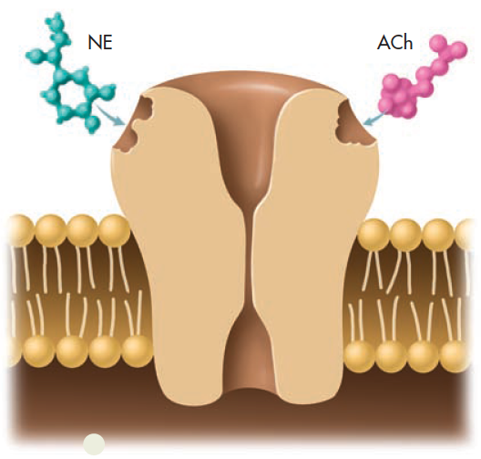
Neurotransmitter and Receptor Site Shapes
Each neurotransmitter has a chemically distinct shape. Like a key in a lock, a neurotransmitter must perfectly fit the receptor site on the receiving neuron for its message to be communicated.
NE: Norepinephrine
Ach: Acetylcholine

Slide 25
Acetylcholine (Ach)
Found in neuromuscular junctions
Involved in muscle movements
Involved in learning and memory

Slide 26
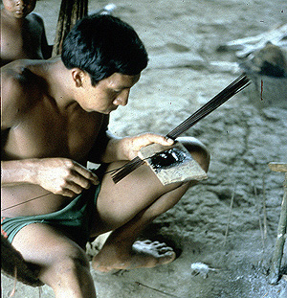
Disruptions of Acetylcholine Functioning
Curare—blocks ACh receptors
paralysis results (lack of ACh)
Nerve gases and black widow spider venom; too much ACh leads to severe muscle spasms and possible death

Slide 27
Alzheimer’s Disease
Deterioration of memory, reasoning, and language skills
Symptoms may be due a to loss of ACh neurons

Slide 28
Dopamine
Involved in movement, attention, and learning
Dopamine imbalance also involved in schizophrenia
Cocaine = dopamine overload
Parkinson’s disease is caused by a loss of dopamine-producing neurons

Slide 29
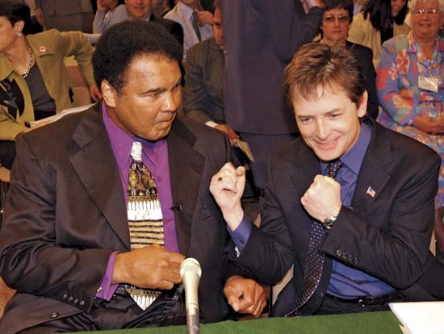
Parkinson’s Disease
Results from loss of dopamine-producing neurons in the substantia nigra
Symptoms include
difficulty starting and stopping voluntary movements
tremors at rest
stooped posture
rigidity
poor balance

Slide 30
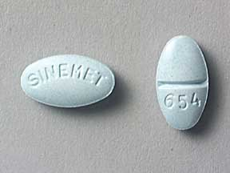
Parkinson’s Disease
Treatments
Levo-dopa
Electrical stimulation of the thalamus has been used to stop tremors

Slide 31
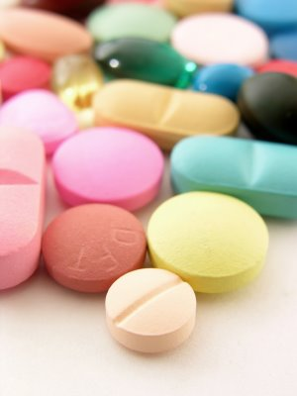
Serotonin
Involved in alertness
Involved in depression
Prozac works by keeping serotonin in the synapse longer, giving it more time to exert an effect
SSRI’s (Selective Serotonin Reuptake Inhibitors)

Slide 32
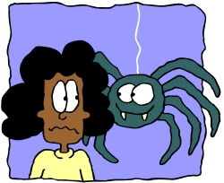
Norepinephrine
Arousal
“Fight or flight” response
Learning
Dysfunction may lead to depression

Slide 33
Glutamate
Bipolar Disorder may be due to an imbalance of glutamate.
Plays a role in cognitive, motor and sensory functions
An excitatory NT

Slide 34
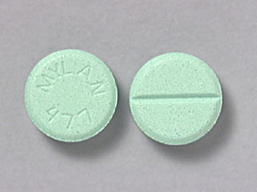
GABA
Inhibition of brain activity, calms
Too much:
Learning, motivation, movement impairment
Too little:
Seizures
Antianxiety meds increase GABA activity:
Valium, Xanax, Diazepam

Slide 35
Endorphins
Control pain and pleasure
Released in response to pain
Morphine and codeine work on endorphin receptors; involved in healing effects of acupuncture
Runner’s high— feeling of pleasure after a long run is due to heavy endorphin release

Slide 36
Summary of Important Neurotransmitters
Neurotransmitter | Primary Roles | Associated Disorder
Acetylcholine | Learning, memory Muscle contractions | Alzheimer’s disease
Dopamine | Movement Thought processes Rewarding sensations | Parkinson’s disease Schizophrenia Drug addiction
Serotonin | Emotional states Sleep Sensory perception | Depression
Norepinephrine | Physical arousal Learning, memory Regulation of sleep | Depression, stress
Glutamate | Excitatory messages | Seizures Alzheimer’s disease
GABA | Inhibitory messages | Anxiety disorders
Endorphins | Pain perception Positive emotions | Opioid addiction

Slide 37
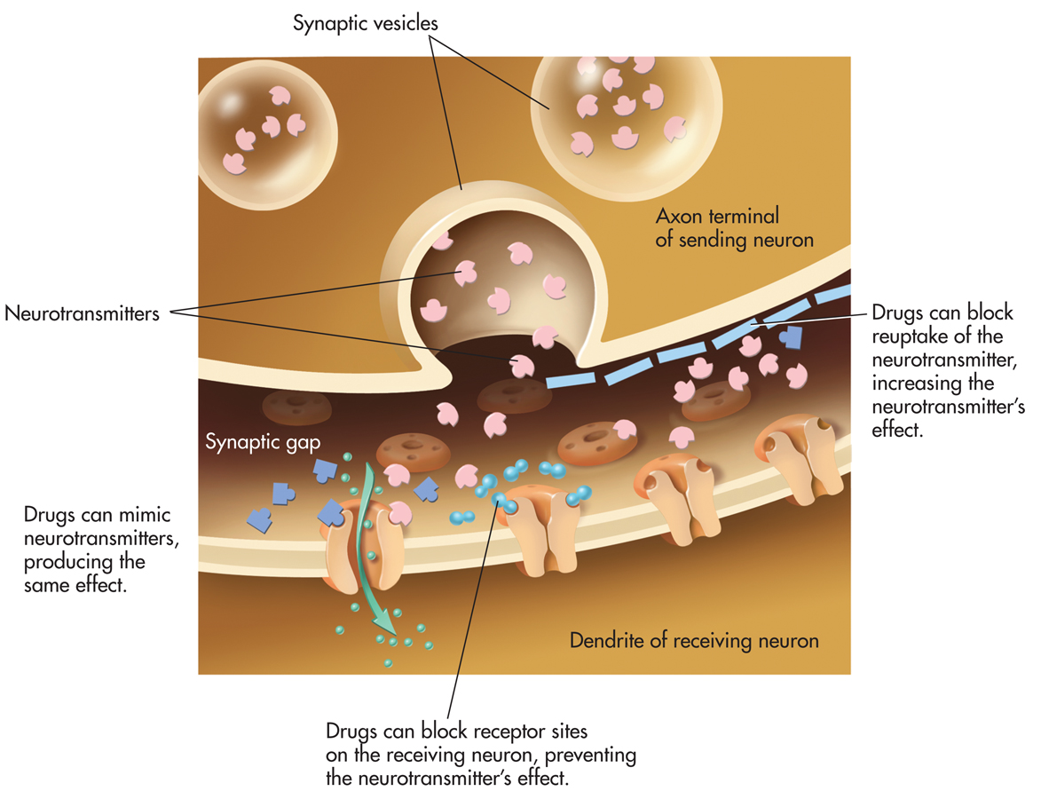
Some Drugs Work on Receptors
Some drugs are shaped like neurotransmitters
Antagonists: poorly fit the receptor and block the NT
eg, beta blockers (inhibits epinephrine)
Agonists: fit receptor well and act like the NT
eg, nicotine (excites dopamine)

Slide 38
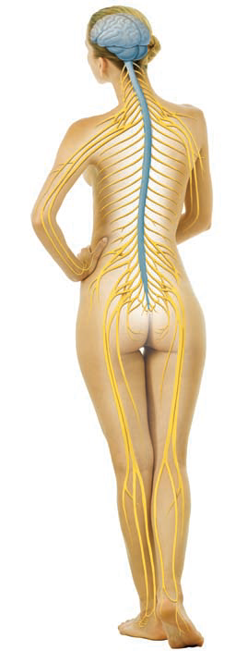
The Nervous System
The nervous system is a complex, organized communication network that is divided into two main divisions: the central nervous system (shown in blue) and the peripheral nervous system (shown in yellow).
Entire NS: 1 Trillion neurons

Slide 39
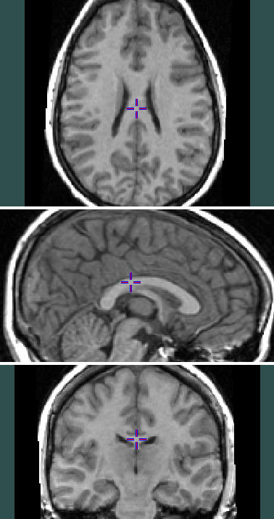
CNS is protected by meninges and cerebrospinal fluid which surrounds the spinal cord and fills ventricles in the brain.
CNS: Brain and Spinal Cord
Ventricles (4 cavities in brain filled with spinal fluid)
Spinal reflexes:
Knee jerk
Processed in spinal cord

Slide 40
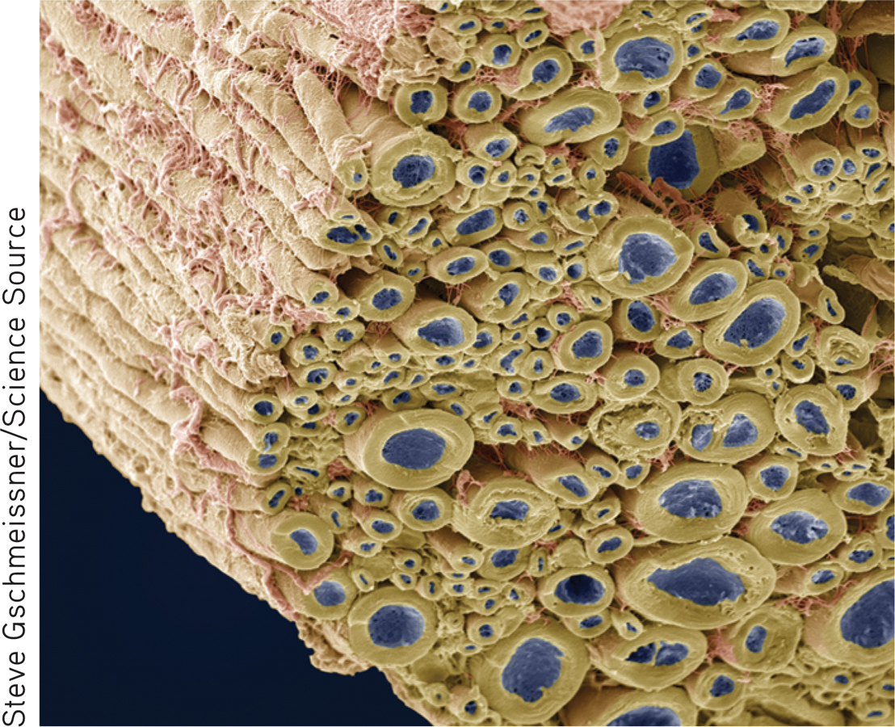
Nerves and Neurons Are Not the Same
Sandra E. Hockenbury, Susan A. Nolan, Don H. Hockenbury: Psychology, Seventh Edition Copyright © 2015 by Worth Publishers

Slide 41
Traumatic Brain Injury: From Concussions to Chronic Traumatic Encephalopathy
A concussion is the most common, and mildest, type of TBI, affecting more than 1 million people every year in the U.S. bomb blasts experienced by people in war zones, auto accidents, falls, and sports injuries.
Repeated concussions can lead to chronic traumatic encephalopathy (CTE), which ultimately leads to dementia and death.
Increasingly CTE has been diagnosed in professional athletes, many of whom have experienced thousands of low-impact hits absorbed over years of playing middle school, high school, college, and professional sports.
After reading this information, what advice might you offer to parents who are considering the enrollment of their young children in impact sports?

Slide 42
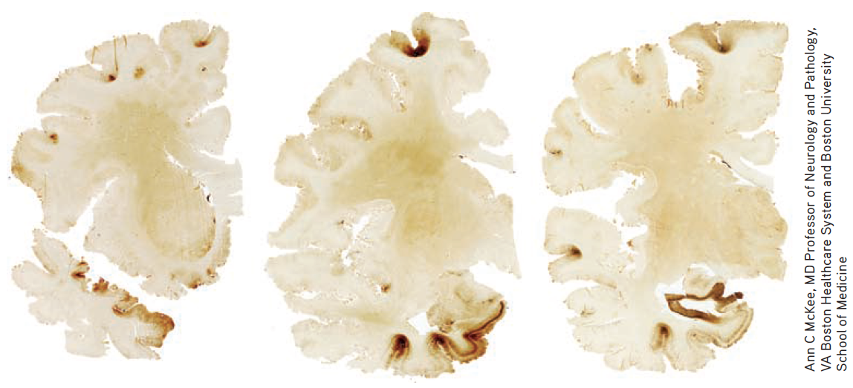
IN FOCUS The Ravages of CTE
Dave Duerson, a former NFL player, suffered from CTE which was diagnosed in an autopsy after his suicide.
Researchers at the Boston University Center or the Study of Traumatic Encephalopathy found the telltale signs of brain damage (brown coloring) in several regions of his brain, slices of which are shown here (McKee & others, 2013).

Slide 43
The Peripheral Nervous System
The peripheral nervous system (PNS) comprises all nerves outside the CNS that extend to the outmost body borders, including the skin.
Somatic nervous system communicates sensory information to CNS and motor messages from CNS to muscles
Autonomic nervous system regulates involuntary functions regulated by the sympathetic (energy expended) and parasympathetic (energy conserved) nervous systems.

Slide 44
Autonomic NS
Sympathetic NS
Emergency response
Parasympathetic NS
Calming response

Slide 45
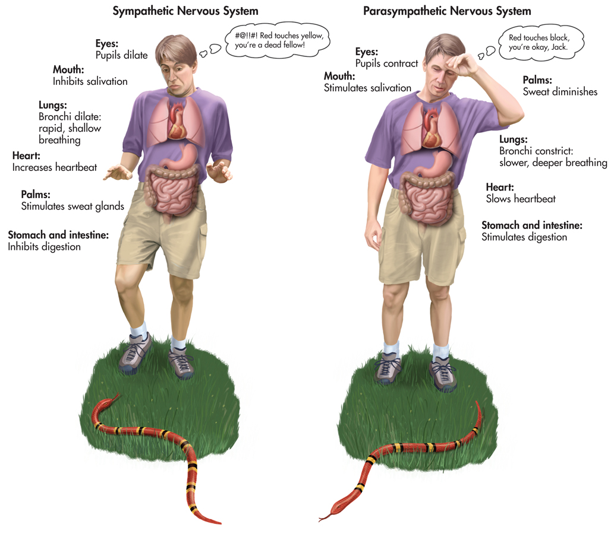

Slide 46
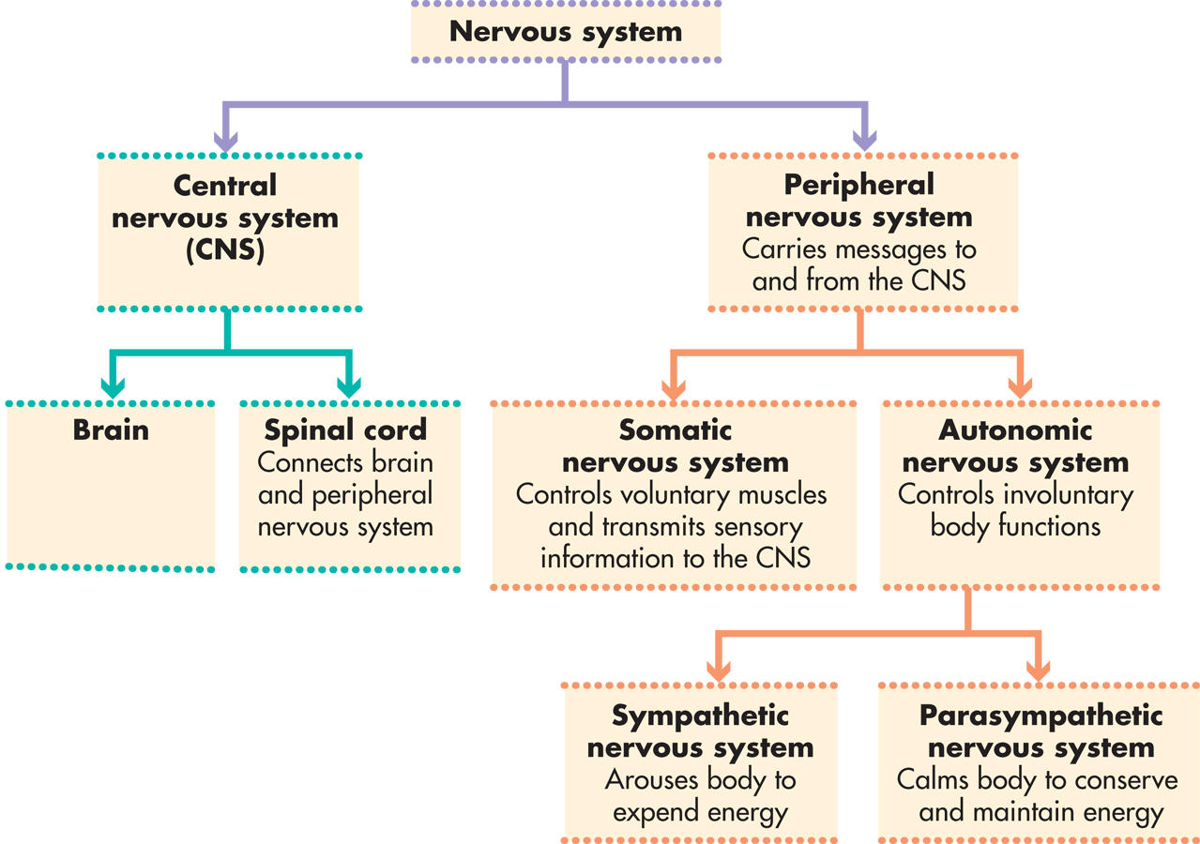

Slide 47
The Endocrine System
The endocrine system is made up of glands that are located throughout the body and uses chemical messengers (hormones) to transmit information.
Hormones
Are triggered by brain (hypothalamus) and circulated by blood
Regulate physical processes and influence behavior
Influence emotional and stress response
Are closely linked to CNS workings
Are (in some cases) chemically identical to neurotransmitters

Slide 48
Endocrine System
Hormones:
Organize nervous system and body tissue
i.e. growth
Activate behaviors
i.e. alertness
Hypothalamus in brain triggers secretion of hormones

Slide 49
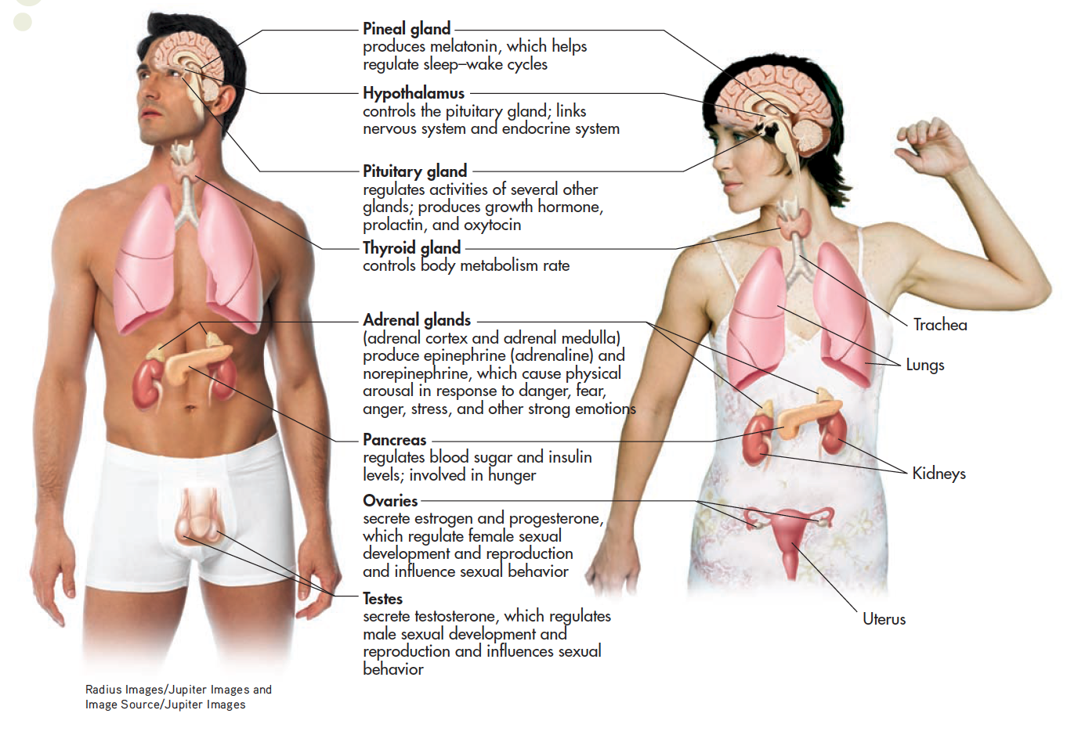
The Endocrine System
Notes:
The endocrine system and the nervous system are directly linked by the hypothalamus in the brain, which controls the pituitary gland. In turn, the pituitary releases hormones that affect the hormone production of several other endocrine glands. In the male and female figures shown here, you can see the location and main functions of several important endocrine glands.

Slide 50
The Endocrine System
Hypothalamus regulates release of pituitary gland hormones.
Growth hormone
Oxytocin
Adrenal glands produce hormones involved in human stress response.
Adrenal cortex (immune system)
Adrenal medulla (epinephrine and norepinephrine)

Slide 51
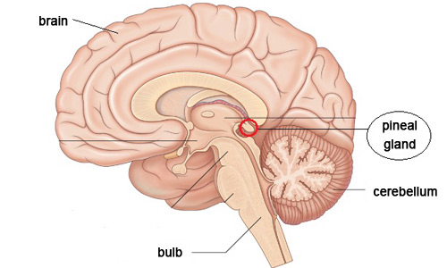
Endocrine: Pineal Gland
Small, in brain
Regulates sleep-wake cycle
Melatonin

Slide 52
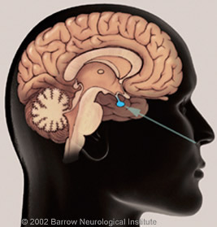
Endocrine: Pituitary Gland
Pea-sized, under brain
Posterior Pituitary
Vasopressin
Oxytocin
“Master Gland” (anterior pituitary)
Many hormones secreted
Growth hormone

Slide 53
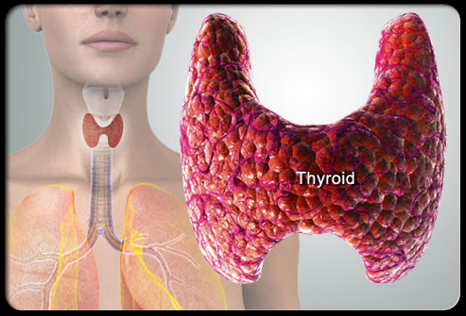
Endocrine: Thyroid Gland
Just below voice box
Regulate body’s rate of metabolism
Hyperthyroidism
Hypothyroidism
Thyroxin

Slide 54
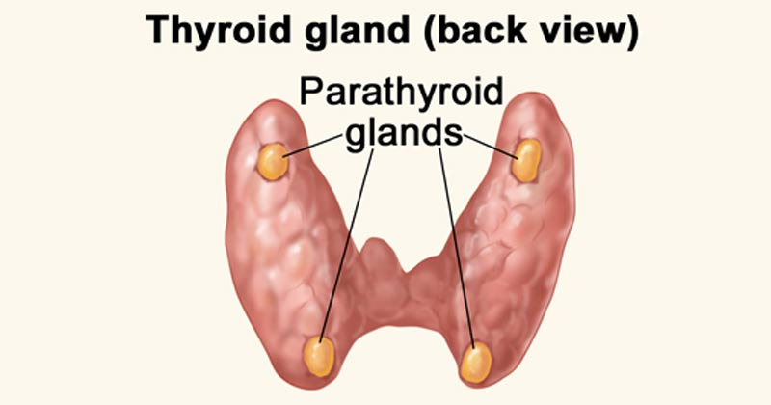
Endocrine: Parathyroid Glands
Inside of thyroid gland, 4 tiny
Regulates levels of calcium and phosphate in body, excitability
Parathormone

Slide 55
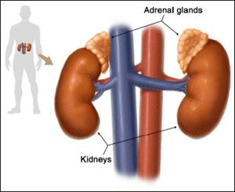
Endocrine: Adrenal Glands
2, just above the kidneys
Adrenal cortex (outer)
Adrenal medulla (inner)
Stress hormones:
Epinephrine (adrenaline)
Norepinephrine
ACTH (prolonged stress response)

Slide 56
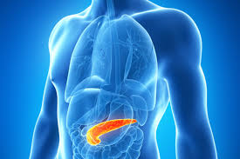
Endocrine: Pancreas
Between stomach and small intestine
Balances levels of blood sugar and insulin
Glucagon and Insulin
Diabetes

Slide 57
Endocrine: Gonads
Ovaries
Estrogens
Progesterone
Cognitive abilities
Sexual behavior
Testes
Androgens
Testosterone
Aggression
Sexual behavior

Slide 58
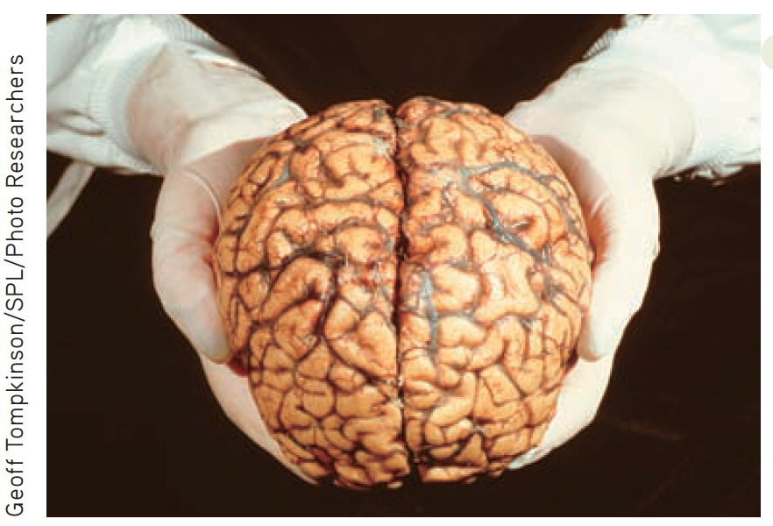
The Human Brain-2%
Weighing roughly three pounds, the human brain is about the size of a small cauliflower and has the consistency of tofu.
Although your brain makes up only about 2 percent of your total body weight, it uses some 20 percent of the oxygen your body needs while at rest (Magistretti, 2009).
The oxygen is used in breaking down glucose to supply the brain with energy.

Slide 59
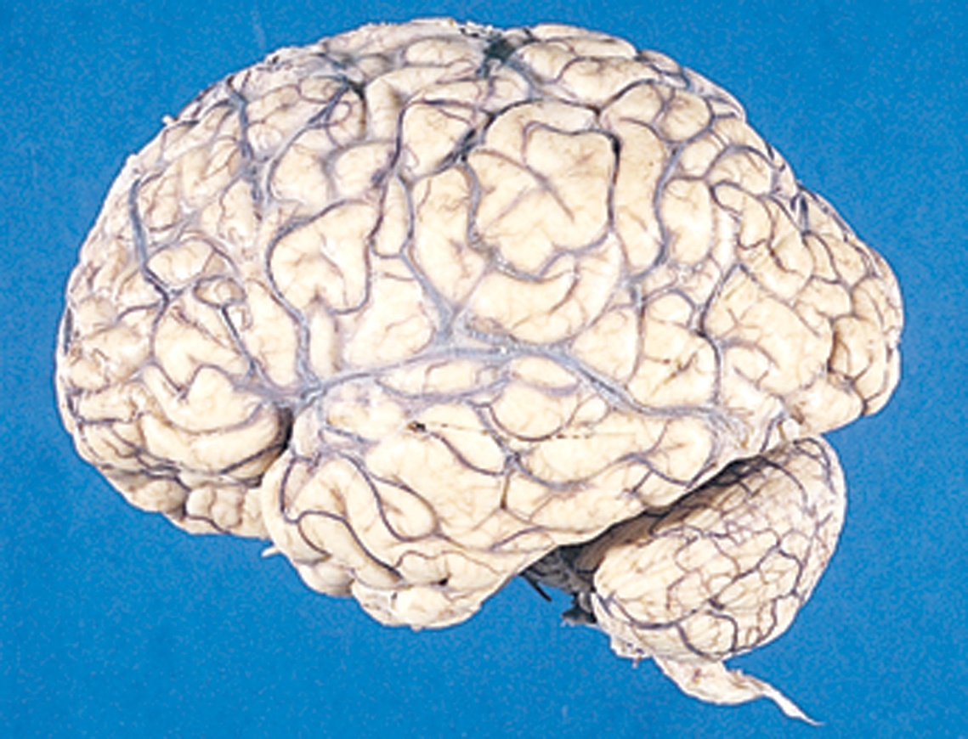
The Brain
Brainstem
Hindbrain
Midbrain
Forebrain
Limbic system
Cortex
Thalamus

Slide 60
The Dynamic Brain
Most psychological processes, especially complex ones, involve multiple brain structures and regions.
Integrated system
Neural pathways

Slide 61
The Dynamic Brain
The human brain has the remarkable capacity to change in response to experience. This ability to change function and structure is called plasticity.
Functional plasticity: The brain’s ability to shift functions from damaged to undamaged brain areas.
Structural plasticity: The brain’s ability to change its physical structure in response to learning, active practice, or environmental influences.

Slide 62
Neurogenesis
Neurogenesis: The growth of new neurons
Gould’s research on the developing primate brain: Adult marmoset monkeys were generating new neurons in the hippocampus every day—groundbreaking research

Slide 63
The Hindbrain
The hindbrain connects the spinal cord with the rest of the brain and consists of three structures.
Medulla (brainstem)
Pons (brainstem)
Cerebellum
Contralateral organization
Sensory information comes in from one side of the body over the hindbrain level and projects to the opposite side of the body.
Outgoing motor messages cross over the hindbrain and control movement and other motor functions on the other side of the brain.

Slide 64
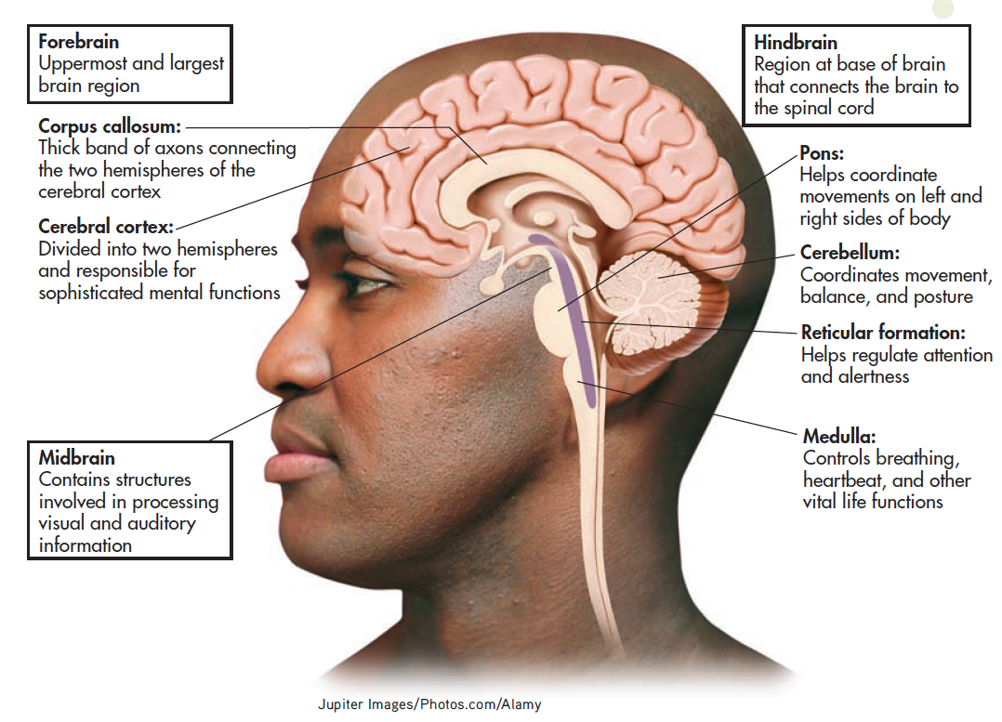
Major Regions of the Brain
Notes:
Situated at the base of the brain, the hindbrain’s functions include coordinating movement and posture, regulating alertness, and maintaining vital life functions. The midbrain helps
process sensory information. In combination, the hindbrain and the midbrain comprise the brainstem. The forebrain is the largest brain region and is involved in more sophisticated behaviors and mental processes.

Slide 65
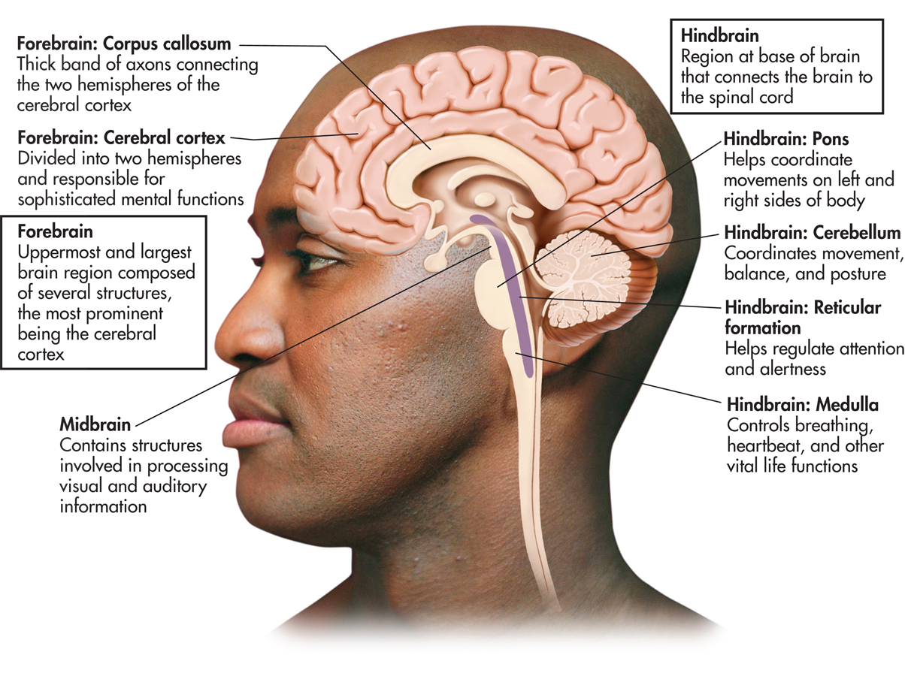
Medulla
Breathing
Heart rate
Digestion
Other vital reflexes
swallowing
coughing
vomiting
sneezing

Slide 66
Pons
Sleep/wake
Helps coordinate movements on left and right sides of the body
eg, postural reflexes that help you maintain balance while standing or moving

Slide 67
Cerebellum: “Little Brain”
Coordinated, rapid voluntary movements
playing the piano, kicking, throwing, etc.
Lesions to cerebellum
jerky, exaggerated movements
difficulty walking
loss of balance
shaky hands

Slide 68
Reticular Formation (RF)
Network of neurons in the brainstem (and thalamus)
Sleep and arousal
Attention
Alerts higher areas of the brain

Slide 69
Midbrain
Substantia nigra:
Involved in motor control and contains a large concentration of dopamine-producing neurons
Portion of midbrain
Midbrain

Slide 70
The Forebrain: 90% of the Brain
Forebrain: Largest and most complex brain region, which contains centers for complex behaviors and mental processes; also called the cerebrum.
The forebrain has increased in size and complexity during evolution.
Notes:
The brains of these different animal species have many structures in common, including a cerebellum and cortex. However, the proportion devoted to the cortex is much greater in mammals than in species that evolved earlier, such as fish and amphibians. The relative size of the different structures reflects their functional importance.

Slide 71
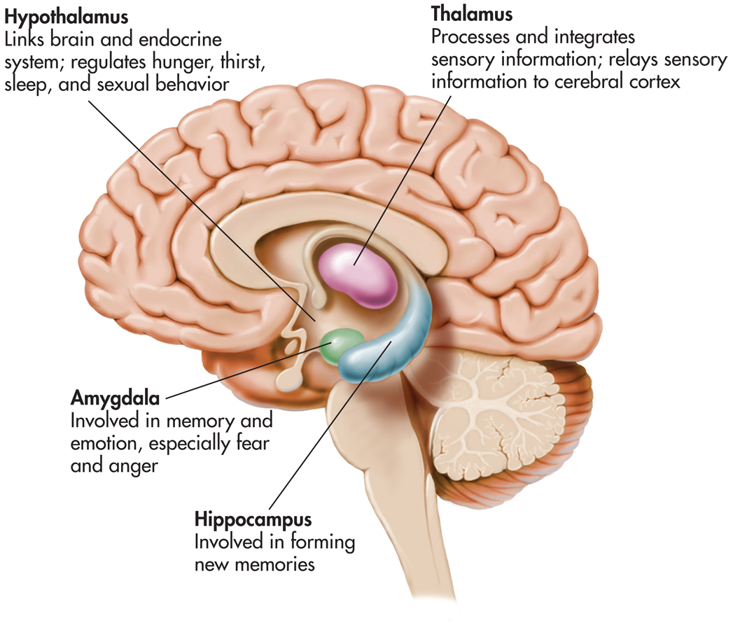
Forebrain Structures: 90% of the brain
Thalamus
Limbic System
Cortex

Slide 72
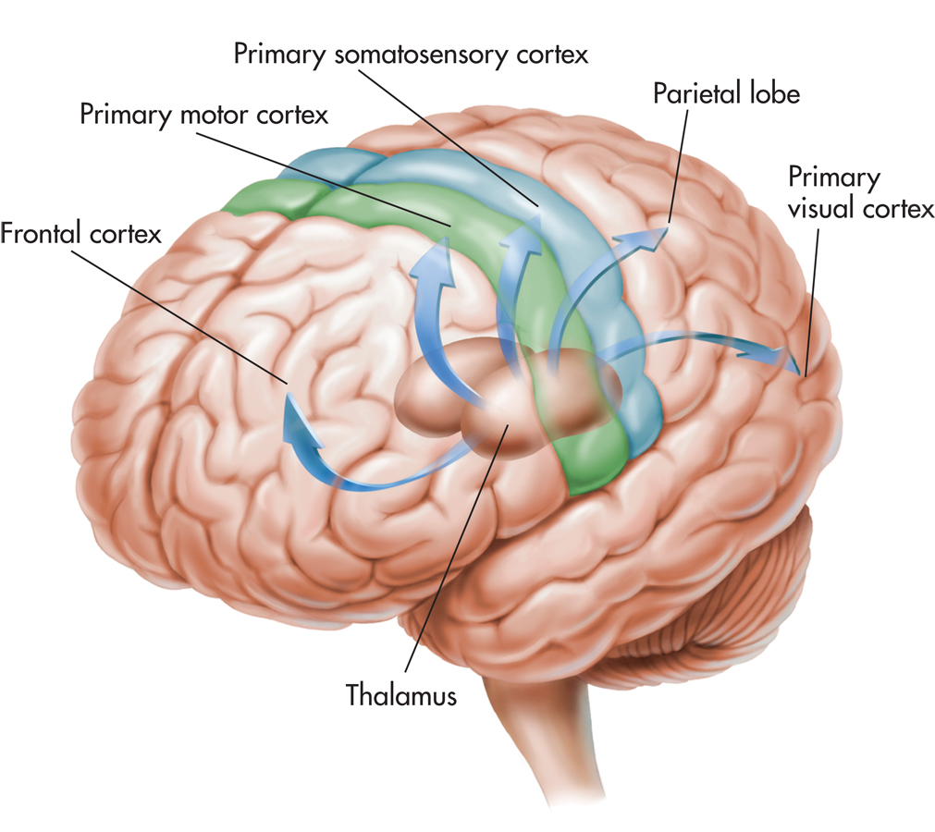
Thalamus
Relay station in brain
Processes most sensory information to and from higher brain centers (except smell)

Slide 73
The Limbic System
Hypothalamus
Motivation behaviors
Amygdala
Basic emotions
Hippocampus
Formation of new memories

Slide 74
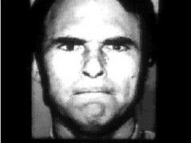
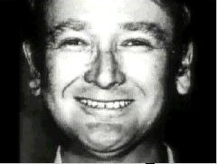
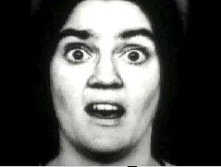
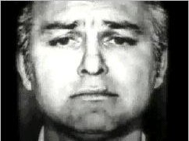
Amygdala and Emotion
Emotions related to self-preservation
Identify emotion from facial expressions
Amygdala damage makes this task difficult.
(click on picture to advance photos)

Slide 75
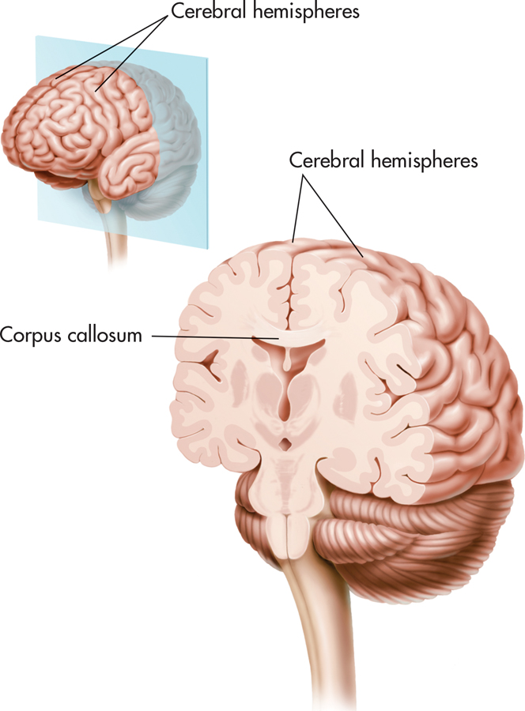
The Cerebral Cortex
The outer portion of the forebrain, the cerebral cortex, is divided into two cerebral hemispheres.
Gray matter
White matter
The corpus callosum, a thick band of neural fibers, serves as the primary communication link between the hemispheres.

Slide 76
Cortical Specialization
Localization—notion that different functions are located in different areas of the brain
Lateralization—notion that different functions are processed primarily on one side of the brain or the other

Slide 77
Lobes of the Cerebral Cortex
Frontal lobe—largest lobe, produces voluntary muscle movements; involved in thinking, planning, and emotional control
Temporal lobe—primary receiving area for auditory information
Occipital lobe—primary receiving area for visual information
Parietal lobe—processes somatic information

Slide 78
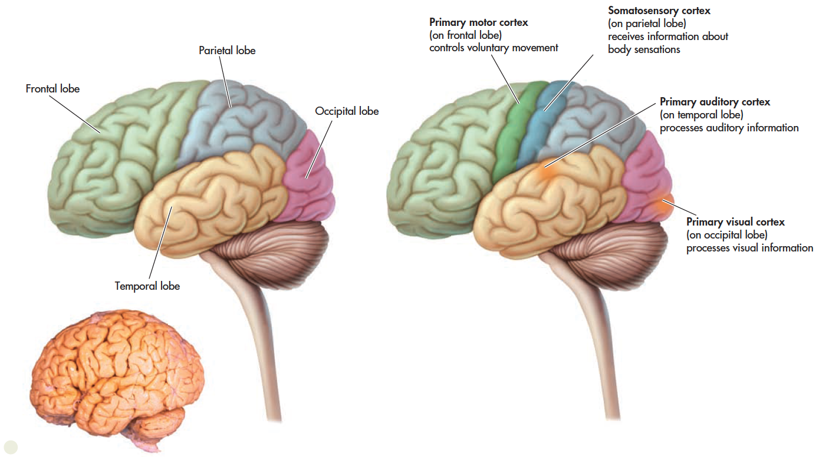
The Cerebral Cortex
Notes:
Remaining bulk of the cerebral cortex consists mostly of association areas (association cortex)
Prefrontal association cortex (voluntary movements)
Parts of temporal, parietal, and occipital lobes (formation of perceptions)

Slide 79
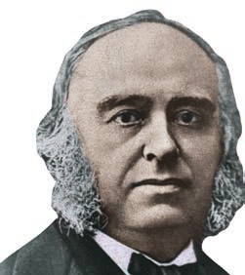
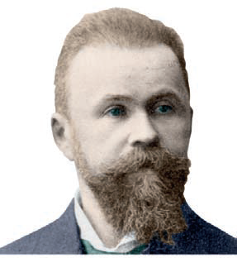
Language and the Left Hemisphere
Broca (1824-1880) provided evidence for cortical localization when treating a patient who comprehend but not produce language. Patient autopsy revealed lower left frontal lobe damage (Broca’s area/expressive aphasia).
Wernicke discovered that damage in another area in the left hemisphere affected spoken and written communication. Patient autopsies revealed left temporal lobe damage (Wernicke’s area/receptive aphasia).
Notes:
People with Broca’s aphasia find it difficult or impossible to produce speech, which
is why it is often referred to as expressive aphasia. Despite their impairments in speaking,
their comprehension of verbal or written words is relatively unaffected.
People with Wernicke’s aphasia have great difficulty comprehending written or spoken
communication, which is why it is often referred to as receptive aphasia. Although
they can speak, they often have trouble finding the correct words.

Slide 80
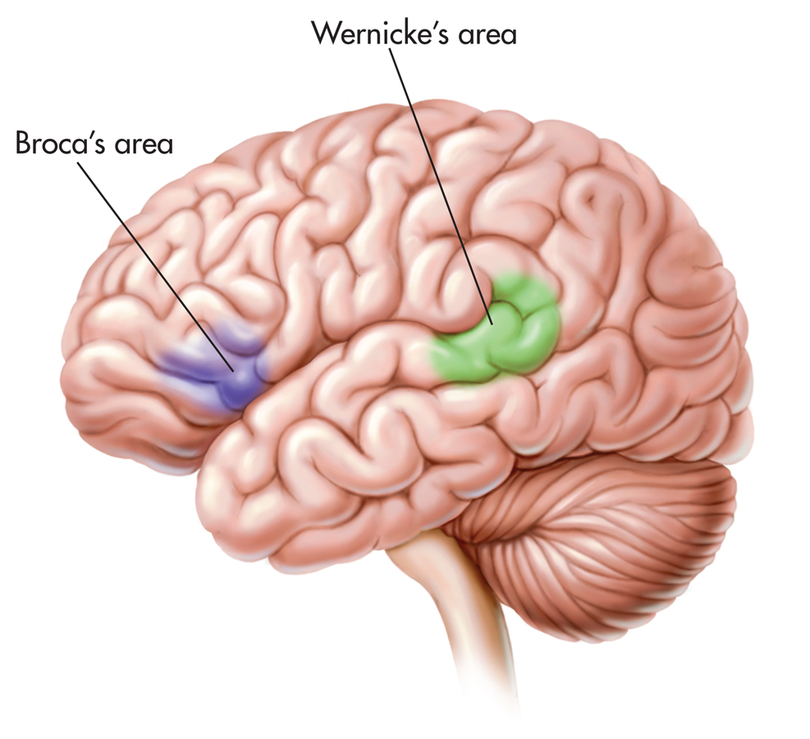
Language and the Brain
Aphasia—partial or complete inability to articulate ideas or understand language because of brain injury or damage
Broca’s area—plays role in speech production
Wernicke’s area—plays role in understanding and meaningful speech

Slide 81
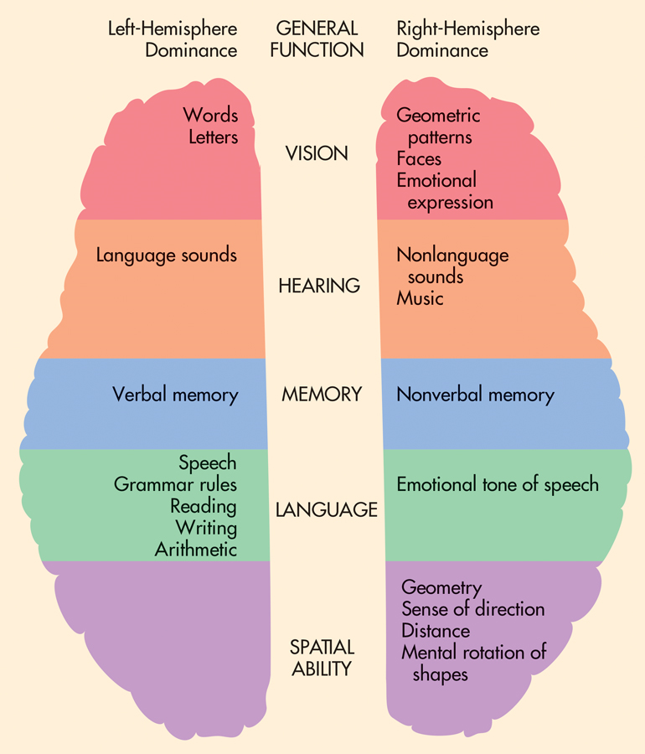
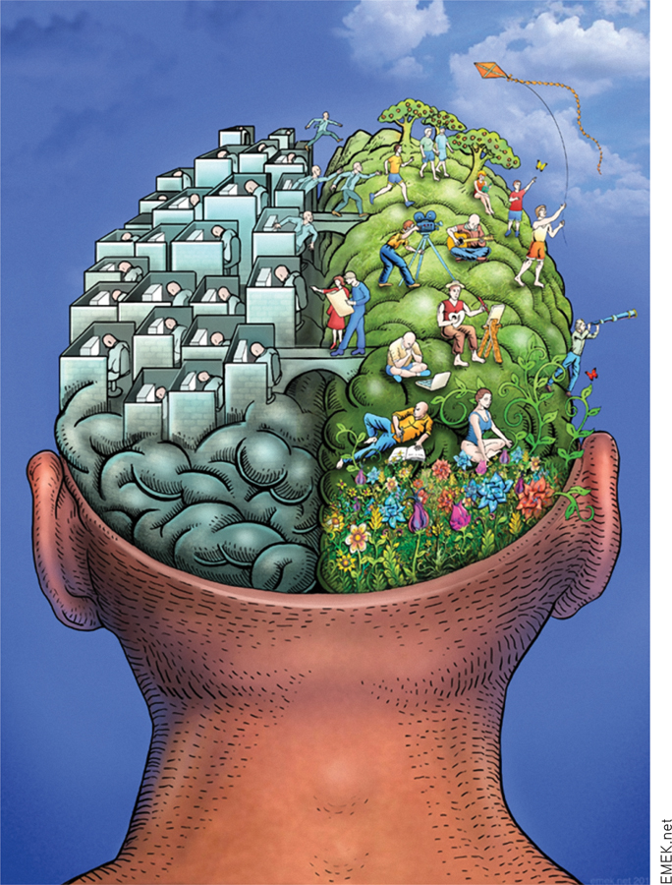

Slide 82
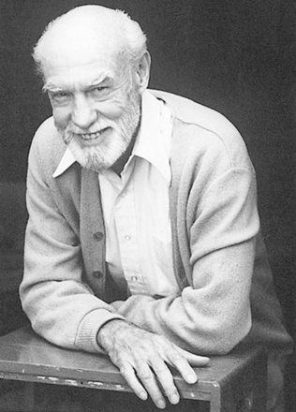
Cutting the Corpus Callosum
Split-brain operation: Surgical procedure that involves cutting the corpus callosum and is used to stop or reduce recurring seizures in severe cases of epilepsy.
Sperry and colleagues developed and apparatus to test the abilities of split-brain patients.
Specialized language abilities of left hemisphere in Broca’s and Wernicke’s area were reconfirmed.

Slide 83
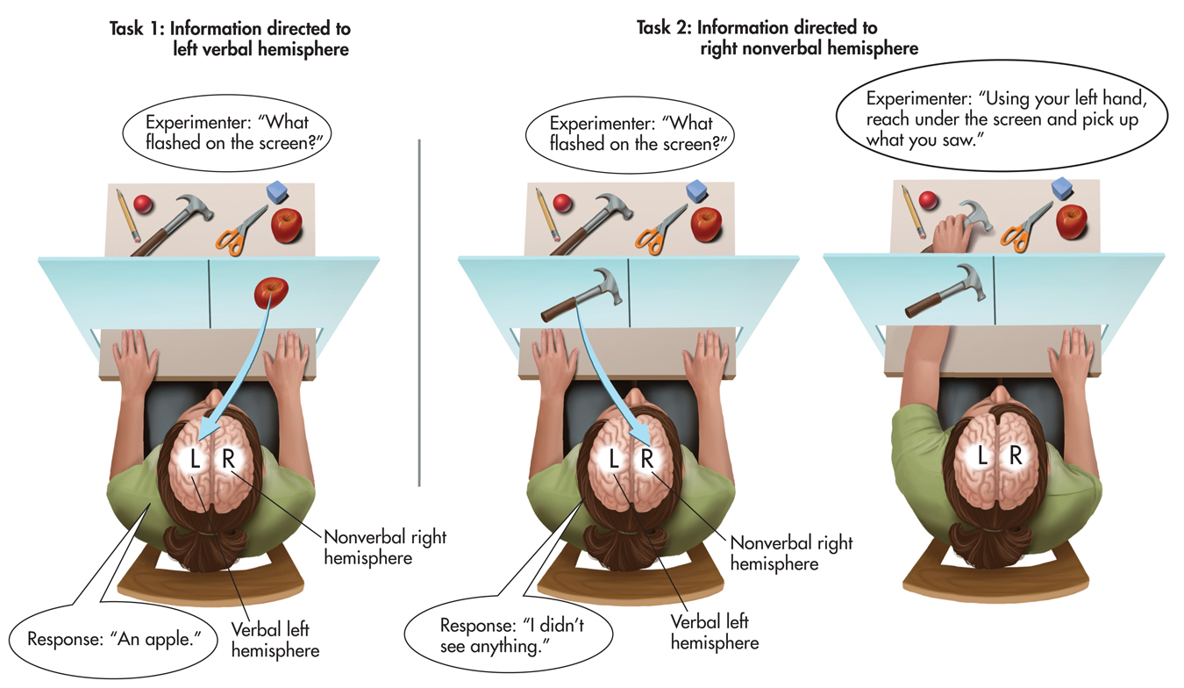

Slide 84
SCIENCE VERSUS PSEUDOSCIENCE Brain Myths
Some people are “right-brained” and other people “left-brained”. Yes or no?
Unless the corpus callosum has been surgically sliced, all humans rely on the smooth, integrated functioning of both their left and right hemispheres to speak, learn, and generally navigate everyday life.
Left-handed people are right-hemisphere dominant. Yes or not?
About 75 percent of left-handers are left-hemisphere-dominant for language, just like right-handers. The remaining 25 percent are either right-hemisphere-dominant for language or bilateral, using both hemispheres for speech and language functions.
The right brain is responsible for creativity and intuition. Yes or no?
Although the right hemisphere is specialized for holistic processing, there is no evidence that the right hemisphere is any more “intuitive” or “creative” than the left hemisphere. One side of the brain can be selectively educated in isolation.

Slide 85
PSYCH FOR YOUR LIFE Maximizing your brain’s potential
Get regular aerobic exercise.
Seek social interaction.
Learn to play a musical instrument.
Take a class outside your college major or in a new area.
Read, and read widely.
Unplug your television for two weeks—or longer.

