Slide 2
Consciousness is your immediate awareness of your internal states—your thoughts, sensations, memories—and the external world around you.

Slide 3
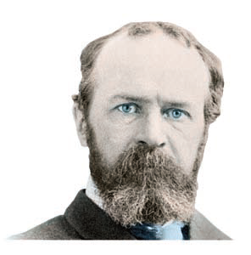
Consciousness
William James (1892) described consciousness as a stream or river.
Consciousness allows people to integrate past, present and future behavior, guide future actions, and maintain a sense of self.
Alamy

Slide 4
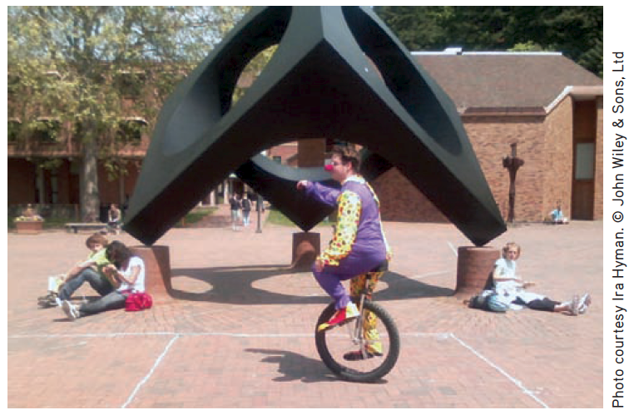
Attention Did You See That Clown?
Do you think you would notice if a unicycling clown crossed your path? Probably—unless you were using a cell phone!
Fully three-quarters of students who were talking on cell phones did not see this clown as they walked across a busy campus square—an example of inattentional blindness.

Slide 5
Characteristics of Attention
Attention has a limited capacity.
Attention is selective.
Attention can be “blind.”
Misdirection magicians exploit the limited, selective nature of attention.
Inattentional blindness: One does not notice some significant object or event that is in clear field of vision.
Inattentional deafness: Failing to hear an auditory message when attention is elsewhere.
Change blindness: Not noticing when something changes

Slide 6
The Perils of Multi-Tasking
Multi-tasking
Involves division of attention
Creates less attention and impairs attention for each task
Is less likely to cause interference when significant task variation is present
Visual task absorption can produce inattentional deafness; auditory task absorption can produce inattentional blindness.
Cell phone use is more dangerously distracting than driving while legally drunk.
Using a handset or Bluetooth device while driving does not improve safety .
Notes:
Multi-tasking refers to paying attention to two or more sources of stimuli at once.

Slide 7
Examples of Human Circadian Rhythm
Function | Typical Circadian Rhythm
Peak mental alertness and memory | Two daily peaks: around 9:00 A.M. and 9:00 P.M.
Lowest body temperature | About 97°F around 4:00 A.M.
Highest body temperature | About 99°F around 4:00 P.M.
Peak hearing, visual, taste, and smell sensitivity | Two daily peaks: around 3:00 A.M. and 6:00 P.M.
Lowest sensitivity to pain | Around 4:00 P.M.
Peak sensitivity to pain | Around 4:00 A.M.
Peak degree of sleepiness | Two daily peaks: around 3:00 A.M. and 3:00 P.M.
Peak melatonin hormone in blood | Between 1:00 A.M. and 3:00 A.M.
Notes:
circadian rhythm (ser-KADE-ee-en) A
cycle or rhythm that is roughly 24 hours
long; the cyclical daily fluctuations in
biological and psychological processes.
The Emergence of Circadian Rhythms
Consistent daily variations in movement,
heart rate, and other variables
are evident during the fifth month of
gestation in the human fetus. After birth,
the synchronization of infants’ circadian
rhythms to a day–night cycle usually
occurs by 2 or 3 months of age (Mistlberger
& Rusak, 2005). Daytime exposure
to bright light helps establish these
regular rest–activity circadian rhythms

Slide 8
The Suprachiasmatic Nucleus THE BODY’S CLOCK
Environmental Cues for Circadian Rhythm
Bright light, especially sunlight, helps regulate sleep–wake cycle and other circadian rhythms.
Light detected by special photoreceptors signals the SCN in the hypothalamus.
Hormone of the pineal gland (Melatonin) produces sleepiness.
Notes:
Suprachiasmatic nucleus (SCN)
Cluster of neurons in the hypothalamus that governs the timing of circadian rhythms
Role of Sunlight
Sunset each day detected by the SCN through its connections with the visual system
SCN triggers an increase in melatonin.
Increased blood levels of melatonin make you sleepy and reduce activity levels.

Slide 9
Circadian Rhythms and Sunlight: The 24.2-hour Day
Internal body clock drifts to its natural—or intrinsic—rhythm. Interestingly, our intrinsic circadian rhythm is about 24.2 hours, or slightly longer than a day.
When deprived of all environmental time cues, sleep-wake, body temperature, and melatonin circadian rhythms become desynchronized.
Jet lag: circadian rhythms are out of synchronization with daylight and darkness cues; thinking, concentration, and memory get fuzzy.
Blind people can experience desynchronized melatonin, body temperature, and sleep-wake circadian cycles.
Kieran Doherty/Reuters/Corbis
Notes:
Circadian Rhythms and the Blind
Many blind people have desynchronized
circadian rhythms because
they’re unable to detect the sunlight
that normally sets the body’s internal
biological clock, the SCN. Like
sighted people deprived of all environmental
time cues, blind people
can experience desynchronized
melatonin, body temperature, and
sleep–wake circadian cycles. Consequently,
about 60 percent of blind
people suffer from recurring bouts of
insomnia and other sleep problems
(Arendt & others, 2005; Mistlberger
& Skene, 2005).

Slide 10
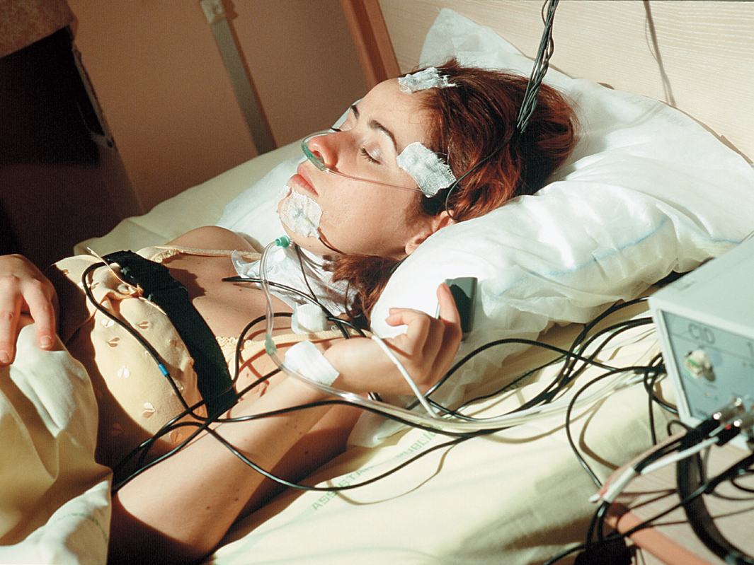
Sleep and Modern Sleep Research
Modern sleep research began with the invention of electroencephalography and the discovery that sleep is marked by distinct physiological processes and stages.
EEG (electroencephalogram): graphic record of brain activity produced by an electroencephalograph
Brain remains active during sleep
Pattern of activity differs from waking state – some areas active, others not
Two basic types of sleep
REM (rapid eye movement) – associated with dreaming
NREM (non- rapid eye movement, or quiet sleep) – divided into four stages
Garo/Phanie/Photo Researchers
Notes:
Electroencephalograph
Invented by German psychiatrist Hans Berger in the 1920s
Uses electrodes placed on the scalp to measure and record brain’s electrical activity
Two basic types of sleep
REM (rapid eye movement) – associated with dreaming
NREM (non- rapid eye movement, or quiet sleep) – divided into four stages
Wired for Sleep Using electrodes pasted
to the scalp, the electroencephalogram
(EEG) detects changes in the brain’s
electrical activity. Other instruments
record eye and muscle movements,
respirations, heart rate, and airflow.
Although it may look uncomfortable,
most people involved in sleep studies
become oblivious to the electrodes and
wires as they drift into sleep (Carskadon
& Rechtschaffen, 2005).

Slide 11
The Onset of Sleep
Brain wave patterns when awake
Beta brain waves: Brain-wave pattern associated with alert wakefulness
Brain wave patterns when
Drowsiness sets in
Sensation of falling, accompanied by a myoclonic jerk (most common)
Alpha brain waves: Brain-wave pattern associated with relaxed wakefulness and drowsiness
Daily activities and preoccupations
Floating, flying, or seeing kaleidoscopic patterns or an unfolding landscape (hypnagogic hallucination)
Include:

Slide 12
IN FOCUS What You Really Want to Know About Sleep
Why do I yawn?
Is yawning contagious?
Why do I get sleepy?
Sometimes in the morning when I first wake up, I can’t move. I’m literally paralyzed! Is this normal?
Do deaf people who use sign language sometimes “sleep-sign” during sleep?
Do the things people say when they talk in their sleep make any sense?
How many of these questions can you answer? Check your text for more information.

Slide 13
The First 90 Minutes of Sleep
Enter NREM sleep four-stage progression
NREM sleep stages
Each progressive NREM sleep stage is characterized by corresponding decreases in brain and body activity.
The first four stages of NREM sleep occupies the first 50 to 70 minutes of sleep.
Characterized by different brain wave patterns.
Notes:
From wakefulness to the
deepest sleep of stage 4 NREM, the
brain’s activity, measured by EEG recordings,
progressively diminishes, as
demonstrated by larger and slower brain
waves. The four NREM stages occupy
the first 50 to 70 minutes of sleep. Then,
in a matter of minutes, the brain cycles
back to smaller, faster brain waves, and
the sleeper experiences the night’s fi rst
episode of dreaming REM sleep, which
lasts 5 to 15 minutes. During the rest of
the night, the sleeper continues to experience
90-minute cycles of alternating
NREM and REM sleep.
Source: Data from Carskadon & Dement (2005).
sleep spindles Short bursts of brain
activity that characterize stage 2 NREM
sleep.
K complex Single but large high-voltage
spike of brain activity that characterizes
stage 2 NREM sleep.

Slide 14
The First 90 Minutes of Sleep
Upon reaching stage 4 and after about 80 to 100 minutes of total sleep time, sleep lightens, returns through stages 3 and 2.
REM sleep emerges, characterized by EEG patterns that resemble beta waves of alert wakefulness.
Four or five sleep cycles occur in a typical night’s sleep; less time is spent in slow-wave, more is spent in REM.
First REM period is about 5 to 15 minutes; length extends in later periods.
Notes:
From wakefulness to the deepest sleep of stage 4 NREM, the brain’s activity, measured by EEG recordings, progressively diminishes, as demonstrated by larger and slower brain waves. The four NREM stages occupy the first 50 to 70 minutes of sleep. Then, in a matter of minutes, the brain cycles back to smaller, faster brain waves, and the sleeper experiences the night’s first episode of dreaming REM sleep, which lasts 5 to 15 minutes. During the rest of the night, the sleeper continues to experience 90-minute cycles of alternating NREM and REM sleep. Source: Data from Carskadon & Dement (2005). sleep spindles Short bursts of brain activity that characterize stage 2 NREM sleep. K complex Single but large high-voltage spike of brain activity that characterizes stage 2 NREM sleep.

Slide 15
The 90-Minute Cycles of Sleep
Largest category of
sleep: NREM
Stage 2—45 to 50%
Of sleep
Notes:
During a typical night, you experience five 90-minute cycles of alternating NREM and REM sleep. The deepest stages of NREM sleep, stages 3 and 4, occur during the first two 90-minute cycles. Dreaming REM sleep episodes become progressively longer as the night goes on. Shifts in sleep position, indicated by the dots, usually occur immediately before and after REM episodes. Source: Data from Hobson (2004)

Slide 16
Synchronized Sleepers
As these time-lapse photographs show, couples who regularly sleep in the same bed tend to have synchronized sleep cycles.
Since bed partners fall asleep at about the same time, they are likely to have similarly timed NREM–REM sleep cycles.
The movements of this couple are also synchronized. Both sleepers shift position just before and after episodes of REM sleep.

Slide 17
Sleep Patterns Over the Lifespan
Percentage of a night’s sleep devoted to REM
Increases during childhood and adolescence
Remains stable throughout adulthood
Decreases during late adulthood
Developmental patterns
Newborn: Sleeps about 16 hours a day, though not all at once; Up to 8 hours—or 50 percent—of the newborn’s sleep time is spent in REM sleep
Infant: Shorter 60-minute sleep cycles, producing up to 13 sleep cycles per day
Toddler: 75-minute sleep cycles
Age 5: Typical 90-minute sleep cycles of alternating REM and NREM
Childhood through late adulthood: Pattern of sleep evolves and changes
Notes:
Sleep-Deprived Adolescents Circadian
rhythms shift in adolescence. Adolescents
tend to fall asleep later and wake up later.
Few teenagers get the 8.5 to 9 hours
of sleep that they need to feel fully
rested. In the U.S., more than two-thirds
of teenagers report that they get less
than 7 hours of sleep on school nights,
which is probably why they tend to sleep
about 2 hours longer on weekends. Consequences
of regular sleep loss include
poor school performance, increased risk
of accidents and injuries, and depressed
mood (Colrain & Baker, 2011).

Slide 18
Sleep Over the Lifespan
Notes:
Sleep quality changes significantly over
the lifespan. In particular, notice that slow wave
sleep decreases over the lifespan,
as does total sleep time. By middle adulthood,
people are more likely to experience
wakefulness after sleep onset. Senior
adults aged 55 and older often take longer
to fall asleep, which is technically called
sleep latency (Bootzin & Epstein, 2011).
Source: Ohayon & others (2004).

Slide 19
Why Do We Sleep? Adaptive Theory
Species Sleep Variation and Evolution
Animals with few natural predators sleep as much as 15 hours a day
Grazing animals, such as cattle and horses, sleep in short bursts—about 4 hours per day
Hibernation patterns coincide with periods during which food is scarce and environmental conditions pose threats
Wayne R Bilenduke/Getty Images
SLEEP IS IMPORTANT IN
Clearing brain metabolic waste products
Maintaining immune function
Learning and memory
Regulating mood
Notes:
Why do we sleep?
To provide needed rest to muscles and body
To clear metabolic waste products from brain
To maintain immune system function
To improve brain function, enhance learning, consolidate memory, and regulate moods and emotion

Slide 20
Sleep
Sleep and memory formation
New memories are strengthened and integrates with existing networks of memories.
Emotional memories are preserved.
“Memory Consolidation”
Effects of sleep deprivation
Sleep deprivation studies (microsleep)
Sleep restriction studies (Diminished concentration, vigilance, reaction time, memory skills, risk assessment ability; more calorie consumption and weight gain; REM rebound and NREM rebound)
Notes:
REM rebound: After several nights of being selectively deprived of REM sleep, REM sleep increases by as much as 50%.
Sleep restriction:
Increased urge to sleep.
Diminished concentration, vigilance, reaction time, memory skills, and the ability to gauge risks
Motor skills decrease, producing a greater risk of accidents.
Hormones are disrupted; levels of stress hormones, immune system diminished
Metabolic changes occur, linked to obesity and diabetes.
Emotions:
Sleep-deprived brain prone to emotional reactions as amygdala activated more strongly.
Sleep deprivation studies: After one night—microsleeps, episodes of sleep lasting only a few seconds, during wakefulness
For a day or more— disruptions in mood, mental abilities, reaction time, perceptual skills, and complex motor skills

Slide 21
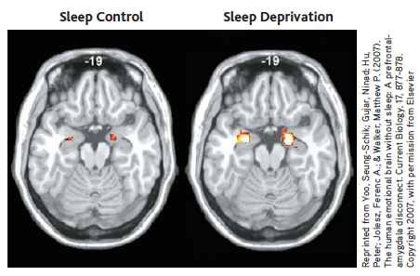
FOCUS ON NEUROSCIENCE The Sleep-Deprived Emotional Brain
The sleep-deprived brain reacts to negative and positive extremes.
The sleep-deprived brain is prone to strong emotional reactions to negative stimuli.
Unrealistically positive responses may lead sleep-deprived people to engage in risky or addictive behavior.

Slide 22
Dreams and Mental Activity During Sleep
Sleep thinking (Sleep Mentation)
Occurs during NREM slow-wave sleep
Vague, bland, thoughtlike ruminations about real-life events
Most dreams happen during REM sleep
People report a dream about 90 percent of the time

Slide 23
Sleep and Memory Formation
REM sleep and NREM stage 2 sleep seem to help consolidate new procedural memories, which involve learning a new skill or task until it can be performed automatically.
New memories formed during the day are reactivated during the 90-minute cycles of sleep.
NREM slow-wave sleep contributes to forming new episodic memories, which are memories of personally experienced events.

Slide 24
Dream Themes and Imagery
Common dream themes
Most dreams are about everyday things.
Women report dreaming about men and women in equal proportion and are more likely to report emotions in their dreams.
Men are more likely to report dreaming about other men and are more likely to report dreams involving physical aggression.
Negative feelings and events are more common than positive ones.
Apprehension or fear is a frequently reported dream emotion for both sexes.
Dreamers are more likely to be victims of aggression than aggressor and instances of aggression are more common than are instances of friendliness.

Slide 25
Nightmares
Vivid and frightening or unpleasant anxiety dreams during REM sleep
Most common during middle and late childhood—ages 5 to 10
10 percent of adults experience nightmares on a weekly basis
Women report more frequent nightmares than men
Daytime stress, anxiety, and emotional difficulties are often associated with nightmares
Nightmares are different from night terrors (sleep terrors)
Notes:
Dream Images The hit film Inception, starring Leonardo DiCaprio, used compelling dream sequences in its tale of corporate espionage accomplished by invading the dreams of unsuspecting competitors. People tend to emphasize visual imagery when describing their dreams, but sounds and physical sensations are also commonly present. Sensations of falling, flying, spinning, or trying to run may be experienced. We tend to dream of familiar people and places, but the juxtapositions of characters, objects, and events are often illogical, and sometimes bizarre (Nielsen & Stenstrom, 2005). Nevertheless, dreamers rarely question a dream’s details— until they wake up!

Slide 26
Theories of Dreaming
Freud
Fulfilled Wishes
Dreams are psychological safety valve.
Hobson and McCarley Activation-Synthesis Model
Neurocognitive Theory of Dreaming
Symbolic sexual and aggressive frustrations expressed during sleep.
Manifest content
Latent content
Not supported by research
Sleep brain activity produces dream story (synthesis).
Dreaming due to automatic activation of brainstem circuits.
Circuits arouse more sophisticated brain areas that generate and impose meaning on sensory signals.
Continuity of waking and dreaming is emphasized.
External sensory stimuli cut off so individual sensory data generated; uncontrollable thought processes.
Dreams reflect our interests, personality, worries.
Notes:
Freud: The notion that dream images contain symbolic messages has been challenged by contemporary neuroscience studies of the dreaming brain.
“In every dream an instinctual wish has to be represented as fulfilled.”
Dreams function as a sort of psychological “safety valve” for the release of unconscious and unacceptable urges.
Because psychological defenses are reduced during sleep, frustrated sexual and aggressive wishes are expressed symbolically in dreams.
Manifest content—elements of the dream that are consciously experienced and remembered.
Latent content—the unconscious wishes that are concealed in the manifest content.
Freud (1911) believed:
Sticks, swords, brooms, and other elongated objects were phallic symbols
Cupboards, boxes, and ovens supposedly symbolized the vagina
Activation-synthesis model
The theory that brain activity during sleep produces dream images (activation), which are combined by brain into a dream story(synthesis)—J. Allan Hobson and Robert McCarley (1977).
Dreaming is due to the automatic activation of brainstem circuits at the base of the brain.
These circuits arouse more sophisticated brain areas, including visual, auditory, and motor pathways.
Activated brain combines, or synthesizes, these internally generated sensory signals and imposes meaning on them.
Neurocognitive theory of dreaming
Model of dreaming that emphasizes continuity of waking and dreaming cognition, and states that dreaming is like thinking under conditions of reduced sensory input and the absence of voluntary control.
Special characteristics of dreams are due to two conditions that occur during sleep.
We are cut off from external sensory stimuli, so we generate our own sensory data.
We’re unable to control our thought processes.
Under these two conditions, “thoughts” take the shape of dreams.

Slide 27
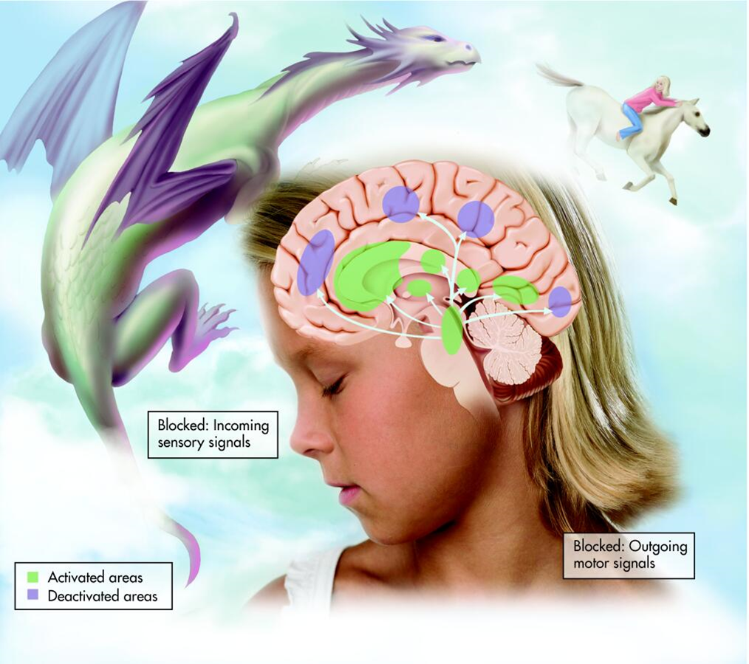

Slide 28
Sleep Disorders
Dyssomnias are sleep disorders involving disruptions in the amount, quality, or timing of sleep.
Insomnia
Obstructive sleep apnea
Narcolepsy and cataplexy
Parasomnias are undesired arousal or actions during sleep.
Sleep terrors
Sleepsex
Sleepwalking and sleep-related eating
disorder
Carol and Mike Werner/Phototake
Sleepwalking
Notes:
Sleepwalking Sleepwalking is fairly common in children. Approximately
1 percent of preschoolers and 2 percent of school-age children walk in
their sleep at least a few nights per week (National Sleep Foundation,
2004a). More generally, about 15 percent of all children have had at least
one sleepwalking episode. Researchers used to believe that children outgrew
their tendency to sleepwalk by late adolescence. However, sleepwalking
in adulthood is much more common than once thought. It’s now
known that about 4 percent of adults are sleepwalkers (Hughes, 2007).
The parasomnias are undesired arousal or actions during sleep.
Brain is partially awake
Arises during the NREM stages 3 and 4 of slow-wave sleep in first half of the night
More common in children and decrease with age
May have genetic predisposition
Triggered by wide-ranging stimuli, including sleep deprivation, stress, erratic sleep schedules, sleeping medications, stimulants, pregnancy, and tranquilizers
Insomnia
Complain about the quality or duration of their sleep
Have difficulty going to sleep or staying asleep
Wake before it is time to get up
Can be traced to anxiety over stressful life events
Obstructive sleep apnea
Sleeper’s airway becomes narrowed or blocked, causing very shallow breathing or repeated pauses in breathing
Narcolepsy
Overwhelming bouts of excessive daytime sleepiness and brief, uncontrollable episodes of sleep
Cataplexy (related)
Sudden loss of voluntary muscle strength and control, lasting from several seconds to several minutes
Usually triggered by a sudden, intense emotion
May be due to reduced numbers of hypocretin-producing neurons in hypothalamus needed for wakefulness
Sleep terrors
Increased physiological arousal, intense fear and panic, frightening hallucinations, no recall of the episode next morning
Sleepsex
Abnormal sexual behaviors and experiences during sleep
Sleepwalking and sleep-related eating disorder
Walking or performing other actions during stage 3 or stage 4

Slide 29
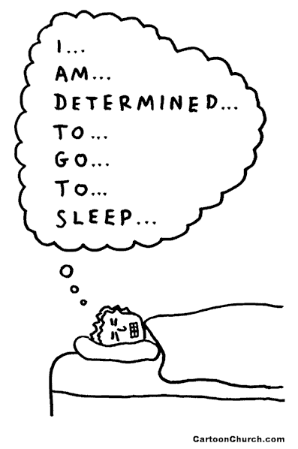
1. Insomnia
The inability to fall asleep or remain asleep or wake up too early
Regularly longer than 30 mins to get to sleep
May be related to stress, anxiety, depression, medication
Can also be caused by noise, temperature, or trying to sleep in a new environment

Slide 30
2. Obstructive Sleep Apnea
Person stops breathing momentarily during sleep
Tends to run in families
Twice as common in men than in women
1 in 25 men, 1 in 50 women, 1 in 10 seniors (Common in men over 40)
Symptoms include snoring, exhaustion the next day, depression, headaches
Continuous Positive Airway Pressure (CPAP)

Slide 31
3. Narcolepsy
Suddenly falling asleep without warning during waking hours (few seconds to several minutes “microsleep”)
Automatic behavior
Narcoleptics often experience loss of muscle tone as well (cataplexy—70% in people who have narcolepsy)
May also drop into REM sleep immediately, causing hypnagogic hallucinations
Likely caused by a central nervous system defect (lack of hypocretins, which are produced by the hypothalamus)

Slide 32
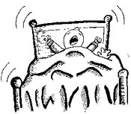
4. Sleep Terrors
“Night Terrors”
Episodes of fright that occur during stages 3 or 4 of NREM sleep
Person may sit up or scream, but likely will not recall the episode in the morning
Person cannot be awakened nor comforted (but may appear awake)
Occurs in ages 4 to 12, usually subsides, but 4 to 5% of adults experience these
NOT A NIGHTMARE

Slide 33
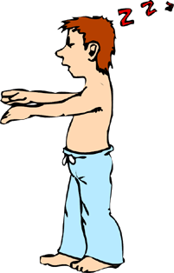
5. Sleepwalking/talking/eating
Sleepwalking “somnambulism”
15% of children
4% of adults
Usually occurs during Stage 4 sleep
Seems to occur more frequently when child/adult is fatigued or anxious
Sleep related eating disorder (SRED)
Not associated with daytime eating disorders

Slide 34
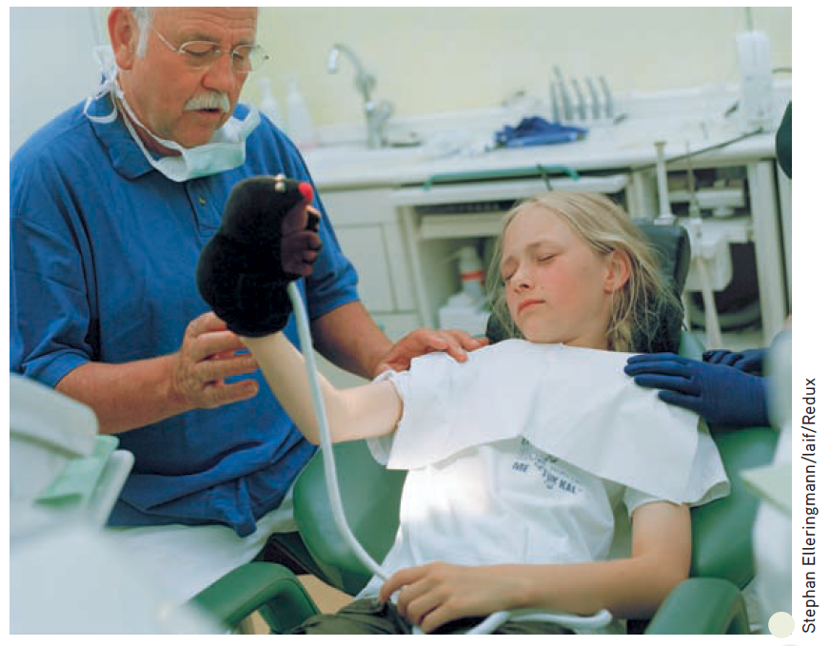
Hypnosis
Hypnosis is a cooperative social interaction in which the hypnotized person responds to the hypnotist’s suggestions with changes in perception, memory, and behavior.
15% of adults are highly susceptible; 10% are difficult or impossible to hypnotize
Effects of hypnosis
Explaining hypnosis
Limits and applications of hypnosis
Children tend to be more responsive to hypnosis than are adults.
Notes:
Hypnosis is derived from the Greek hypnos, meaning “sleep”
Hypnosis is an unusual state of awareness, defined as a cooperative social interaction in which the hypnotic participant responds to suggestions made by hypnotist
Characterized by highly focused attention
Best candidates for hypnosis are individuals who approach the experience with positive, receptive attitudes

Slide 35
Hypnosis
Effects of hypnosis
Profound changes in subjective experience of consciousness
Sensory changes (hallucinations, temporary blindness, deafness, or sensation loss)
Behavior outside the hypnotic state
Post hypnotic suggestion
Posthypnotic amnesia
Increased confidence in incorrect memories

Slide 36
Hypnosis
Explaining hypnosis
Hypnotized person consciously experiences one stream of mental activity that complies with hypnotist’s suggestion (neodissociation theory of hypnosis/Hilgard).
Dissociated stream of mental activity (hidden observer) processes information that is unavailable to consciousness to hypnotized person
Alternative theories
Social cognitive theory
Suggestibility theories
Limits and applications of hypnosis
People cannot be hypnotized against their will and perform actions contrary to their morals and values.
Hypnosis cannot strengthen physical capabilities or create new talents.
Hypnosis can help in modifying problematic behaviors.

Slide 37
Help Through Hypnosis
Research has demonstrated that hypnosis can effectively:
Reduce pain and discomfort associated with cancer, rheumatoid arthritis, burn wounds, and other chronic conditions
Reduce pain and discomfort associated with childbirth
Reduce the use of narcotics to relieve postoperative pain
Improve the concentration, motivation, and performance of athletes
Lessen the severity and frequency of asthma attacks
Eliminate recurring nightmares
Enhance the effectiveness of psychotherapy in the treatment of obesity, hypertension, and anxiety
Remove warts
Eliminate or reduce stuttering
Suppress the gag reflex during dental procedures

Slide 38
Meditation in Different Cultures
Meditation
Involves any one of a number of sustained concentration techniques that focus attention and heighten awareness
Can be practiced as secular technique
Goal of all meditation forms
Controlling or training attention
General categories
Focused attention techniques
Open monitoring techniques
“here and now”
AP Photo/Herald-Leader, David Perry
Notes:
Meditation
Lowered physiological arousal
Decreased heart rate
Decreased blood pressure
Predominance of alpha brain waves
Meditation in Different Cultures (Left) Like this group in Hanoi, Vietnam, many people throughout Asia
begin their day with tai chi, often meeting in parks and other public places. Tai chi is a form of meditation
that involves a structured series of slow, smooth movements. Sometimes described as “meditation in
motion,” tai chi has been practiced for over 2,000 years.
(Right) Zen Buddhist practitioners in an American temple practice zazen, or “just sitting,” a form of
open monitoring meditation (Austin, 2009). Originating in China, Zen is found in many Asian countries,
especially Japan, Korea, and Vietnam. Over the past few decades, Zen Buddhism has become increasingly
popular in the United States and other Western countries.

Slide 39
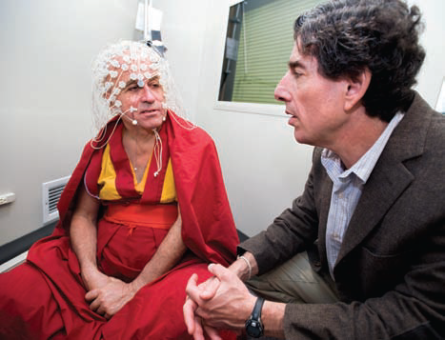
Scientific Studies of Meditation Effects
Studying the Well-Trained Mind
Neuroscientist and psychologist Richard Davidson confers with Buddhist monk Matthieu Ricard during an EEG study that monitored brain waves during different meditative practices
Carefully controlled studies have found that meditation can
Improve concentration, perceptual discrimination, and attention
Increase working memory in American Marines during basic training
Improve emotional control and well-being
Reduce stress and minimize its physical effects
Notes:
Ricard, a former molecular
biologist, helped design the studies, held
under the auspices of the Mind and Life
Institute (www.mindandlife.org). The
14th Dalai Lama has been instrumental
in encouraging such collaborations
between Western scientists and Tibetan
Buddhist practitioners (Ekman & others,
2005). As the Dalai Lama wrote,
“Buddhists have a 2,500-year history of
investigating the workings of the mind.”
Using imaging devices that show what
occurs in the brain during meditation,
Dr. Davidson has been able to study the
effects of Buddhist practice for cultivating
compassion, equanimity, or mindfulness
(Gyatso, 2003).

Slide 40
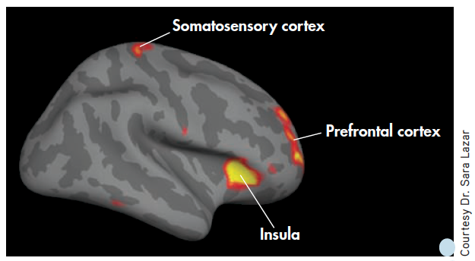
FOCUS ON NEUROSCIENCE Meditation and the Brain
Does meditation affect brain structure?
Long-term meditators had more gray matter in regions associated with attention, emotion, and sensory processing (Lazar and colleagues).
New meditators showed gray-matter-density in the hippocampus, cerebellum, and other areas associated with memory, emotion, and awareness (Hölzel and others).
Meditation
Matters
Notes:
A study by Sara Lazar and her colleagues
(2005) found that cortical areas shown in red and
yellow were significantly thicker in meditators than in a
matched control group. The somatosensory cortex and
insula are both associated with sensory awareness, with
the insula specifically linked to awareness of internal body
sensations and signals. According to the researchers, the
particular region of the prefrontal cortex that was thicker
in the meditators than the controls is thought to be associated
with the integration of thoughts and feelings.

Slide 41
Psychoactive Drugs
Psychoactive drugs are chemical substances that can alter arousal, mood, thinking, sensation, and perception, have an affect on the brain
Broad categories of psychoactive drugs:
Depressants: Drugs that depress, or inhibit, brain activity
Opiates: Drugs that are chemically similar to morphine and that relieve pain and produce euphoria
Stimulants: Drugs that stimulate, or excite, brain activity
Psychedelics: Drugs that distort sensory perceptions

Slide 42
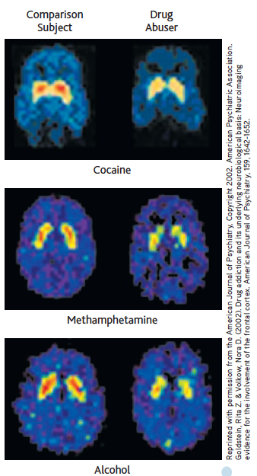
The Addicted Brain
Common Effects of Addictive Drugs
Drugs influence on brain activity
Altering synaptic transmission among neurons
Increasing or decreasing neurotransmitter amounts
Blocking, mimicking, or influencing a particular neurotransmitter’s effects
Addictive drugs activate dopamine-producing neurons in brain’s reward system
Notes:
The intoxicating effects of all addictive drugs are produced by rapidly increasing dopamine levels in the brain’s reward system (Volkow & others, 2009, 2011b). As the brain adjusts to the effects of repeated drug use, long-term changes occur in the brain’s reward circuitry. The number of dopamine receptors is indicated by orange and yellow in the scans above. Substance abuse sharply reduces the number of dopamine receptors in the brain’s reward system.

Slide 43
Common Effects of Psychoactive Drugs
Physical dependence: body and brain chemistry have physically adapted to a drug
Drug tolerance: increasing amounts of drug are needed to gain original effect
Withdrawal symptoms: unpleasant physical reactions to lack of drug, plus intense craving
Drug rebound effect: withdrawal symptoms are opposite to the drug’s action
Drug abuse: recurrent drug use resulting in disruption of academic, social, or occupational functioning, legal or psychological problems
Change in reward circuitry: normally reinforcing experiences of everyday life are no longer satisfying or pleasurable
Notes:
Addiction involves a condition in which a person feels psychologically and physically compelled to take a specific drug

Slide 44
The Depressants
Depressants
Depress or inhibit central nervous system activity.
Produce drowsiness, sedation, or sleep
Relieve anxiety and lower inhibitions
Produce addictive effects (increased sedative effects when combined)
Kinds
Alcohol
Barbiturates
Inhalants
Tranquilizers

Slide 45
Alcohol
The Dangers of Driving Under the Influence
Many drug experts consider alcohol to have highest social costs of all addictions.
17 million Americans are either dependent upon alcohol or have serious alcohol problems
Accounts for estimated 90,000 deaths annually in U.S.; including 1,400 college students
Involved in assaults, homicides, motor vehicle accidents, domestic, partner and child abuse, and birth defects.
Notes:
Intoxicated drivers have
impaired perceptual ability and psychomotor
functions, delayed reaction time,
and poor coordination. They are also
likely to display impaired judgment, poor
impulse control, and an inflated self-image.
This deadly combination results
in more than 17,000 U.S. traffic deaths
each year.
Inhalants
Chemical substances that are inhaled to produce an alteration in consciousness
Paint solvents, spray paint, gasoline, and aerosol sprays
Act as central nervous system depressants
Dangers
Suffocation
Toxic to the liver and other organs
Chronic abuse leads to neurological and brain damage
Barbiturates
Reduce anxiety and promote sleep
Depress activity in brain centers that control arousal, wakefulness, and alertness
Depress brain’s respiratory centers
Common barbiturates
Seconal and Nembutal
Illegal: methaqualone (street name quaalude)
Withdrawal
Low doses - irritability and REM rebound nightmares
High doses - hallucinations, disorientation, restlessness, and life-threatening convulsions
Inhalants
Depressants that relieve anxiety.
Commonly prescribed tranquilizers — Xanax, Valium, Librium, and Ativan

Slide 46
Psychological effects of alcohol
Produces a mild euphoria, talkativeness, and feelings of good humor and friendliness
Lessens inhibitions by depressing brain centers responsible for judgment and self-control
Physical effects of alcohol
Withdrawal causes rebound hyper-excitability in the brain
This Is Fun?
According to a national survey
of college students, more than half “drank to get drunk” in the previous year
© Bill Varie/Alamy
Notes:
This Is Fun? According to a national survey
of college students, more than half
“drank to get drunk” in the previous year
(Wechsler & Nelson, 2008). Despite the
deaths from alcohol poisoning of several
college students each year, binge drinking
and public drunkenness remain common
at spring break celebrations. College
students currently spend $5.5 billion a
year on alcohol, more than they spend on
textbooks, soft drinks, tea, milk, juice, and
coffee combined (Nelson & others, 2005).
Inhalants
Chemical substances that are inhaled to produce an alteration in consciousness
Paint solvents, spray paint, gasoline, and aerosol sprays
Act as central nervous system depressants
Dangers
Suffocation
Toxic to the liver and other organs
Chronic abuse leads to neurological and brain damage
Barbiturates
Reduce anxiety and promote sleep
Depress activity in brain centers that control arousal, wakefulness, and alertness
Depress brain’s respiratory centers
Common barbiturates
Seconal and Nembutal
Illegal: methaqualone (street name quaalude)
Withdrawal
Low doses - irritability and REM rebound nightmares
High doses - hallucinations, disorientation, restlessness, and life-threatening convulsions
Inhalants
Depressants that relieve anxiety.
Commonly prescribed tranquilizers — Xanax, Valium, Librium, and Ativan

Slide 47
Behavioral Effects of Blood Alcohol Levels
Blood Alcohol Level | Behavioral Effects
0.05% | Lowered alertness; release of inhibitions; impaired judgment
0.10% | Slowed reaction times; impaired motor function; less caution
0.15% | Large, consistent increases in reaction time
0.20% | Marked depression in sensory and motor capability; obvious intoxication
0.25% | Severe motor disturbance; staggering; sensory perceptions greatly impaired
0.30% | Stuporous but conscious; no comprehension of the world around them
0.35% | Surgical anesthesia; minimal level causing death
0.40% | About half of those at this level die

Slide 48
Depressants
Inhalants
Are chemical substances that are inhaled to produce an alteration in consciousness; most prevalent among adolescent and young male adults
Includes paint solvents, spray paint, gasoline, and aerosol sprays
Act as central nervous system depressants
Dangers
Suffocation
Toxic to the liver and other organs
Chronic abuse leads to neurological and brain damage
MRI evidence shows more extensive damage that cocaine users
Tranquilizers
Depressants that relieve anxiety.
Commonly prescribed tranquilizers — Xanax, Valium, Librium, and Ativan

Slide 49
Depressants
Barbiturates
Reduce anxiety and promote sleep
Depress activity in brain centers that control arousal, wakefulness, and alertness
Depress brain’s respiratory centers
Common barbiturates
Seconal and Nembutal
Illegal: methaqualone (street name quaalude)
Withdrawal
Low doses: Irritability and REM rebound nightmares
High doses: Hallucinations, disorientation, restlessness, and life-threatening convulsions

Slide 50
The Opioids FROM POPPIES TO DEMEROL
Addictive drugs that relieve pain
Produce feelings of euphoria
Opiates occupy endorphin receptor sites in the brain, mimicking the effect of endorphins
Alter reaction to pain by reducing the brain’s perception of pain
Withdrawal
Not life-threatening
Produces unpleasant drug rebound symptoms
Intense craving for heroin
Fever, chills, muscle cramps, and gastrointestinal problems

Slide 51
The Opioids FROM POPPIES TO DEMEROL
Addictive drugs that relieve pain
Produce feelings of euphoria
Opiates occupy endorphin receptor sites in the brain, mimicking the effect of endorphins
Alter reaction to pain by reducing the brain’s perception of pain
Natural opiates
Opium - from the opium poppy
Morphine - active ingredient in opium
Codeine - derived from opium or morphine
Synthetic and semisynthetic opiates
Heroin, methadone, oxycodone
Prescription painkillers: OxyContin,Vicodin, Percodan, Demerol, Fentanyl

Slide 52
Stimulants
Stimulant drugs increase brain activity, while the psychedelic drugs create perceptual distortions, alter mood, and affect thinking.
Kinds
Caffeine #1
Nicotine
Amphetamines
Cocaine

Slide 53
Stimulants
Caffeine
Promotes wakefulness, mental alertness, vigilance, and faster thought processes
Stimulates dopamine in brain’s prefrontal cortex
Blocks adenosine receptors in brain, blocking urge to sleep
Can produce anxiety, restlessness, and increased heart rate
Can disrupt normal sleep patterns
Contribute to sleep disorders, NREM parasomnias, sleepwalking
Nicotine
Increases neural activity in many brain areas
Including the frontal lobes, thalamus, hippocampus, and amygdala
Increases mental alertness and reduces fatigue or drowsiness
Withdrawal symptoms
Jumpiness, irritability, tremors, headaches
Drowsiness, “brain fog,” light-headedness

Slide 54
Stimulants
Amphetamines
Stimulate brain activity, increasing mental alertness and reducing fatigue
Elevate mood and produce a sense of euphoria
Suppress appetite
Benzedrine and dexedrine are prescription amphetamines
Methamphetamine, known as meth, is an illegal drug
Withdrawal symptoms
Fatigue, deep sleep, intense mental depression, and increased appetite
Psychological dependency on the drug for the euphoric state or “rush”
Extensive neurological damage, especially to the frontal lobes
Cognitive and social skill deficits
Depression, emotional instability, and impulsive and violent behavior
Take years for brain to recover from damage

Slide 55
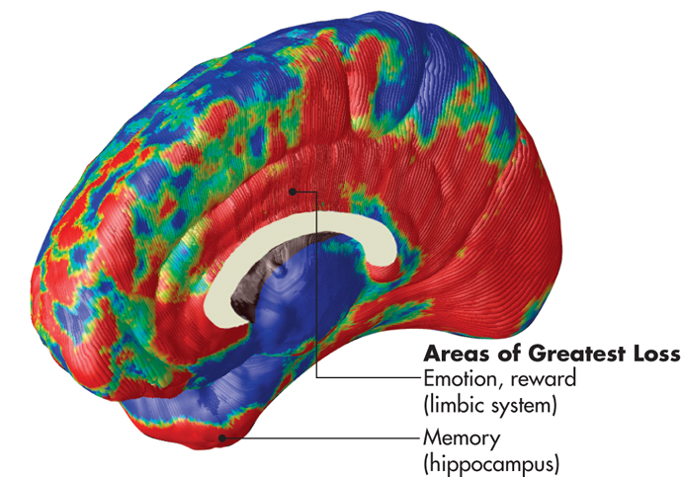
How Methamphetamines Erode the Brain
Thompson, Paul M.; Hayashi, Kiralee M.; Simon, Sara L.; Lonkon,
Edyth D., et al. (2004). Structural abnormalities in the brains
of human subjects who use methamphetamine. Journal of
Neuroscience, 24, 6028–6036.
Notes:
Researcher Paul Thompson and his colleagues (2004) used MRI
scans to compare the brains of chronic methamphetamine users
to those of healthy adults. In the composite scan shown here,
red indicates areas with tissue loss from 5 to 10 percent. Green
indicates 3 to 5 percent tissue loss, and blue indicates relatively
intact brain regions. Thompson found that meth abusers experienced
up to 10 percent tissue loss in limbic system areas
involved in emotion and reward. Significant tissue loss also occurred
in hippocampal regions involved in learning and memory.
”We expected some brain changes, but we didn’t expect so
much brain tissue to be destroyed,” Thompson said. Not surprisingly,
methamphetamine abusers performed more poorly
on memory tests as compared to healthy people the same age
(Thompson & others, 2004).

Slide 56
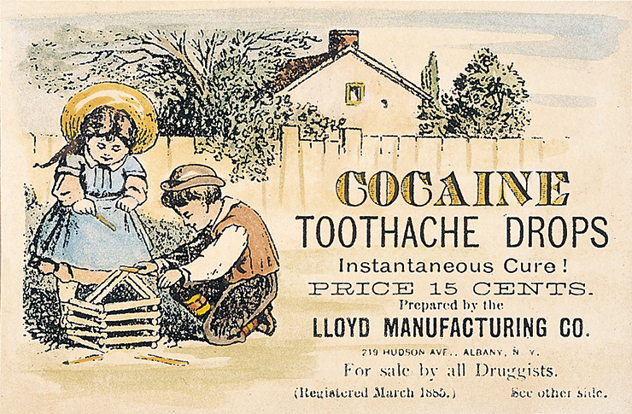
Illegal stimulant derived from the leaves of coca plant
Produces intense euphoria, mental alertness, and self-confidence
Cocaine blocks the reuptake of dopamine, serotonin, norepinephrine
Blocking reuptake potentiates or increases effects of neurotransmitters
Prolonged use of amphetamines can result in stimulant-induced psychosis
Cocaine
A stimulant
Cocaine Toothache Drops?
Notes:
Prior to 1914, cocaine
was legal in the United States and, like the opiates,
was widely used as an ingredient in over-the-counter
medicines (Jonnes, 1999). From this 1885
advertisement for Cocaine Toothache Drops, it’s
clear that cocaine was used to treat children as well
as adults. Cocaine derivatives, such as novocaine
and lidocaine, are still used medically as anesthetics.
Cocaine was also part of Coca-Cola’s original
formula in 1888. It was replaced in 1903 with
another stimulant, caffeine. Coca leaves, with the
cocaine extracted for medical purposes, are still
used for flavoring cola drinks.

Slide 57
Psychedelic Drugs MESCALINE, LSD, AND MARIJUANA
Psychedelic drugs create profound perceptual distortions, alter mood, and affect thinking.
Psychedelic literally means “mind manifesting”.
Kinds
Mescaline
LSD and psilocybin
Marijuana
© John Mitchell/Alamy
Peyote-Inspired Visions
Notes:
The Huichol Indians of Mexico
have used peyote in religious ceremonies for hundreds
of years. Huichol yarn paintings, like the one shown
here, often depict imagery and scenes inspired by traditional
peyote visions. These visions resemble the geometric
shapes and radiating patterns of hallucinations
induced by psychedelic drugs. Today, peyote is used as
a sacrament in the religious ceremonies of the Native
American Church, a religion with more than 300,000
members (Swan & Big Bow, 1995). According to one
study, the use of peyote as a sacrament in the context
of church ritual was not associated with either psychological
or cognitive problems in Navajo members of the
Native American Church (Halpern & others, 2005).

Slide 58
Psychedelic Drugs
Mescaline: Psychedelic drug derived from the peyote cactus
Psiocybin: Psychedelic drug sometimes referred to as “magic mushrooms” or “shrooms”
LSD: Synthetic psychedelic drug
Mimic serotonin in brain
Stimulate serotonin receptor sites in the somatosensory cortex
Adverse reactions to LSD
Flashbacks (recurrences of the drug’s effects)
Depression
Long-term psychological instability
Prolonged psychotic reactions

Slide 59
Psychedelic Drugs
Marijuana
Active ingredient tetrahydrocannabinol, abbreviated THC
Lumping marijuana with the highly psychedelic drugs mescaline and LSD is misleading
At high doses, produce sensory distortions; can interfere with muscle coordination, perception, and driving ability
Neural Action
Naturally occurring brain chemical, called anandamide
Anandamide involved in regulating transmission of pain signals and may reduce painful sensations
Similar to THC
Brain sites have receptors that respond to both

Slide 60
Medical Marijuana
THC has been shown to be helpful in several medical treatment
Pain
Epilepsy
Hypertension
Nausea, especially from chemotherapy
Glaucoma and asthma

Slide 61
Designer “Club” Drugs ECSTASY AND THE DISSOCIATIVE ANESTHETIC DRUGS
MDMA or ecstasy
Synthetic club drug: stimulant, emotional, and mild psychedelic effects
Causes neurons to release serotonin
Blocks serotonin reuptake, amplifying and prolonging serotonin effects
Problems
Dehydration, rapid heartbeat, tremors, muscle tension and involuntary teeth-clenching, and hyperthermia
Damages serotonin nerve endings in the brain causing depression, memory and verbal reasoning problems
Dissociative anesthetics – PCP and Ketamine (Special K)
PCP affects levels of the neurotransmitter glutamate, indirectly stimulating the release of dopamine in the brain
Reduces sensitivity to pain and produces feelings of detachment and dissociation
Users can become severely disoriented, violent, aggressive, or suicidal
High doses of PCP can cause hyperthermia, convulsions, and death

Slide 62
PSYCH FOR YOUR LIFE Overcoming Insomnia
Strategies for preventing sleep problems
Monitor intake of stimulants.
Establish a quiet bedtime routine.
Create the conditions for a restful sleep.
Establish a consistent sleep-wake schedule.

