Slide 2
Learning: Relatively enduring change in behavior or knowledge as a result of experience.
Conditioning: Process of learning associations between environmental events and behavioral responses.

Slide 3
Conditioning, Learning, and Behavior
Through different kinds of experiences, people and animals acquire enduring changes in their behaviors.
Philippe Body/age fotostock
Notes:
Psychologists have identified general principles of learning that explain how we acquire new behaviors. These principles apply to simple responses, but they can also help explain how we learn complex skills, like
the classic Khmer dance routines that these girls are learning in Phnom Penh, Cambodia.

Slide 4
Classical Conditioning
Definition:
The basic learning process that involves repeatedly pairing a neutral stimulus with a response-producing stimulus until the neutral stimulus elicits the same response

Slide 5
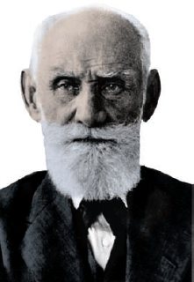
Classical Conditioning
Pavlov
Was Russian physiologist awarded a Nobel Prize for his work on digestion
Discovered and was first to study Pavlovian (classical) conditioning; studied subjective mental processes
Recognized that stimulus under investigation did not produce a new behavior but caused an existing behavior to occur
Popperfoto/Getty Images
Pavlov
Notes:
Classical conditioning explains how certain stimuli can trigger an automatic response.
Operant conditioning is useful in understanding how new, voluntary actions are acquired.
Observational learning occurs when new behaviors are acquired by observing the actions of others.

Slide 6
Classical Conditioning
Is involuntary.
Is passive.
Is also known as:
Associational Learning
Pavlovian Conditioning
Respondent Conditioning

Slide 7
Involuntary behaviors (reflexes) are things like:
Ducking your head when someone throws a ball at your face.
Pulling your hand away when placed on a hot stove.
When your heart rate increases immediately after a “close call” on the interstate.

Slide 8
Classical Conditioning Terms
Unconditioned stimulus (UCS): Natural stimulus that reflexively elicits a response without the need for prior learning
Unconditioned response (UCR): Unlearned, reflexive response that is elicited by an unconditioned stimulus
Conditioned stimulus (CS): Formerly neutral stimulus that acquires the capacity to elicit a reflexive response
Conditioned response (CR): Learned, reflexive response to a conditioned stimulus

Slide 9
Basic Principles of Classical Conditioning Involve
Two stimuli are repeatedly paired.
After repeated pairings, neutral stimulus elicits same basic reflexive response as the natural stimulus.
Pairing a neutral stimulus with an unlearned, natural stimulus that automatically elicits a reflexive response.
This occurs in the absence of the natural stimulus.

Slide 10
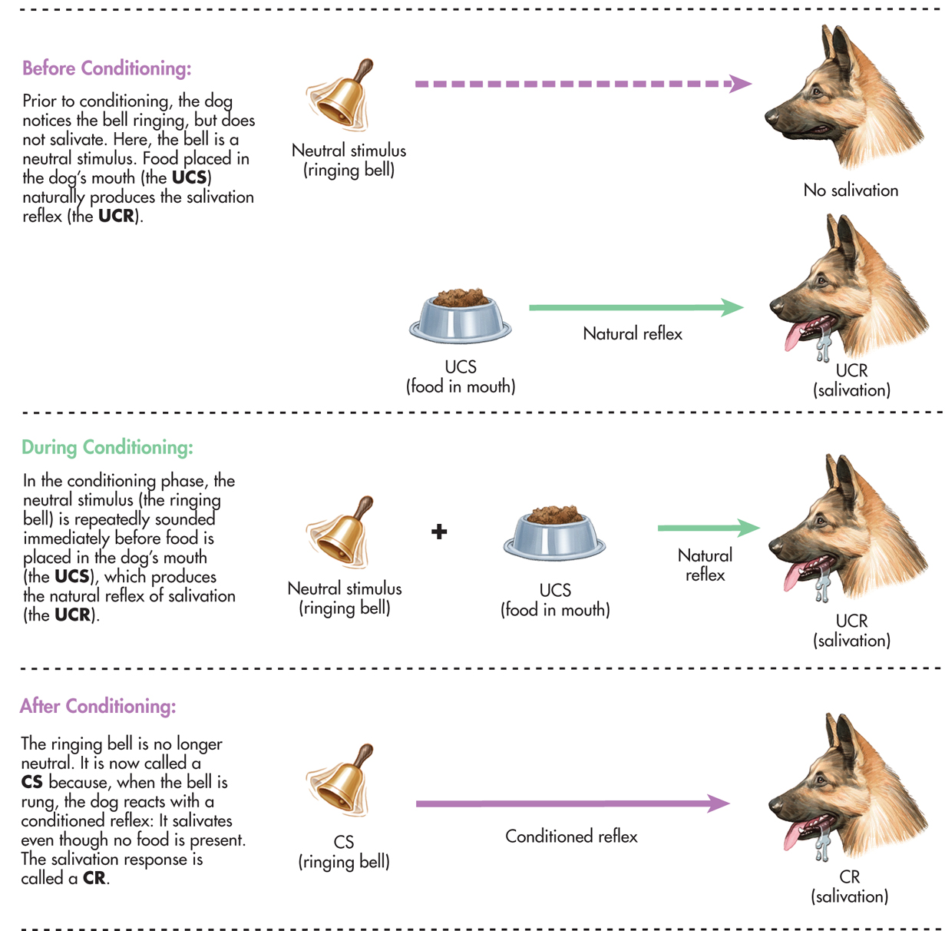
Unconditioned Stimulus
Unconditioned Response
Conditioned Stimulus
Conditioned Response

Slide 11
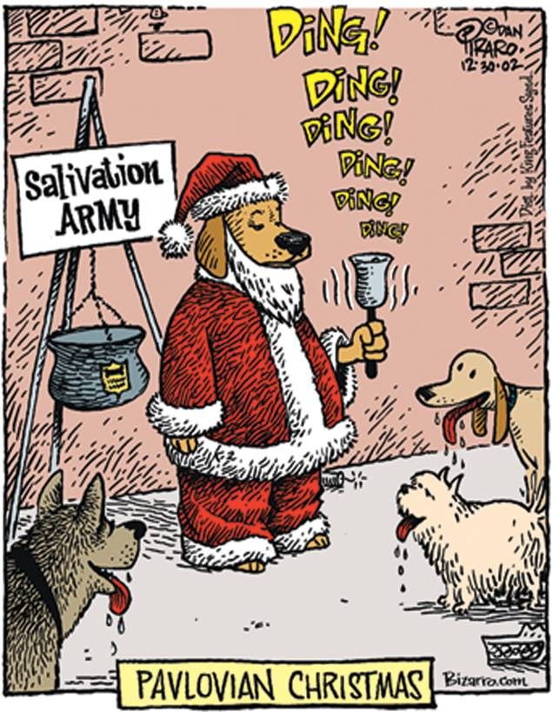

Slide 12
Factors that Affect Conditioning
Timing
Conditioning most effective when conditioned stimulus is presented immediately before unconditioned stimulus
Usually ½ second to a few seconds
Frequency
The more frequently the CS and UCS are paired, the stronger the association.
REUTERS/Stringer

Slide 13
Factors that Affect Conditioning
Stimulus generalization
The occurrence of a learned response not only to the original stimulus but to other, similar stimuli as well
Stimulus discrimination
The occurrence of a learned response to a specific stimulus but not to other, similar stimuli
Higher order conditioning
Procedure in which a conditioned stimulus from one learning trial functions as the unconditioned stimulus in a new conditioning trial; second conditioned stimulus comes to elicit the conditioned response, even though it has never been directly paired with unconditioned stimulus.
REUTERS/Stringer

Slide 14
UCS
Food
UCR
Salivation
CS (UCS)
Bell
CR (UCR)
Salivation
CS
Football
CR
Salivation
Note: The “Food” has never
Been paired with the “Football”
For learning to occur.

Slide 15
Factors that Affect Conditioning
Extinction (in classical conditioning): Gradual weakening and apparent disappearance of conditioned behavior; occurs when the conditioned stimulus is repeatedly presented without the unconditioned stimulus
Spontaneous recovery: Reappearance of a previously extinguished conditioned response after a period of time without exposure to the conditioned stimulus

Slide 16
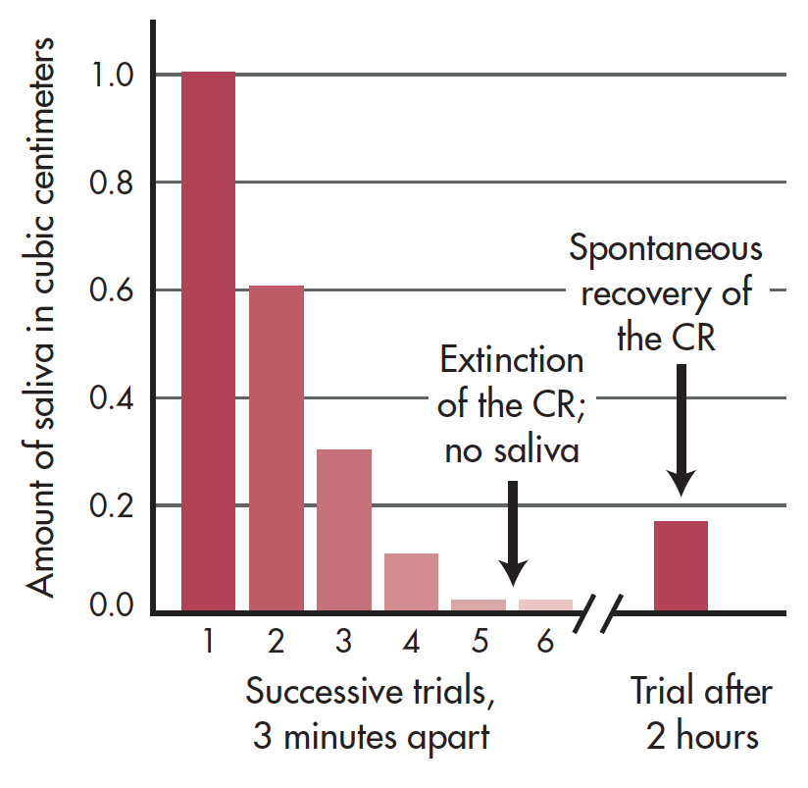
Extinction and Spontaneous Recovery in Pavlov’s Laboratory
This demonstration involved a dog that had already been conditioned to salivate (the CR) to just the sight of the meat powder (the CS).
During the extinction phase, the CS was repeatedly presented at three minute intervals and held just out of the dog’s reach.
As you can see in the graph, over the course of six trials the amount of saliva secreted by the dog quickly decreased to zero. This indicates that extinction had occurred.
After a two-hour rest period, the CS was presented again. At the sight of the meat powder, the dog secreted saliva once more, evidence for the spontaneous recovery of the conditioned response. Source: Data from Pavlov (1927).

Slide 17
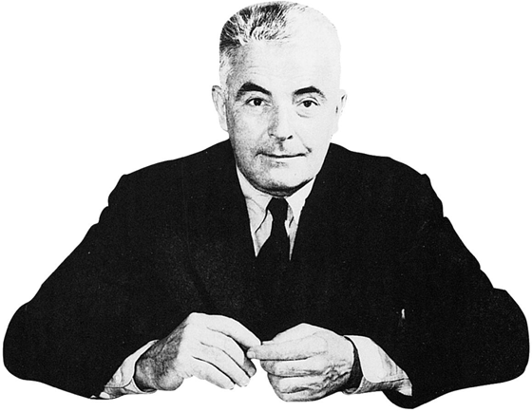
From Pavlov to Watson THE FOUNDING OF BEHAVIORISM
Watson
Founded new approach called behaviorism
Advocated scientific study of objectively observed behavior
Believed all human behavior is result of conditioning and learning
Conducted controversial “Case of Little Albert”
Notes:
Pavlov systematically investigated different aspects of classical conditioning. Pavlov believed he had discovered the mechanism by which all learning occurs, but he did not apply his findings to human behavior.

Slide 18
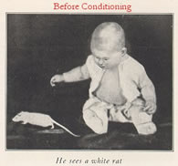
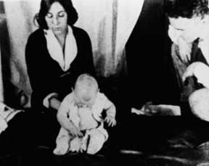
Classically Conditioned Emotional Reactions
John Watson and “Little Albert” 1920
Little Albert learned to fear a white rat when it was paired with a loud noise.

Slide 19
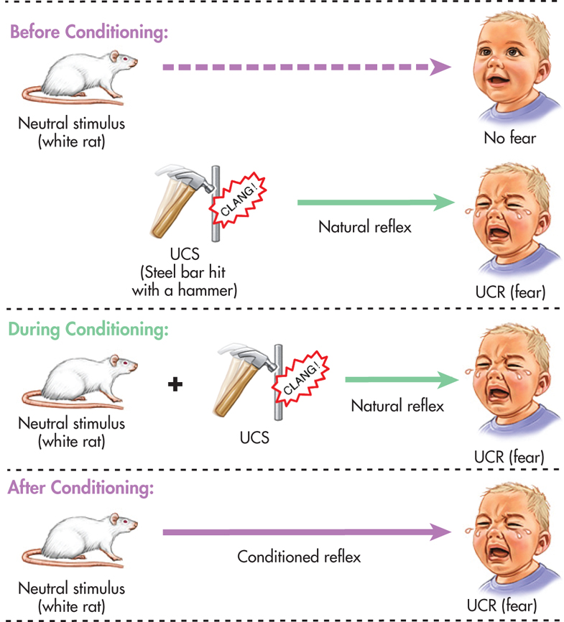
Conditioned Emotional Reactions
The Famous Case of Little Albert. Was It Ethical?

Slide 20
IN FOCUS Watson, Classical Conditioning, and Advertising
John Watson was pioneer in application of classical conditioning principles to advertising.
These principles are widely used in today’s commercials and print ads, pairing emotion-evoking images with otherwise neutral stimuli, like soft drinks or new cars.
Do you think these strategies are effective?

Slide 21
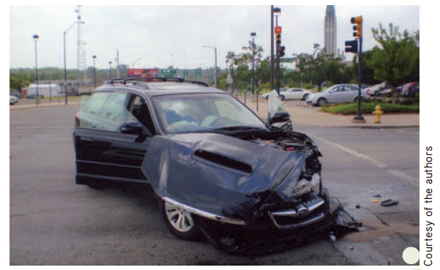
Other Classically Conditioned Responses
Classically Conditioned Emotional Reactions
After being involved in a serious auto accident, many people
develop a conditioned emotional response to the scene
of the accident.
Although the person in this accident wasn’t seriously hurt, just looking at the photo of the
intersection and his totaled car makes his neck tighten up and his heart race.
In this example, can you identify
the UCS, UCR, CS, and CR?

Slide 22
Other Classically Conditioned Responses
Uyen Le/iStockphoto
The Smell of Coffee
Drug Responses
Regular use may produce “placebo response” where user associates sight, smell, taste with the drug effect.
Conditioned compensatory response (CCR)—classically conditioned response in which stimuli that reliably precede the administration of a drug elicit physiological reaction that is opposite to the drug’s effects; may be one explanation for the characteristics of withdrawal and tolerance.
Uyen Le/iStockphoto

Slide 23
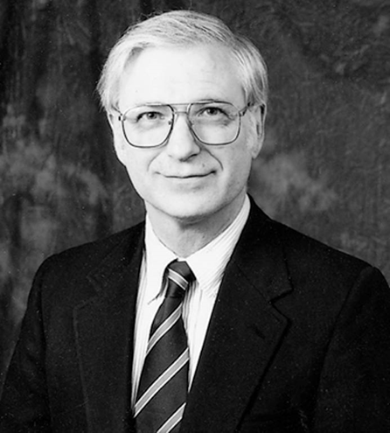
Cognitive Aspects of Classical Conditioning
Robert Rescorla
In Rescorla’s research, rats actively processed information about reliability of signals encountered.
Reliable and unreliable signals need processing:
Conditioned stimulus must be a reliable signal that predicts presentations of unconditioned stimulus.
Through active processing of information, animals assess the predictive value of stimuli.
Notes:
Contemporary learning researchers acknowledge the importance of both cognitive factors and evolutionary influences in classical conditioning

Slide 24
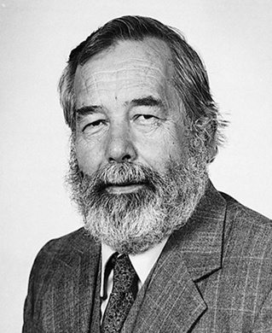
Evolutionary Aspects of Classical Conditioning
Behaviorists originally argued that learning principles applied to all species in the 1960s.
Conditioned taste aversions demonstrated the importance of natural behavior patterns influenced by evolution.
John Garcia demonstrated a classically conditioned dislike for and avoidance of a particular food that develops when an organism becomes ill after eating the food.
This violates standard conditioning model
Only needs one pairing
Time between CS and UCS can be several hours
One factor that helps explain Garcia’s results is biological preparedness.
Notes:
Biological preparedness: Organism is innately predisposed to form associations between certain stimuli and responses

Slide 25
Taste Aversion
UCS
Poison, bacteria, virus, etc.
UCR
ill
CS
The “food” (i.e., spaghetti, jello, caviar, etc.)
CR
avoid

Slide 26
IN FOCUS Evolution, Biological Preparedness, and Conditioned Fears
Because poisonous snakes, reptiles, and insects have been associated with danger throughout the evolution of mammals, there is an evolved “fear module” in the brain that is highly sensitized to such evolutionarily relevant stimuli.
Seligman
Phobias seem to be quite selective. Extreme, irrational fears of snakes, spiders, heights, and small enclosed places are relatively common.
Humans biologically prepared to develop fears of objects or situations such as snakes, spiders, and heights—that may once have posed a threat to humans’ evolutionary ancestors.
Öhman and Mineka

