Slide 1
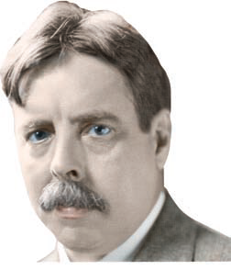
Operant Conditioning: Associating Behaviors and Consequences
Operant conditioning deals with the learning of active, voluntary behaviors that are shaped and maintained by their consequences. First called “instrumental conditioning.”
Thorndike
First psychologist to systematically investigate animal learning and how voluntary behaviors are influenced by their consequences
Trial and error
Law of effect
Humanities and Social Science Library/New York Public
Library/Photo Researchers
Edward Lee Thorndike

Slide 2
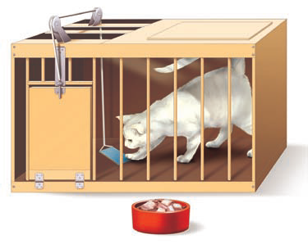
Operant Conditioning
Thorndike and the Law of Effect
Responses followed by a satisfying effect become strengthened and are more likely to recur in a particular situation.
Responses followed by a dissatisfying effect are weakened and less likely to recur in a particular situation.
Cats had to escape from a “puzzle” box
Process was by trial and error
Observation led to Law of Effect
Notes:
Shown above is one of Thorndike’s puzzle boxes, which were made mostly out of wood slats and wire mesh. Thorndike constructed a total of 15 different puzzle boxes, which varied in how difficult they were for a cat to escape from. In a simple box like this one, a cat merely had to step on a treadle at the front of the cage to escape. More complex boxes required the cat to perform a chain of three responses—step on a
treadle, pull on a string, and push a bar up or down (Chance, 1999).

Slide 3
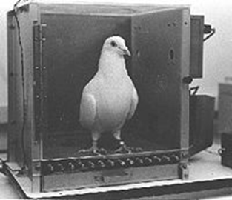
Believed that psychology should restrict itself to studying only phenomena that could be objectively measured and verified—outwardly observable behavior and environmental events
Coined the term operant to describe any “active” behavior that operates upon the environment to generate consequences
Invented the Skinner box
Bettmann/Corbis
B. F. Skinner and the Search for “Order in Behavior”

Slide 4
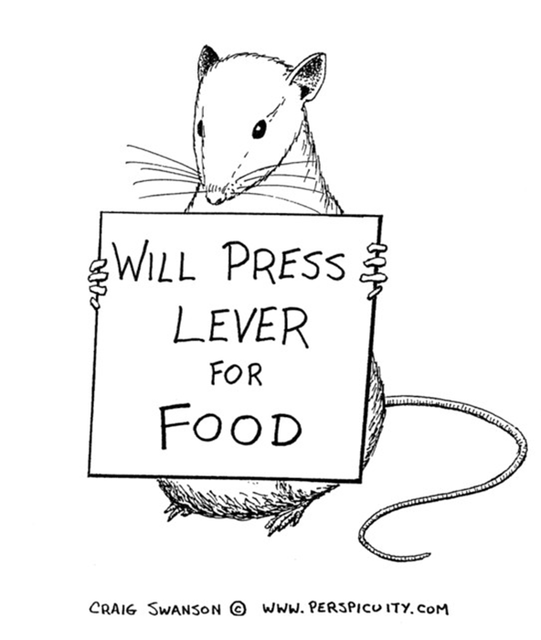

Slide 5
Reinforcement: always increases behavior
Two forms of reinforcement
Positive: Response is followed by the addition of a reinforcing stimulus, increasing the likelihood that the response will be repeated in similar situations
Negative: Response results in the removal of, avoidance of, or escape from a punishing stimulus, increasing the likelihood that the response will be repeated in similar situations
Notes:
Operant conditioning explains learning as a process in which behavior is shaped and maintained by its consequences. One possible consequence of a behavior is reinforcement.
Negative reinforcement
Aversive stimuli involve physical or psychological discomfort that an organism seeks to escape or avoid. Behaviors are said to be negatively reinforced when they let you either
(1) Escape aversive stimuli that are already present, or
(2) Avoid aversive stimuli before they occur.
Escape behavior; avoidance behavior

Slide 6
Reinforcement
Two forms of reinforcing stimuli
Primary reinforcer: Stimulus or event that is naturally or inherently reinforcing for a given species, such as food, water, or other biological necessities
Secondary (conditioned) reinforcer: Stimulus or event that has acquired reinforcing value by being associated with a primary reinforcer such as money

Slide 7
Avoidance and Escape Conditioning (to “aversive” stimuli) (often times involves negative reinforcement)
Avoidance Conditioning
Learning a desired behavior to prevent the occurrence of something unpleasant such as a punishment
Escape Conditioning
Learning a desired behavior to exit something that is unpleasant.

Slide 8
Punishment: always decreases behavior
Punishment is process in which a behavior is followed by an aversive consequence that decreases the likelihood of behavior’s being repeated
Many people confuse punishment and negative reinforcement.
Two types of punishment identified by Skinner
Punishment by application: a situation in which an operant is followed by presentation or addition of an aversive stimulus; also called positive punishment
Punishment by removal: a situation in which an operant is followed by the removal or subtraction of a reinforcing stimulus; also called negative punishment

Slide 9
Punishment
Punishment by application
You forget to wear your nametag to work and your supervisor gives you a “write up.”
Punishment by removal
You don’t eat all of your dinner so you don’t get dessert.

Slide 10
Comparing Punishment and Negative Reinforcement
To identify the type of reinforcement or punishment that has occurred, determine whether the stimulus is aversive or reinforcing and whether it was presented or removed following the operant.
Process | Operant | Consequence | Effect on Behavior
Punishment | Wear a warm but unstylish flannel shirt | A friend makes the hurtful comment, “Nice shirt. Whose couch did you steal to get the fabric?” | Decrease wearing the shirt in the future
Negative reinforcement | Wear a warm but unstylish flannel shirt | Avoid feeling cold and uncomfortable all day | Increase wearing the shirt in the future

Slide 11
Is Spanking Effective?
Spanking is a common form of discipline used in the U.S.
Some researchers believe that mild and effective spanking is not necessarily harmful.
Other research demonstrates that physical punishment is associated with increased child aggressiveness, delinquency, and antisocial behavior. Additionally there is an increased risk that such discipline might escalate into physical abuse.
So what do you think?

Slide 12
Drawbacks to Punishment
Punishment only suppresses behavior. It does not teach the desired behavior.
Punishment can produce undesirable results such as hostility, fear, anger.
Punishment may teach undesirable aggressive behavior.
Effects of punishment might be temporary.

Slide 13
IN FOCUS Changing the Behavior of Others: Alternatives to Punishment
Although punishment may temporarily decrease the occurrence of a problem behavior, it doesn’t promote more desirable or appropriate behaviors in its place.
Four strategies to reduce undesirable behaviors without resorting to punishment:
Strategy 1: Reinforce an incompatible behavior.
Strategy 2: Stop reinforcing the problem behavior.
Strategy 3: Reinforce the nonoccurrence of the problem behavior.
Strategy 4: Remove the opportunity to obtain positive reinforcement.

Slide 14
Premack principle
Get subject to do a lesser desired behavior by rewarding subject with activity they would prefer to do.
“If you finish your homework today, I’ll take you shopping tomorrow.”

Slide 15
CRITICAL THINKING Is Human Freedom Just an Illusion?
Skinner proposed that operant conditioning principles could be applied to help solve societal problems.
Behavior is determined by the environment → Control the environment
Society could be redesigned using operant conditioning principles to produce more socially desirable behaviors (Walden Two)
How does the gamification movement support or refute Skinner’s ideas?
Notes:
In a movement called gamification advocates turning daily life into a kind of virtual reality game, in which “points” or other conditioned reinforcers are awarded to reward healthy or productive behaviors (Campbell, 2011). For example, some businesses give reductions on health insurance premiums to employees who rack up enough points on a specially equipped pedometer that monitors their daily activity level.

Slide 16
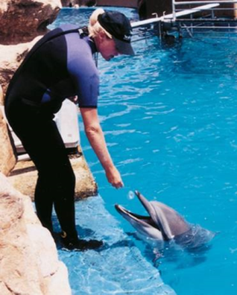
Operant Conditioning Terms
Discriminative stimulus
Specific stimulus in the presence of which a particular operant is more likely to be reinforced
Shaping
Selectively reinforcing successively closer approximations of goal behavior until goal behavior is displayed
Extinction
Gradual weakening and disappearance of conditioned behavior; occurs when an emitted behavior is no longer followed by a reinforcer

Slide 17
Key Components of Operant Conditioning
In the presence of a specific environmental stimulus (discriminative stimulus), we emit a particular behavior (operant), which is followed by a consequence (reinforcement or punishment).
If the consequence is either positive or negative reinforcement, we are more likely to repeat the operant when we encounter the same or similar discriminative stimuli in the future.
If the consequence is some form of punishment, we are less likely to repeat the operant when we encounter the same or similar discriminative stimuli in the future.
Notes:
Discriminative stimulus: Specific stimulus in the presence of which a particular operant is more likely to be reinforced

Slide 18
The Partial Reinforcement Effect and Schedules of Reinforcement
Early work by Skinner used continuous reinforcement: a schedule of reinforcement in which every occurrence of a particular response is reinforced.
Running out of food for his rats, Skinner stretched out the pellets by not rewarding every trial and discovered the partial reinforcement effect.
Partial reinforcement effect: Behaviors that are conditioned using partial reinforcement are more resistant to extinction than behaviors that are conditioned using continuous reinforcement.

Slide 19
Schedules of Reinforcement
Skinner (1956) found that specific preset arrangements of partial reinforcement produced different patterns and rates of responding (schedules of reinforcement).
Fixed-ratio (FR) schedule
Variable-ratio (VR) schedule
Fixed-interval (FI) schedule
Variable-interval (VI) schedule
Let’s look at the next slide to see the typical response pattern produced by each schedule.
Notes:
Schedule of reinforcement: The delivery of a reinforcer according to a preset pattern based on the number of responses or the time interval between responses.
Fixed-ratio (FR) schedule: A reinforcement schedule in which a reinforcer is delivered after a fixed number of responses has occurred.
Variable-ratio (VR) schedule: A reinforcement schedule in which a reinforcer is delivered after an average number of responses, which varies unpredictably from trial to trial.
Fixed-interval (FI) schedule: A reinforcement schedule in which a reinforcer is delivered for the first response that occurs after a preset time interval has elapsed.
Variable-interval (VI) schedule: A reinforcement schedule in which a reinforcer is delivered for the first response that occurs after an average time interval, which varies unpredictably from trial to trial.

Slide 20
Schedules of Reinforcement
Fixed Ratio (FR)
FR-100: Paid $10 for every 100 envelopes you stuff
Variable Ratio (VR)
VR-25: On average, you are rewarded after 25 attempts
“Gambler’s schedule”

Slide 21
Schedules of Reinforcement
Fixed Interval (FI)
FI-2: Pop quiz is given every 2 days. So, you study more right before the quiz than right after one. (scalloping)
Variable Interval (VI)
VI-30: On average, you are rewarded with a “hit” every 30 seconds when you play your favorite video game.

Slide 22
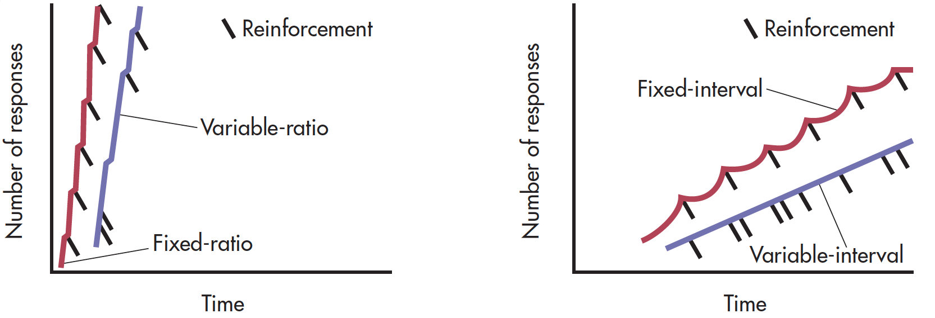
Schedules of Reinforcement and Response Patterns
Notes:
Different patterns of responding are produced by the four basic schedules of reinforcement.
Left: The predictable nature of a fixed-ratio schedule (the red line) produces a high rate of responding, with a pause after the reinforcer is delivered.
The unpredictable nature of variable-ratio schedules (purple) also produces high, steady rates of responding, but with hardly any pausing between reinforcers.
Right: Fixed-interval schedules (red) produce a scallop-shaped pattern of responding. The unpredictable nature of variable-interval schedules (purple) produces a moderate but steady rate of responding.

Slide 23
Applications of Operant Conditioning
Applications of Operant Conditioning
Clinical Psychology – dealing with counterproductive behaviors
Sports Training – aiding performance
Education and Working with Students – improving grades and study habits
Business – increasing productivity

