Slide 1
Contemporary Views of Operant Conditioning
Tolman
Cognitive processes play important role in complex behavior learning
Although these processes cannot be directly observed, these can be experimentally verified and inferred by careful observation of outward behavior
Cognitive maps
Strengthened behavior

Slide 2
Cognitive Aspects of Operant Conditioning
Cognitive map—term for a mental representation of the layout of a familiar environment (Tolman)
Latent learning—learning that occurs in the absence of reinforcement, but is not demonstrated until a reinforcer is available (Tolman’s rats p. 211) (see next slide)
Learned helplessness—phenomenon in which exposure to inescapable and uncontrollable aversive events produces passive behavior (Seligman)

Slide 3
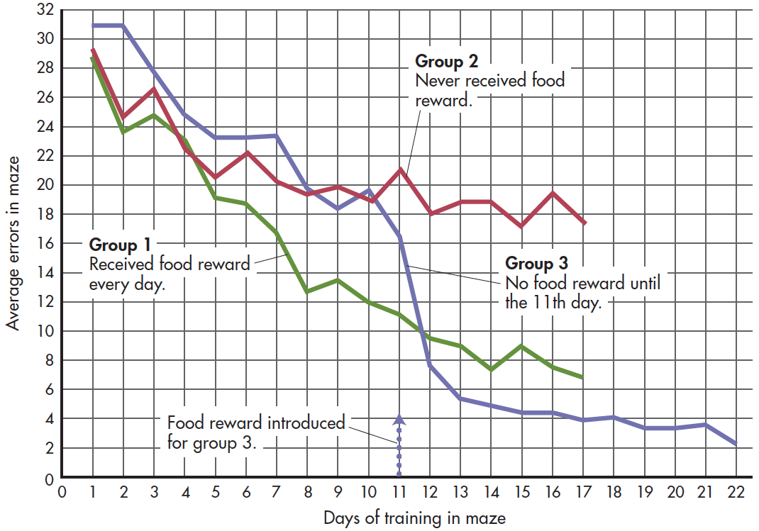
Tolman: Cognitive Maps and Latent Learning

Slide 4
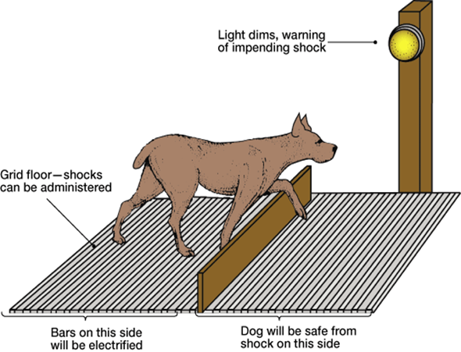
Learned Helplessness
Seligman (b. 1942) began his research career by studying learned helplessness in dogs, and later, in humans.
He applied his findings to psychological problems, including depression.
Seligman developed techniques to teach people to overcome feelings of helplessness, habitual pessimism, and depression

Slide 5
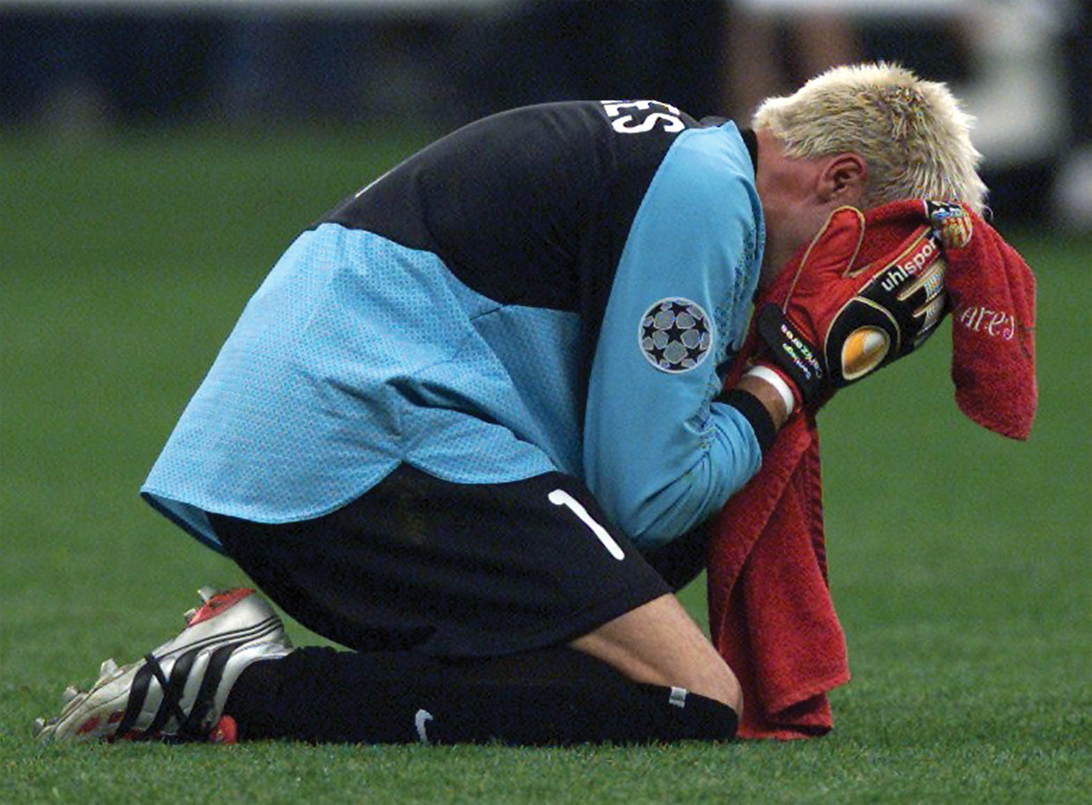
Cognitive Aspects Continued
Learned Helplessness (Seligman)
Learned helplessness is the phenomenon in which exposure to inescapable and uncontrollable aversive events produces passive behavior.
The cognitive expectation that behavior would have no effect on the environment causes a person or animal to become passive.
This can be seen in studying behavior, athletic performance, and psychological disorders such as depression management.
REUTERS/Dylan Martinez

Slide 6
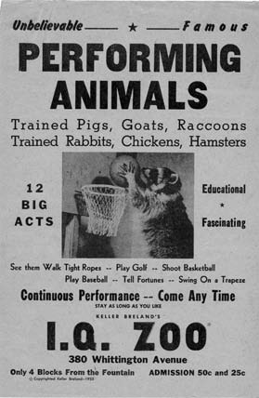
Operant Conditioning and Biological Predispositions
Skinner and other behaviorists firmly believed that general laws of operant conditioning applied to all animal species.
Others (like Brelands) found that an animal’s natural behavior patterns could influence the learning of new behaviors based on biological and evolutionary predispositions.
The principle of instinctive drift (naturally occurring behaviors that interfere with operant responses) prevented the animals from engaging in the learned behaviors that would result in reinforcement.
Robert E. Bailey

Slide 7
Comparing Classical and Operant Conditioning
 | Classical Conditioning | Operant Conditioning
Type of behavior | Reflexive, involuntary behaviors | Nonreflexive, voluntary behaviors
Source of behavior | Elicited by stimulus | Emitted by organism
Basis of learning | Associating two stimuli: CS + UCS | Associating a response and the consequence that follows it
Responses conditioned | Physiological and emotional responses | Active behaviors that operate on the environment
Extinction process | Conditioned response decreases when conditioned stimulus is repeatedly presented alone | Responding decreases with elimination of reinforcing consequences
Cognitive aspects | Expectation that CS reliably predicts the UCS | Performance of behavior influenced by the expectation of reinforcement or punishment
Evolutionary influences | Innate predispositions influence how easily an association is formed between a particular stimulus and response | Behaviors similar to natural or instinctive behaviors are more readily conditioned

Slide 8
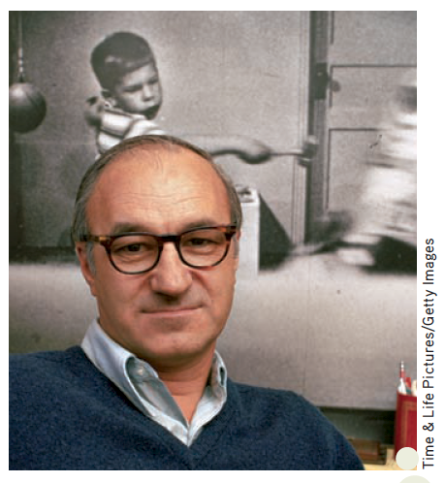
Observational Learning (Social Learning, Vicarious Learning)
The Bobo Doll Study
Bandura demonstrated the influence of observational learning in a series of experiments conducted in the early 1960s. Children watching a violent video clip seemed to imitate aggressive behavior.
Demonstrated the principle that expectation of reinforcement (by watching someone being rewarded) can act to reinforce a behavior.
Albert Bandura (b. 1925) Bandura contends that most human behavior is acquired through observational learning.

Slide 9
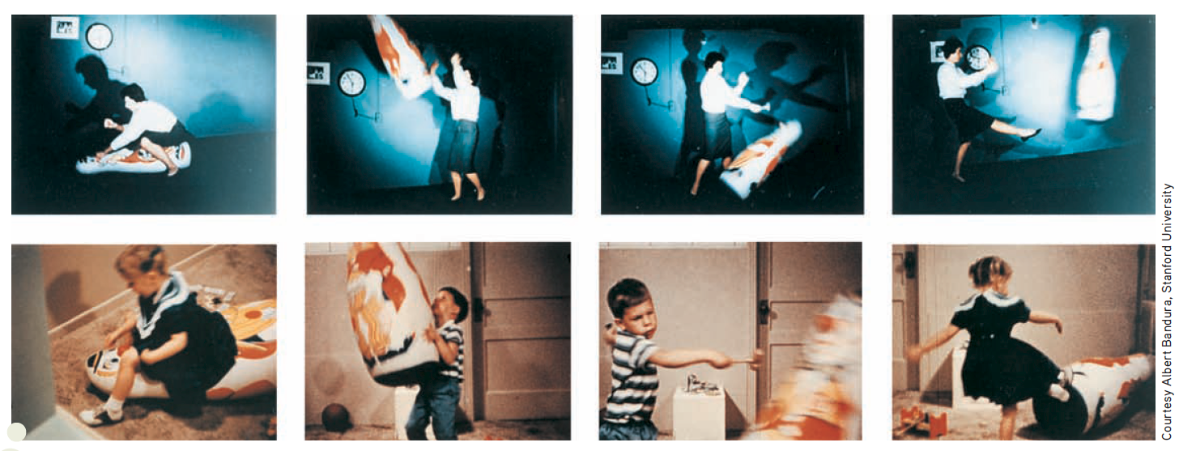
Classic Bobo Doll Experiment
Notes:
Bandura demonstrated the powerful influence of observational learning in a series of experiments conducted in the early 1960s. Children watched a film showing an adult playing aggressively with an inflated Bobo doll. If they saw the adult rewarded with candy for the aggressive behavior or experience no consequences, the children were much more likely to imitate the behavior than if they saw the adult punished for the aggressive behavior (Bandura, 1965; Bandura & others, 1963).

Slide 10
Cognitive Processes involved in imitation
Pay attention to the model (attention)
Remember the model’s behavior (memory)
Have the ability to perform the model’s behavior (motor skills)
Motivation to attempt the behavior (motivation) (see next table)

Slide 11
Factors That Increase Imitation
You’re more likely to imitate:
People who are rewarded for their behavior
Warm, nurturing people
People who have control over you or have the power to influence your life
People who are similar to you in terms of age, sex, and interests
People you perceive as having higher social status
When the task to be imitated is not extremely easy or difficult
If you lack confidence in your own abilities in a particular situation
If the situation is unfamiliar or ambiguous
If you’ve been rewarded for imitating the same behavior in the past

Slide 12
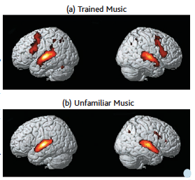
FOCUS ON NEUROSCIENCE Mirror Neurons: Imitation in the Brain
Mirror neurons
Reflect visual processing and mentally represent and interpret the actions of others
May play a role in empathy, language, and social cognition or contribute to autism and other social functioning disorders (more scientific evidence needed)
Music to the ears—and brain!
Notes:
Musical Mirror Neurons
Non-musicians were trained to play a piece of music by ear on a piano keyboard, then underwent a series of fMRI scans (Lahav & others, 2007). Panel (a) shows the participants’ brain activity as they listened to the
same music they had already learned to play. Even though they were not moving as they lay in the scanner, motor areas of the brain were activated (dark red). The brighter red/yellow color indicates activation in the brain’s auditory areas. Panel (b) shows participants’ brain activity while they listened to unfamiliar music utilizing the same musical notes but in a different sequence. As you compare the scans in (a) and (b), notice the extensive activation in motor-related brain regions when the participants listened to the music that they had already learned to play, as in (a). However, these motor areas were not activated when they listened to the unfamiliar music that they had never played, as in (b).

