Slide 2
Memory: A group of related mental processes that are involved in acquiring, storing, and retrieving information

Slide 3
What Is Memory?
Three major processes
Encoding: transforming information into a form that can be entered and retained by memory system
Storage: retaining information in memory so that it can be used at a later time
Retrieval: recovering stored information for conscious awareness

Slide 4
The Stage Model of Memory
Information is transferred from one memory stage to another
Sensory Memory
Registers a great deal of information from environment for a very brief period
Short-term Memory Temporarily holds all the information you are currently thinking about or consciously aware of
Long-term Memory Long-term storage of information, potentially for a lifetime

Slide 5
The Stage Model of Memory

Slide 6
Sensory Memory
Function of sensory memory is to very briefly store sensory impressions so that they overlap slightly with one another
Used to perceive the world as continuous, rather than as a series of disconnected visual images or disjointed sounds
Capacity: unlimited

Slide 7
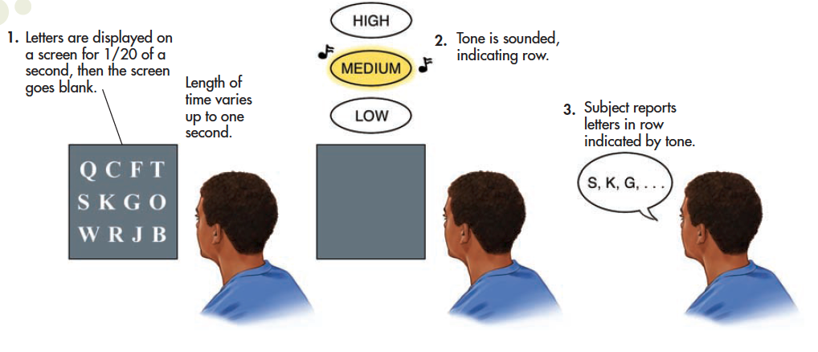
Sperling’s Experiment Demonstrating the Duration of Sensory Memory
Notes:
This figure depicts George Sperling’s classic 1960 experiment.
Subjects stared at a screen on which rows of letters were projected for just one-twentieth of a second, then the screen went blank.
After intervals varying up to one second, tone was sounded that indicated the row of letters the subject should report.
If the tone was sounded within about one-third of a second, subjects were able to report the letters in the indicated row because the image of all the letters was still in sensory memory.

Slide 9
G E N P
X I W L
K A I H

Slide 10
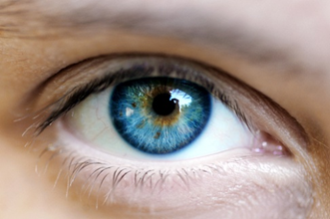
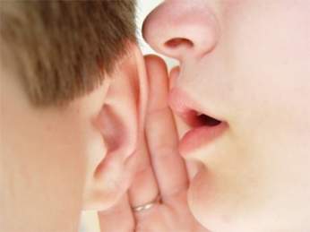
Sperling’s Experiment Duration of Sensory Memory
Visual sensory memory is sometimes referred to as iconic memory because it is the brief memory of an image, or icon.
Duration: approximately ¼ to ½ of a second
Measured first by George Sperling using partial report technique
Auditory sensory memory is sometimes referred to as echoic memory, meaning a brief memory that is like an echo.
Lasts up to three or four seconds

Slide 11
Short-Term Working Memory
STM provides temporary storage for information transferred from sensory and long-term memory.
Duration – about 20 seconds
Can be retained longer through maintenance rehearsal
Mental or verbal repetition of information
Information loss may be due to decay or interference from new or competing information

Slide 12
Maintenance (Rote) Rehearsal
Mental or verbal repetition of information allows information to remain in working memory longer than the usual 20 seconds, usually without meaning

Slide 13
Short-Term Working Memory
Capacity
Described by George Miller as “The Magical Number Seven, Plus or Minus Two”
Can be increased by chunking; maintenance rehearsal to encode
Current research suggests that the true “magical number” is four plus or minus one when chunking not an option (Cowan)

Slide 14
Demonstration of Short-Term Memory Capacity
Row 1 — 8 7 4 6
Row 2 — 3 4 9 6 2
Row 3 — 4 2 7 7 1 6
Row 4 — 5 1 4 0 8 1 3
Row 5 — 1 8 3 9 5 5 2 1
Row 6 — 2 1 4 9 7 5 2 4 8
Row 7 — 9 3 7 1 0 4 2 8 9 7
Row 8 — 7 1 9 0 4 2 6 0 4 1 8

Slide 15
Chunking
Grouping small bits of information into larger units of information
expands working memory load
Which is easier to remember?
UAVFCIDBDSAI
DVDFBIUSACIA

Slide 16
From Short-Term Memory to Working Memory
Baddeley’s model of working memory
The terms working memory and short-term memory are sometimes used interchangeably
Working memory refers to the active, conscious manipulation of temporarily stored information with three main components, each of which can function independently
Phonological Loop: specializes in verbal material
Visuospatial Sketchpad: visual or spatial material
Central Executive: retrieves from LTM if needed
Notes:
Suppose you are trying to figure out the fastest way to get to a friend’s house. In Baddeley’s model of working memory, you would use the phonological loop to verbally recite the directions. Maintenance rehearsal helps keep the information active in the phonological loop. You would use the visuospatial sketchpad to imagine your route and any landmarks along the way. The central executive actively processes and integrates information from he phonological loop, the visuospatial sketchpad, and long-term memory.

Slide 17
Long-term Memory
Once information passes from sensory to working (short term) memory, it can be encoded into long-term memory
Maintenance Rehearsal
Sensory
Memory
Working or
Short-term
Memory
Encoding
Long-term
Memory
Sensory
Input
Attention
Retrieval

Slide 18
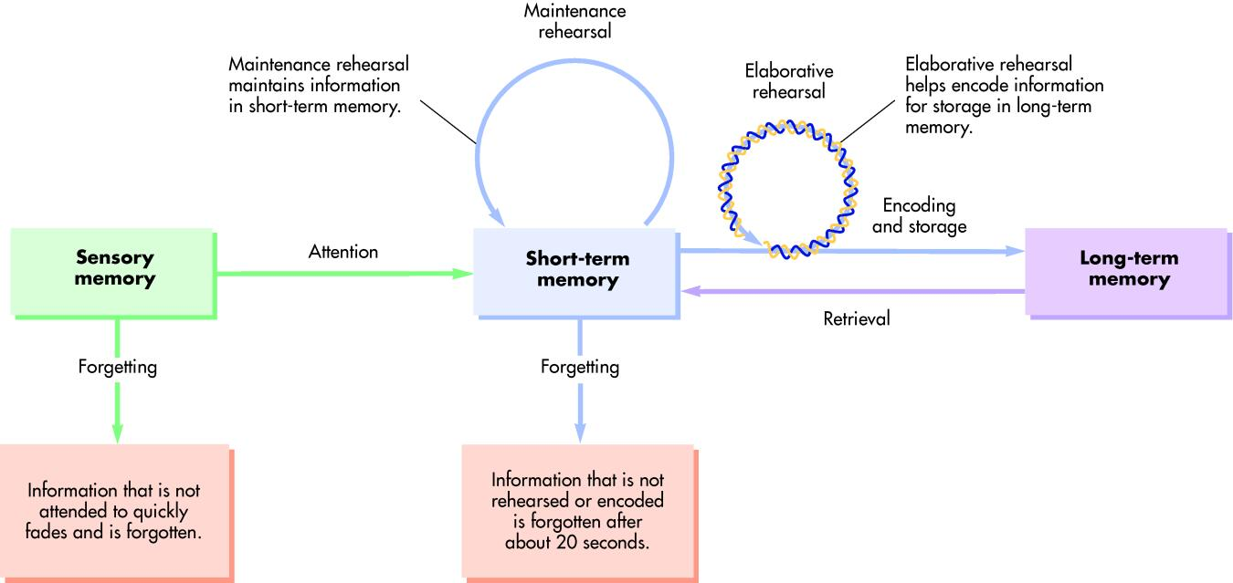

Slide 19
Long-Term Memory
LTM provides storage for information for extended period of time.
Duration – longer than 20 seconds
Capacity--limitless
Involves quick retrieval with little effort

Slide 20
Long-Term Memory: Encoding
Elaborative rehearsal
Focus on the meaning of the information
Relate the info to things you already know
Self-reference effect
Apply information to yourself
Visual imagery
Images can help your memory

Slide 21
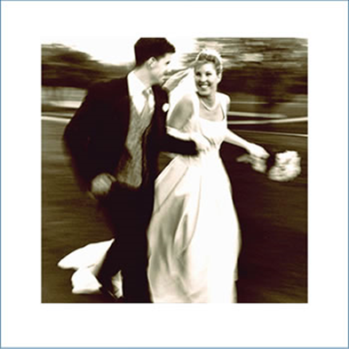
Long-Term Memory: Storage
Procedural memory – how to perform different skills, operations, and actions
Episodic memory – memory of specific events or episodes
Autobiographical memory – memory of life events
Semantic memory – general knowledge

Slide 22
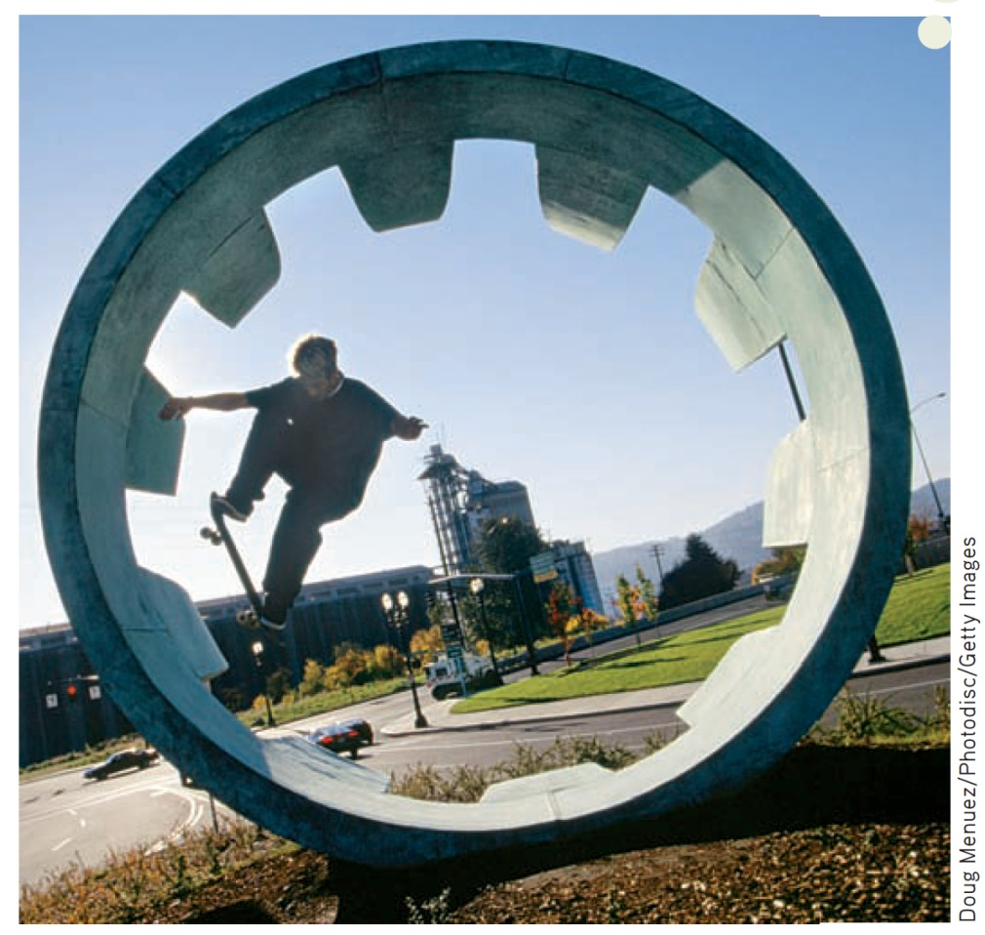
Types of Information Stored in Long-Term Memory
A memorable skateboard ride involves three types of long-term memory: procedural, semantic & episodic.
Remembering how to steer and balance on a skateboard are examples of procedural memory.
Knowing the names of the different parts of the skateboard would be examples of semantic memory.
And, the young man’s vivid memory of the day he rode his skateboard in a huge drainpipe would be an example of an episodic memory.

Slide 23
Types of Information in Long-Term Memory: Three Major Categories

Slide 24
Episodic Memory
Memory tied to your own personal experiences
Examples:
What month is your birthday?
Do you like to eat caramel apples?
Q: Why are these explicit memories?
A: Because you can actively declare your answers to these questions

Slide 25
Semantic Memory
Memory not tied to personal events
General facts and definitions about the world
Examples:
How many tires on a car?
What is a cloud?
What color is a banana?

Slide 26
Procedural Memory
Memory that enables you to perform specific learned skills or habitual responses
Examples:
Riding a bike
Using the stickshift while driving
Tying your shoe laces
Q: Why are these procedural memories implicit?
A: You don’t have to consciously remember the steps involved in these actions to perform them
Try to explain to someone how to tie a shoelace

Slide 27
Implicit and Explicit Memory: Two Systems of LTM
Explicit memory (declarative memory) is memory with awareness
Information or knowledge that can be consciously recollected
Two types of explicit memory
Implicit memory (nondeclarative memory) is memory without awareness
Information or knowledge that affects behavior or task performance but cannot be consciously recollected
Procedural information--Motor skills, actions
Episodic information—information about events or “episodes”
Semantic information—information about facts, general knowledge, school work

Slide 28
Culture and Memory
Cross-cultural research shows how culture helps shape one’s sense of self.
Earliest autobiographical memories are for events that occurred between the ages of two and four.
Cultural differences in autobiographical memory are formed in very early childhood, through interaction with family members.
American memories: Discrete, reflecting individual experiences or feelings
Chinese and Taiwanese memories: General, routine activities with family, schoolmates, or community members, brief accounts that centered on collective activities
Dean Conger/Corbis
Notes:
Psychologist Qi Wang (2013) found that the earliest memories of Chinese and Taiwanese adults tended to focus on routine activities that they shared with other members of their family or social group rather than
individual events. Perhaps years from now, these children will remember walking with their preschool friends to play in the park.

Slide 29
The Organization of Information in Long-Term Memory
Clustering
Related items are clustered together to form higher-order categories.
List items remembered better if list presented in categories.
Poorer recall occurs with random presentation.
Even if list items are random, people still organize information into some logical pattern.

Slide 30
Side note:
Clustering is a Long-Term phenomenon.
Chunking is a Short-Term phenomenon.

Slide 31
Clustering Demonstration
chair
boat
footstool
orange
pear
peach
bed
bus
train
plum
grapes
motorcycle
apple
car
airplane
lamp
banana
dresser
sofa
bookcase
truck
table
strawberry
bicycle
Notes:
Study the words on this list for one minute. Then count backward by threes from 108 to 0. When you’ve completed that task, write down as many of the words from the list as you can remember.

Slide 32
Semantic Network Model
Mental links form between concepts.
Common properties provide basis for mental link.
Shorter path between two concepts = stronger association in memory.
Concept is activated in semantic network, spread in any number of directions, activating other associations in network.
For example, the word red might activate “blue” (another color), “apple” or “fire truck” (objects that are red), or “alert” (as in the phrase “red alert”).
Useful as metaphor, but not an actual brain structure.

Slide 33
Long-Term Memory: Retrieval
In many instances, ability to retrieve stored memory hinges on having an appropriate retrieval cue.
Retrieval
Retrieval cue
Retrieval cue failure
Notes:
Forgetting is the inability to retrieve previously available information.
Retrieval refers to the process of accessing and retrieving stored information in long-term memory.
Retrieval cue is a clue, prompt, or hint that can help trigger recall of a stored memory.
Retrieval cue failure refers to inability to recall long-term memories because of inadequate or missing retrieval cues.

Slide 34
The Tip-of-the-Tongue (TOT) Experience
TOT involves the sensation of knowing that specific information is stored in long-term memory but being unable to retrieve it.
People have about one TOT experience per week.
People can dredge up partial response.
TOT occurs with ASL users.
About half the time, people can accurately identify first letter of the target word and number of syllables in it.
They can also often produce words with similar meanings or sounds.
90 percent of TOT experiences are eventually resolved, often within a few minutes.

Slide 35
Testing Retrieval
Cued recall
test of LTM that involves remembering an item of information in response to a retrieval cue
Recognition
test of LTM that involves identifying correct information from a series of possible choices
Recall
test of LTM that involves retrieving memories without cues; also termed free recall

Slide 36
The Serial Position Effect
Serial position effect—
tendency to remember items at the beginning and end of a list better than items in the middle
There are two parts to the serial position effect.
Primacy effect: The tendency to recall the first items in a list
Recency effect: The tendency to recall the final items in a list
Christina Aguilera botched the Star-Spangled Banner when she performed at the 2011 Super Bowl. Even seasoned performers are not immune to the serial position effect!
AP Photo/Paul Spinelli

Slide 37
Encoding Specificity Principle
When conditions of retrieval are similar to conditions of encoding, retrieval is more likely to be successful.
People are more likely to remember things if the conditions under which they recall them are similar to the conditions under which they learned them.
Context effects Tendency to remember information more easily when the retrieval occurs in the same setting in which you originally learned the information
Mood congruence Factors related to mood or emotion

Slide 38
Context Effect & Mood Congruence

Slide 39
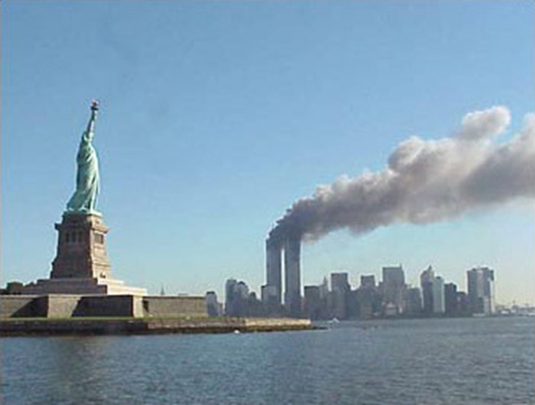
Flashbulb Memories
These memories are thought to involve the recall of very specific details or images surrounding a significant, rare, or vivid event
However, research demonstrates:
Both flashbulb and everyday memories gradually decayed over time.
Flashbulb memories are emotionally charged, but they are not necessarily more accurate than memories of more common events.
Notes:
Can you remember where you were when you learned of the death of Michael Jackson? Of the bombing at the Boston Marathon? Supposedly, shocking national or international events can trigger highly accurate,
long-term flashbulb memories. But meaningful personal events, such as your high school graduation or wedding day, are also said to produce vivid flashbulb memories.

Slide 40
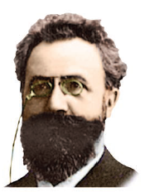
Forgetting
Ebbinghaus
First began to study forgetting by using nonsense syllables, like:
ROH, LEZ, SUW, QOV, XAR, KUF, BIW, CUL, TIX, QAP, WEJ, ZOD
Much of what we forget is lost relatively soon after we originally learned it
How quickly we forget material depends on how well the material was encoded in the first place, how meaningful the material was, and how often it was rehearsed
Bettmann/Corbis
Hermann Ebbinghaus

Slide 41
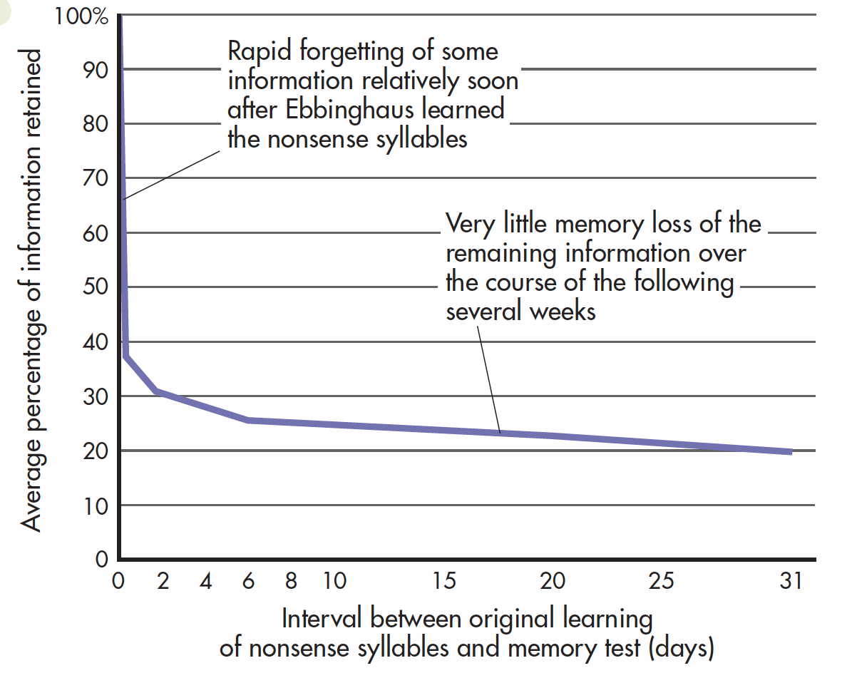
The Ebbinghaus Forgetting Curve
Notes:
Ebbinghaus’s research demonstrated the basic pattern of forgetting: relatively rapid loss of some information, followed by stable memories of the remaining information.
Source: Data from Ebbinghaus (1885/1987).

Slide 42
Why Do We Forget? Encoding Failure
One of the most common reasons for forgetting occurs when information is not encoded initially into long term memory (encoding failure).
Absentmindedness
Failure to remember what needs to be done in the future involves a prospective memory error.
Retrieval cue failure of WHEN something needs to be done

Slide 43
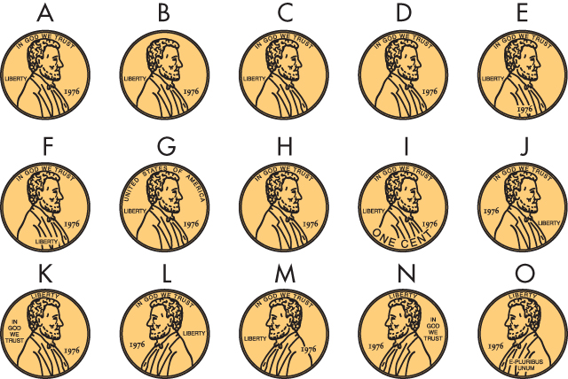
Which Is the Real Penny?

Slide 44
Answer

Slide 45
Why Do We Forget? Decay Theory
Decay Theory
When a new memory is formed, it creates a distinct structural or chemical change in the brain (memory trace).
Memory traces fade away over time as a matter of normal brain processes.
Challenges
Some research has shown that information can be remembered decades after it was originally learned.
Ebbinghaus theorized that rate of forgetting decreases over time.
TIME

Slide 46
Why Do We Forget?: Interference Theory
Interference Theory
Memories interfering with memories
Forgetting not caused by mere passage of time
Caused by one memory competing with or replacing another memory
Two types of interference
Retroactive interference
A NEW memory interferes with remembering OLD information
Proactive interference
An OLD memory interferes with remembering NEW information

Slide 47
Retroactive Interference
When a NEW memory interferes with remembering OLD information
Example: When new phone number interferes with the ability to remember old phone number

Slide 48
Proactive Interference
Opposite of retroactive interference
When an OLD memory interferes with remembering NEW information
Example: Memories of where you parked your car on campus the past week interferes with ability find car today
?
?
?
?
?
?
?
?

Slide 49
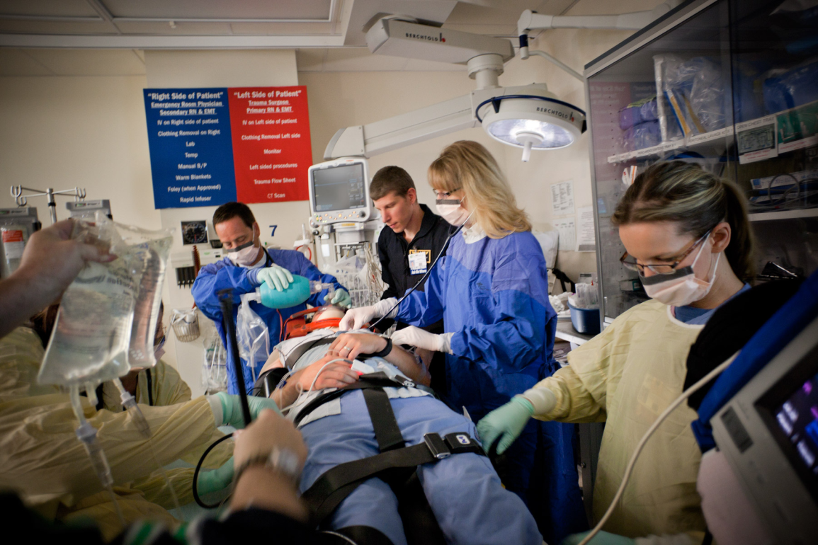
Why Do We Forget? Motivated Forgetting

Slide 50
Motivated forgetting occurs when an undesired memory is held back from awareness.
Suppression—conscious forgetting
Repression—unconscious forgetting (Freudian)
Controversial
Taxi/Getty Images
Notes:
Car accidents, serious illnesses, surgeries, and other traumatic events are painful to relive in memory. Some researchers believe that by voluntarily directing our attention away from memories of such traumatic
events, we can eventually suppress our memory of the experiences, making them difficult or impossible to consciously retrieve (Anderson & others, 2011).

Slide 51
IN FOCUS Déjà Vu Experiences
Déjà Vu is a brief but intense feeling of remembering a scene or an event that is actually being experienced for the first time.
1 of 6 people (16 percent) experience déjà vu about once a month.
Incidence decreases with age.
Causes
Arises when enough features in the current situation trigger the sensation of matching features already contained in a previous memory leading to disruption in source memory or source monitoring
Can be related to an encoding failure called inattentional blindness
May occur when brain dysfunction triggered by temporal lobe disruptions

Slide 52
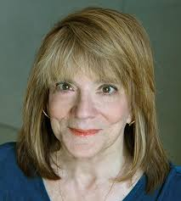
Imperfect Memories
Memory details change over time
Without awareness, details can be added, subtracted, exaggerated, or downplayed.
Misinformation effect
Post-event can distort eyewitness recollection of an original event (Loftus).
Source confusion
True source of memory can be forgotten.
A memory can be attributed to the wrong source.

Slide 53
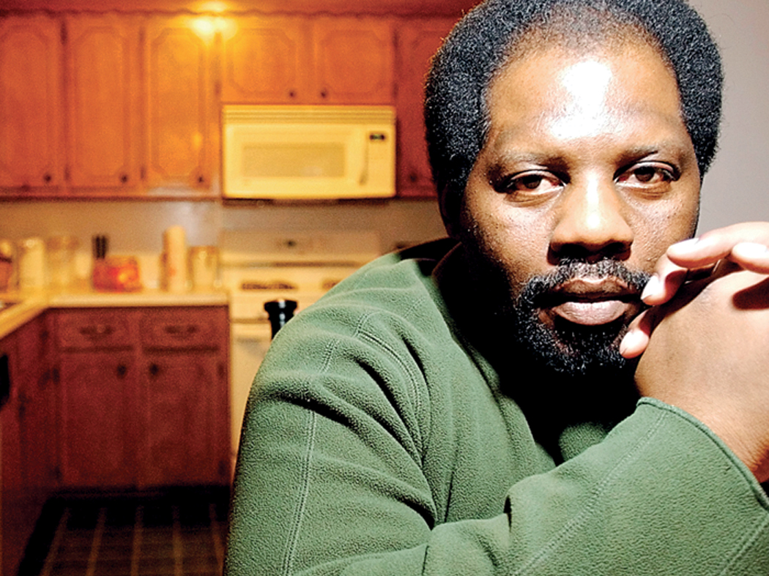
Eyewitness Testimony
Recall is not an exact replica of original events.
Recall is a construction built and rebuilt from various sources.
Often fit memories into existing beliefs or schemas
Based solely on the victim’s eyewitness identification, McGee was arrested for attacking, kidnapping, and raping.
Despite the fact that McGee had an alibi and was suffering from an abdominal hernia that would have made it virtually impossible for him to commit the crime, he was convicted and sentenced to 365 years in jail.
Thirteen years after his conviction, DNA testing proved that he was innocent of the crime.
Kelly Kerr/Tulsa World
Notes:
Four months after being attacked, kidnapped, and raped, an Oklahoma woman picked Arvin McGee out of a photographic lineup and identified him as her attacker.
Based solely on the victim’s eyewitness identification, McGee was arrested for the crime. His first trial was declared a mistrial. His second ended in a hung jury. His third resulted in a guilty verdict.
Despite the fact that McGee had an alibi and was suffering from an abdominal hernia that would have made it virtually impossible for him to commit the crime, he was convicted and sentenced to 365 years in jail.
Thirteen years after his conviction, DNA testing proved that he was innocent of the crime.

Slide 54
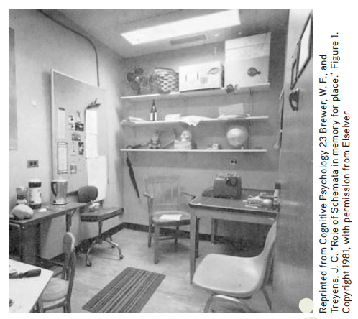
Schemas, Scripts, and Memory Distortions
Can the knowledge people had before an event occurred influence their later memory of the event?
Schemas organize clusters of knowledge and information about particular topics.
Scripts are schemas that involve typical sequence of actions and behaviors at a common event.
False memories are created for actions that would have been consistent with a script.
False memories of a psychology
Professor’s office
What happened?
Notes:
After briefly waiting in the psychology professor’s office shown above, participants were taken to another room and asked to recall details of the office—the real purpose of the study. Many participants falsely remembered
objects that were not actually in the office, such as books, a filing cabinet, a telephone, a lamp, pens, pencils, and a coffee cup. Why? The details that the participants erroneously remembered were all items that would be consistent with a typical professor’s office (Brewer & Treyens, 1981). Schemas can cause memory errors by prompting us to fill in missing details with schema-consistent information (Kleider & others, 2008).

Slide 55
Factors Contributing to False Memories
Factor | Description
Misinformation effect | When erroneous information received after an event leads to distorted or false memories of the event
Source confusion | Forgetting or misremembering the true source of a memory
Schema distortion | False or distorted memories caused by the tendency to fill in missing memory details with information that is consistent with existing knowledge about a topic
Imagination inflation | Unfounded confidence in a false or distorted memory caused by vividly imagining the pseudoevent
False familiarity | Increased feelings of familiarity due to repeatedly imagining an event
Blending fact and fiction | Using vivid, authentic details to add to the legitimacy and believability of a pseudoevent
Suggestion | Hypnosis, guided imagery, or other highly suggestive techniques that can inadvertently or intentionally create vivid false memories

Slide 56
CRITICAL THINKING The Memory Wars: Recovered or False Memories?
The controversy
Questions about the validity of recovery methods (memory wars)
The critical issues
Some details of traumatic event may be forgotten, but event can be remembered.
Many recovered memories are actually false memories.
Conclusions
Childhood abuse contributes to adulthood psychological problems.
Recovered memories need to be regarded with cautions.
Memory details can be easily distorted.
All memories involve reconstruction.
False memories can be unintentionally created; guidelines needed.

Slide 57
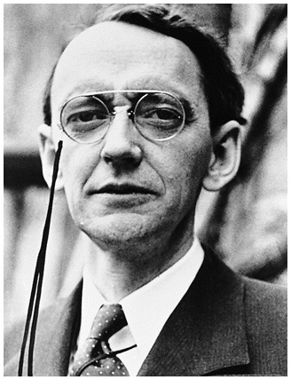
Biological Basis of Memory
Karl Lashley searched for a localized memory trace or engram.
Removed different sections of the cortex of rats who learned a maze
Found that maze-learning in rats was distributed throughout the brain

Slide 58
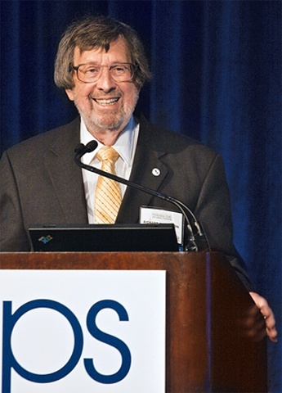
Biological Basis of Memory
Richard Thompson found that memory for simple classically conditioned responses was localized (in the cerebellum).
Eye blink to a puff of air in a rabbit (area of cerebellum removed, no eye blink)

Slide 59
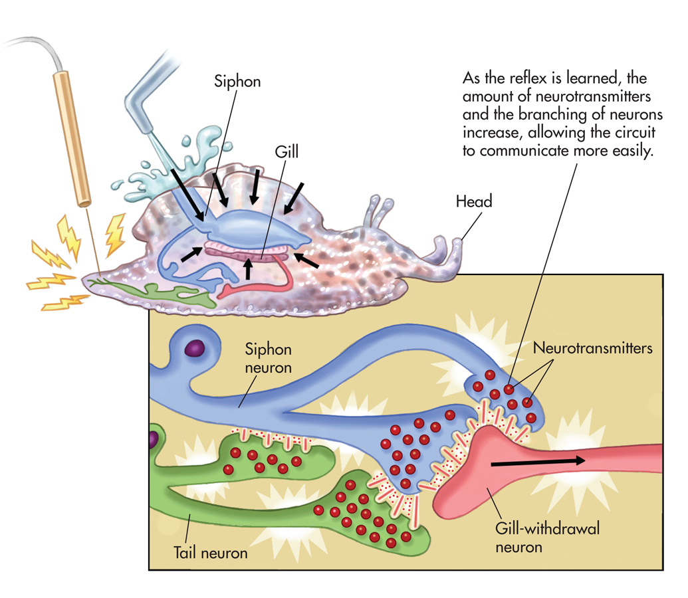
New Memories in a Snail
Aplysia—a sea snail used to study how memories can change neurons

Slide 60
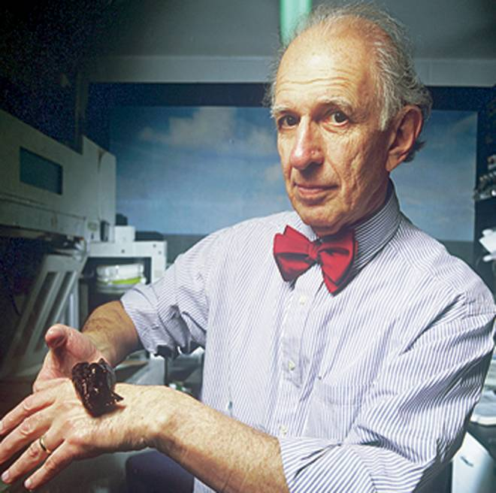
Biological Basis of Memory
Eric Kandel and the aplysia:
Function of the neurons was altered (increased in n.t.)
Structure of the neurons changes (# of interconnecting branches increased)
Known as “Long-term potentiation”

Slide 61
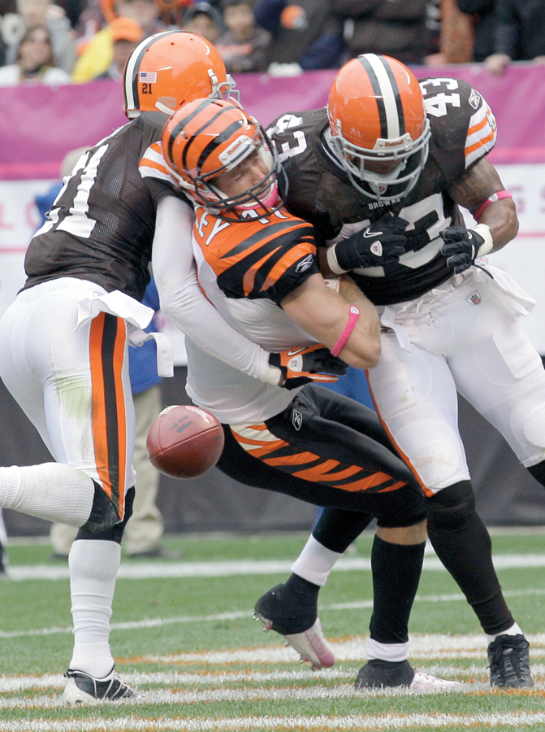
Processing Memories in the Brain
Amnesia: Severe memory loss
Retrograde amnesia—inability to remember past episodic information; common after head injury; need for consolidation
Anterograde amnesia—inability to form new memories; related to hippocampus damage
Memory consolidation is the gradual, physical process of converting new long-term memories to stable, enduring memory codes.
AP Photo/Amy Sancetta

Slide 62
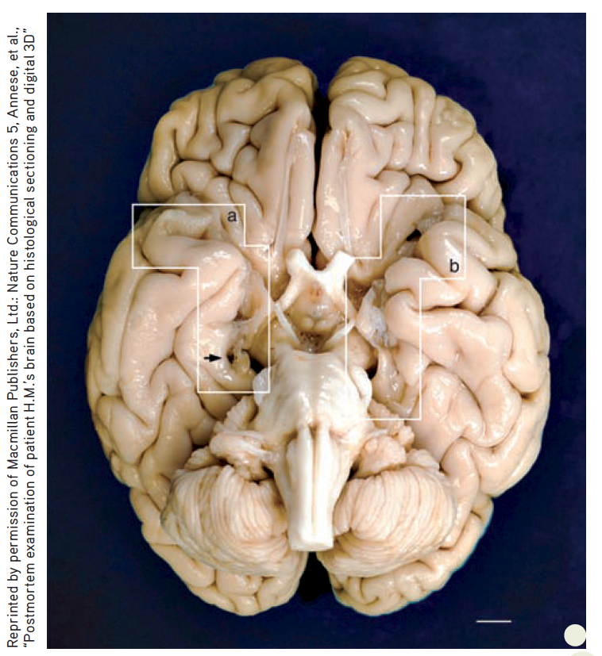
Implicit and Explicit Memory in Anterograde Amnesia
H.M.
Had portions of the medial (inner) temporal lobe on each side of his brain, including the brain structure called the hippocampus, removed
Unable to acquire new long-term memories of events (episodic information) or general knowledge (semantic information)
Had some residual declarative memory abilities (retained info about famous people)
After death
Micro-thin slices used to create 3-D digital model of H.M.’s brain
Notes:
At the age of 9, Henry was hit by a bicyclist and jarred his head badly. Not long after, he began experiencing seizures. By early adulthood, Henry’s seizures had increased in both severity and frequency. In an effort to control the seizures, an experimental surgery was performed, removing the hippocampus and amygdala on each side of Henrly’s brain.
Because of the profound anterograde amnesia caused by the surgery, Henry became one of the most intensive case studies in psychology and neuroscience. Over the next half century, Henry participated in hundreds of studies that fundamentally altered the scientific understanding of memory.
Henry died on December 2, 2008, but his contributions to science continue. Neuroscientist Jacopo Annese and his team (2014) dissected
Henry’s brain, slicing it into 2,400 micro-thin slices in a marathon, 3-day session that was streamed online. Photographs of each
slice were taken to create a virtual 3-D digital model of Henry’s brain. The white boxes (a) and (b) show where portions of the hippocampus
and amygdala on the left and right side of Henry’s brain were removed. The researchers also discovered a previously unknown
small lesion on Henry’s left frontal lobe, which they speculate is probably scar tissue from the original surgery. You can watch a short
video of the dissection at http://thebrainobservatory.ucsd.edu/hm_live.php

Slide 63
Brain Structures Involved in Memory

Slide 64
Alzheimer’s Disease
Progressive disease that destroys brain’s neurons, gradually impairing memory, thinking, language, and other cognitive functions, resulting in the complete inability to care for oneself
Most common form of dementia; causes still unknown
Brains develop two abnormal structures—beta-amyloid plaques and neurofibrillary tangles

Slide 65
Alzheimer’s Disease
Early dementia = mild memory impairment
Progresses to more pervasive memory loss and confusion
Internal brain damage has become widespread
Unable to communicate and sense of self and identity has vanishes
Finally, complete incapacitation and death
Courtesy of Dr. Paul Thompson, Laboratory of Neuro-Imaging and the Imaging Genetics Center at UCLA
Notes:
Progressive disease that destroys brain’s neurons, gradually impairing memory, thinking, language, and other cognitive functions, resulting in the complete inability to care for oneself
Most common form of dementia; causes still unknown
Brains develop two abnormal structures—beta-amyloid plaques and neurofibrillary tangles

Slide 66
PSYCH FOR YOUR LIFE Ten Steps to Boost Your Memory
Commit the necessary time.
Organize the information.
Elaborate on the material.
Explain it to a friend.
Use visual imagery.
Reduce interference within a topic.
Counteract the serial position effect.
Use contextual cues to jog memories.
Use a mnemonic device for remembering lists.
Sleep on it to help consolidate those memories.

