Slide 2
Cognition: Mental activities involved in
acquiring, retaining, and using knowledge
Thinking: Manipulation of mental
representations of information in order to
draw inferences and conclusions.
Mental image: Mental representation
of objects or events that are not physically
present.

Slide 3
Solving Problems and Making Decisions
Problem-solving strategies
Trial and error: Trying a variety of solutions and eliminating those that don’t work
REUTERS/Cheryl Ravelo
Recipes are often developed through a process of trial and error.

Slide 4
Solving Problems and Making Decisions
$x=\frac{−b±\sqrt{b^{2}−4ac}}{2a}$y + z = r2
Problem-solving strategies
Algorithms: Using a specific rule, procedure, or method (such as a mathematical formula) that inevitably produces the correct solution
REUTERS/Cheryl Ravelo

Slide 5
Solving Problems and Making Decisions
Problem-solving strategies
Heuristics: Following a general rule of thumb to reduce the number of possible solutions (subgoals, working backward)
REUTERS/Cheryl Ravelo

Slide 6
Estimating the Probability of Events: Decisions Involving Uncertainty
The Availability Heuristic
Probability of an event judged by how easily previous occurrences of that event can be recalled.
The less accurately our memory of an event reflects the actual frequency of the event, the less accurate our estimate of event’s likelihood will be.
The availability heuristic is more likely to be used when people rely on information held in their long-term memory to determine the likelihood of events occurring.
Watt Jim/Getty Images
Notes:
Most people will overestimate deaths from natural disasters because disasters are frequently shown on TV.
Most people will underestimate deaths from asthma because those deaths do not make local news.

Slide 7
Estimating the Probability of Events: Decisions Involving Uncertainty
Representativeness heuristic refers to the likelihood of an event is estimated by comparing how similar it is to the prototype of the event.
Faulty estimates can be produced if:
Possible prototype variations not considered
Approximate number of existing prototypes not considered
The representativeness heuristic is more likely to be used when people compare different variables to make predictions.
Notes:
The availability heuristic is more likely to be used when people rely on information held in their long-term memory to determine the likelihood of events occurring.
The representativeness heuristic is more likely to be used when people compare different variables to make predictions.

Slide 8
Examples:
Availability Heuristic
Most people will overestimate deaths from natural disasters because disasters are frequently on TV
Representativeness Heuristic
Jump to a conclusion based on a small set of data
The long haired guy is a surfer from California and the muscular blonde haired guy that plays football is from Iowa.

Slide 9
Problem-Solving Strategies
Insight involves the sudden realization of how a problem can be solved.
Notes:
Intuition
Coming to a conclusion or making a judgment without conscious awareness of the thought processes involved
Guiding stage — you perceive a pattern in information, but not consciously
Integrative stage — a representation of pattern becomes conscious, usually in form of a hunch or hypothesis

Slide 10
Problem-Solving Strategies
Intuition refers to coming to a conclusion or making a judgment without conscious awareness of the involved thought processes.
First stage (guiding) = Pattern of information being considered is unconsciously perceived
Second stage (integrative) = Representation of pattern becomes conscious, usually as hunch or hypothesis
The intuitive hunch is new idea that integrates new information with existing knowledge stored in long-term memory.
Notes:
Intuition
Coming to a conclusion or making a judgment without conscious awareness of the thought processes involved
Guiding stage — you perceive a pattern in information, but not consciously
Integrative stage — a representation of pattern becomes conscious, usually in form of a hunch or hypothesis

Slide 11
Obstacles to Solving Problems Thinking outside the box
Functional fixedness
Refers to the tendency to view objects as functioning only in their usual or customary way
A type of mental set
AP Photo/Bullit Marquez
Overcoming functional fixedness: Successful repurposing involves finding new uses for familiar objects–the essence of overcoming functional fixedness.
Notes:
The goal of repurposing is to find new uses for objects that would otherwise end up clogging waterways, littering sidewalks and roads, or accumulating in landfills. Using liter-sized water bottles and inexpensive solar-powered bulbs, Filipino architect Rodelon Ramos and Iliac Diaz developed a durable, cheap light fixture that can be used to light a home for as long as five hours

Slide 12
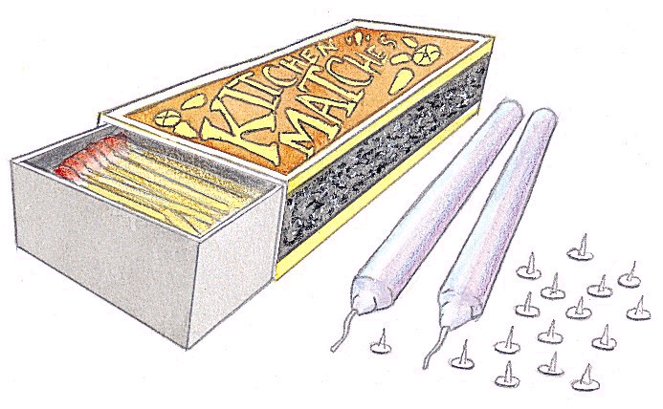
Mounting Candle Problem
Using only the objects present on the right, attach the candle to the bulletin board in such a way that the candle can be lit and will burn properly
Notes:
key words: functional fixedness, mental set; problem solving
Although students can work on this problem by simply thinking and visualizing a solution in their heads, this demonstration works better by by bringing the actual materials to class and doing a live demonstration with your students, letting them attemtp to solve the problem through trial and error.
To do this task you need the folllowing materials:
1. a cork bulletin board
2. a book of matches
3. a candle
4. a BOX of thumbtacks
- make sure you keep the thumbtacks in a BOX
- also make sure the thumbtacks aren't too big that they can pass through your candle. The smaller the thumb tack, the better

Slide 13
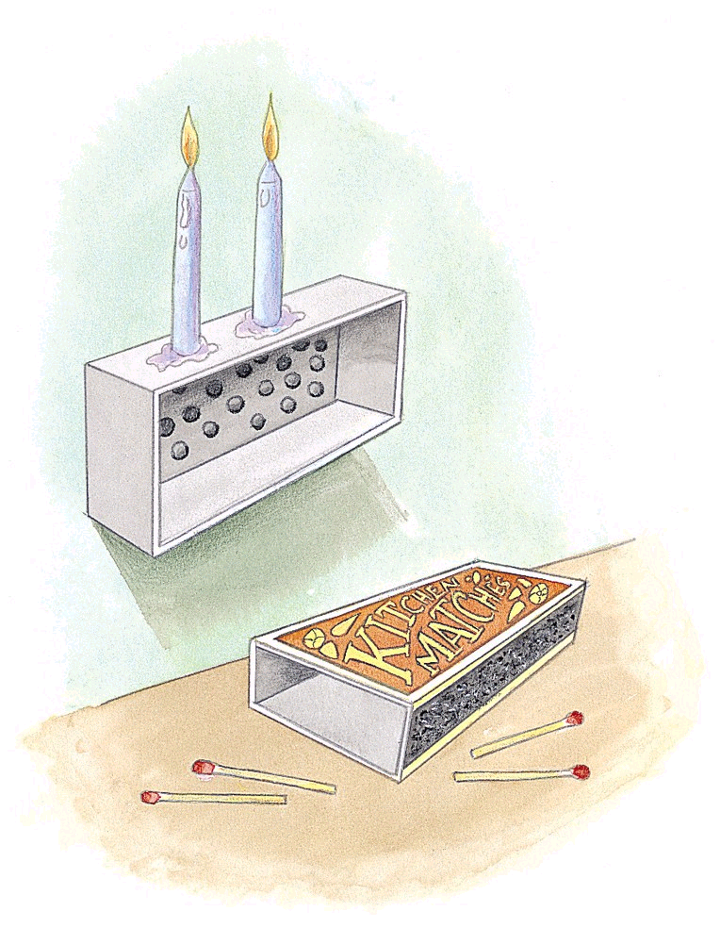
Answer to Candle Problem
Most people do not think of using the box for anything other than its normal use (to hold the tacks)
To solve the problem, you have to overcome functional fixedness
Notes:
key words: functional fixedness; mental sets; problem solving

Slide 14
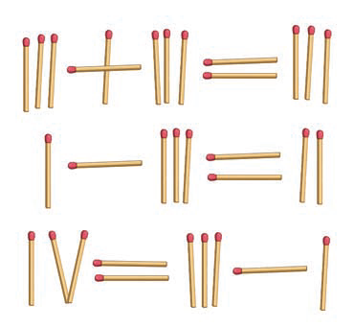
Obstacles to Solving Problems
Mental set
Refers to the tendency to persist in solving problems with solutions that have worked in the past
May prevent seeing other possible solutions, especially in areas where one is knowledgeable or well trained.
Can sometimes suggest a useful heuristic
Were you able to solve the equations in Figure 7.5? The solutions are on page 283 of the text.
Notes:
Were you able to solve the equations in Figure 7.5? The solutions are on page 283 of the text.
Mental Set The equations on the right, expressed in Roman numerals, are obviously incorrect. Your task is to transform each incorrect equation into a correct equation by moving ONE matchstick in each
equation. The matchstick can only be moved once. Only Roman numerals and the three arithmetic operators +, –, or = are allowed. Take your best shot at solving the equations before looking at the solutions on page 283.
Remember, in the Roman numeral system, I = 1; II = 2; III = 3; IV = 4; V = 5.
Solution to Figure 7.5 Most people try to correct the equations in Figure 7.5 by moving a matchstick that changes one of the numbers. Why? Because solving the math problems that we are assigned in school almost always
involves manipulating the numbers, not the arithmetic signs. While this assumption is a useful one in solving the vast majority of math problems—especially the ones that you are assigned as homework—it is an example of a mental set that can block you from arriving at new, creative solutions to problems.

Slide 15
Nine Dots Problem
Without lifting your pencil or retracing any line, draw four straight lines that connect all nine dots
Notes:
key words: mental sets; problem solving; nine dots problem

Slide 16
Nine Dots Mental Set
Most people will not draw lines that extend from the square formed by the nine dots
To solve the problem, you have to break your mental set
Notes:
key words: mental sets; problem solving; nine dots problem

Slide 17
Decision-Making Strategies
Different cognitive strategies are used when making decisions, depending on the type and number of options available to us.
Elimination by aspects model
rate choices based on features; eliminate those that do not meet the desired criteria, despite other desirable characteristics
Single-feature model Make a decision by focusing on only one feature
Additive model systematically evaluate the important features of each alternative

Slide 18
CRITICAL THINKING Persistence of Unwarranted Beliefs
Contradictory evidence can actually strengthen a person’s established beliefs.
Why?
Belief-bias effect
Confirmation bias
Fallacy of positive instances
Overestimation effect
Notes:
Belief-bias effect: Occurs when people accept only the evidence that conforms to their belief, rejecting or ignoring any evidence that does not
Confirmation bias: Tendency to search for information or evidence that confirms a belief, while making little or no effort to search for information that might disprove belief
Fallacy of positive instances: Tendency to remember uncommon events that seem to confirm our beliefs and to forget events that disconfirm our beliefs
Overestimation effect: Tendency to overestimate the rarity of events

Slide 19
The Effect of Language on Perception
Whorfian Hypothesis
Whorf (1956): Language determines the very structure of thoughts and perceptions.
Whorfian hypothesis also called the linguistic relativity hypothesis.
Whorf’s strong contention that language determines perception and structure of thought has not been supported.
Language use, however, has been found to influence particular concepts, as in mathematics.
Can You Count Without Number Words?
©Edward Gibson, MIT Brain and Cognitive Sciences
Notes:
Cognitive neuroscientist Edward Gibson traveled to a remote Amazon village to confirm previous research by anthropologist and linguist David Everett (2005, 2008) that showed the Pirahã people lacked the ability to count and had no comprehension of numbers. Gibson found that rather than identifying quantities by exact numbers, the Pirahã research participants used only relative terms like “few,” “some,” and “many.” According to Gibson, the Pirahã are capable of learning to count, but did not develop a number system because numbers are simply not useful in their culture (Frank & others, 2008).

Slide 20
Measuring Intelligence
Intelligence: Global capacity to think rationally, act purposefully, and deal effectively with the environment. It is reflected in effective, rational, and goal-directed behavior.
(Book smarts v. Street smarts)

Slide 21
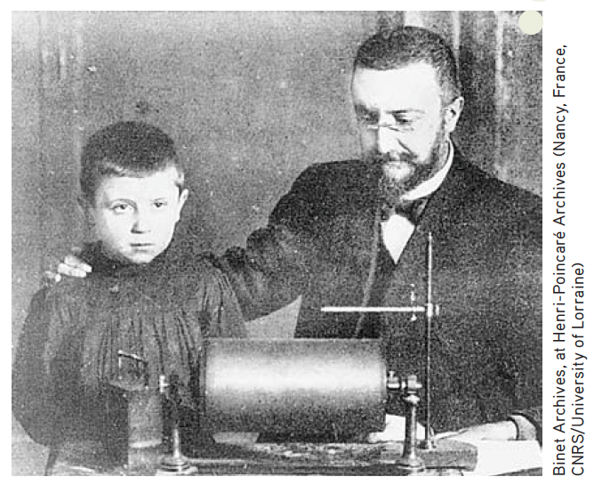
Development of Intelligence Tests
Alfred Binet
Devised a series of tests to measure different mental abilities for the French government
Developed goal to help identify “slow” children who could benefit from special help
Invented concept of mental age based on the average age at which questions were answered correctly
1905: Binet-Simon Test
Notes:
An “advanced” 7-year-old might have a mental age of 9, while a “slow” 7-year-old might demonstrate a mental age of 5

Slide 22
Lewis Terman and the Stanford-Binet Intelligence Test
Developed the Stanford-Binet Intelligence Scales 1916 at Stanford University
Revision of Binet’s test
Developed the concept of IQ:
IQ formula = MA/CA × 100
Example: A bright child of a chronological age (CA) of 8 scores at a mental age (MA) of 12 for an IQ of 150.
12/8 x 100 = 150

Slide 23
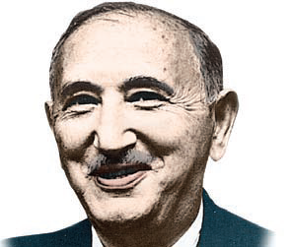
David Wechsler and Wechsler Intelligence Scales
Developed for adults: Dissatisfaction with Stanford-Binet Intelligence Scales led to the development of the Wechsler Adult Intelligence Scale (WAIS). Its several components included a verbal score and performance score.1955
Developed for kids: Wechsler Intelligence Scale for Children (WISC) and the Wechsler Preschool and Primary Scale of Intelligence (WPPSI)
Archives of the the History of American Psychology/
The University of Akron. Color added by publisher
David Wechsler
Notes:
Verbal score: Scores on subtests of vocabulary, comprehension, and knowledge of general information
Performance score: Largely nonverbal subtests: identifying missing parts in incomplete pictures, arranging pictures to tell a story, arranging blocks to match a given pattern

Slide 24
Agree or Disagree
High IQ scores can contribute to, but do not predict, success in life.

Slide 25
Principles of Test Construction
Many kinds of psychological tests measure various aspects of intelligence or mental ability.
Achievement test: Test designed to measure a person’s level of knowledge, skill, or accomplishment in a particular area.
Aptitude test: Test designed to assess a person’s capacity to benefit from education or training.

Slide 26
Basic Requirements of Good Test Design
Standardization
Administration of a test to a large, representative sample of people under uniform conditions for the purpose of establishing norms
Reliability
Ability of a test to produce consistent results when administered on repeated occasions under similar conditions
Validity
Ability of a test to measure what it is intended to measure
Notes:
Norms: Typically closely follow a pattern of individual differences called a normal curve, or normal distribution

Slide 27
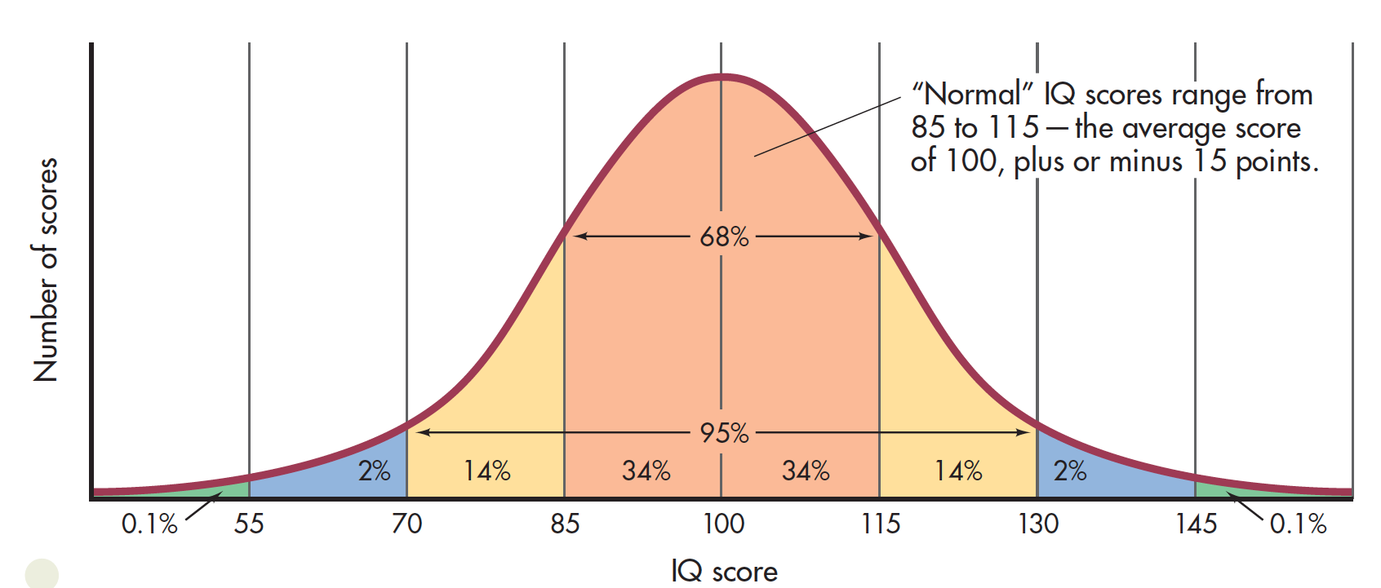
The Normal Curve of Distribution of IQ Scores
Notes:
The distribution of IQ scores on the WAIS-IV in the general population tends to follow a bell-shaped normal curve, with the average score defined as 100. Notice that 68 percent of the scores fall within the “normal” IQ range of 85 to 115. Ninety-five percent of the general population score between 70 and 130, while only one-tenth of 1 percent score lower than 55 or higher than 145.

Slide 28
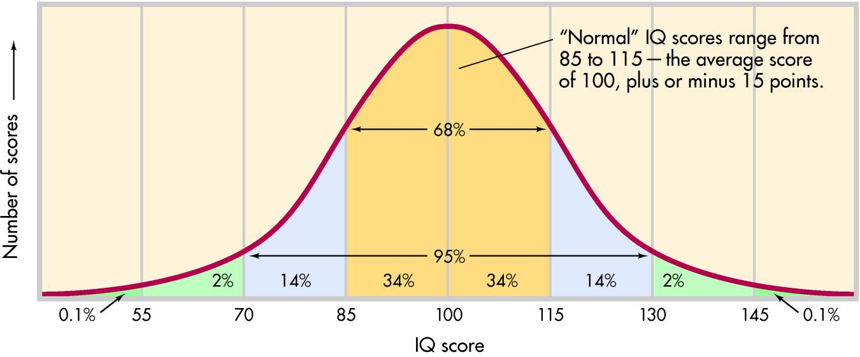
All raw scores converted to standardized scores
Normal distribution
Mean of 100
Standard deviation of 15
<1% above 145 or below 55
68% will score between 85 and 115
Notes:
figure taken from CD-ROM, Gray text, pg. 363, figure 10.5

Slide 29
Theories of Intelligence
Charles Spearman—g factor
Louis Thurstone—intelligence as a person’s “pattern” of mental abilities
Howard Gardner—multiple intelligences
Robert Sternberg—triarchic theory

Slide 30
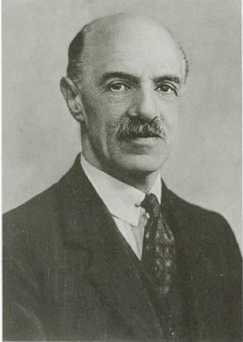
Theories of Intelligence
Spearman
Believed that single factor (g) underlies many different kinds of mental abilities
Posed that level of intelligence was equivalent to his or her level of “mental energy”
Found scores on different tests tended to be similar
Notes:
People who did well or poorly on a test of one mental ability, such as verbal ability, tended also to do well or poorly on the other tests.

Slide 31
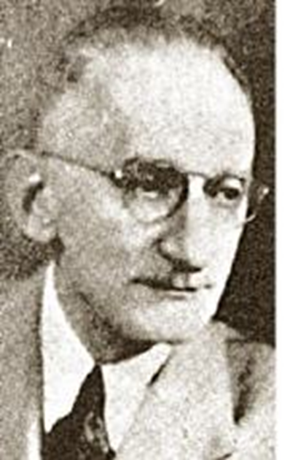
Theories of Intelligence
Thurstone
Proposed seven different primary mental abilities, each relatively independent of intelligence
Suggested intelligence is cluster of abilities
Believed intelligence was too diverse to be quantified in single number or IQ score

Slide 32
Louis Thurstone
7 Primary Mental Abilities
Verbal comprehension
Word fluency
Spatial visualization
Numerical ability
Reasoning
Perceptual speed
Memory

Slide 33
Theories of Intelligence
Gardner
Mental abilities are independent of each others and cannot be accurately reflected in single measure of intelligence
Looked at skills and products valued in different cultures
Identified eight distinct, independent intelligence; ninth awaiting further research (existential intelligence)
Notes:
According to Gardner’s model of intelligence, everyone has a different pattern of strengths and weaknesses.

Slide 34
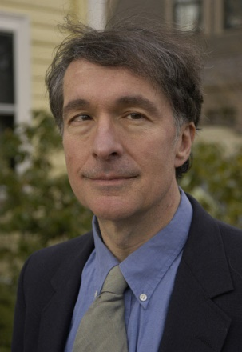
Gardner’s Multiple Intelligences
Linguistic intelligence | Adept use of language: poet, writer, public speaker, native storyteller
Logical-mathematical intelligence | Logical, mathematical, and scientific ability: scientist, mathematician, navigator, surveyor
Musical intelligence | Ability to create, synthesize, or perform music: musician, composer, singer
Spatial intelligence | Ability to mentally visualize the relationships of objects or movements: sculptor, painter, expert chess player, architect
Bodily-kinesthetic intelligence | Control of bodily motions and capacity to handle objects skillfully: athlete, dancer, craftsperson
Interpersonal intelligence | Understanding of other people’s emotions, motives, intentions: politician, salesperson, clinical psychologist
Intrapersonal intelligence | Understanding of one’s own emotions, motives, and intentions: essayist, philosopher
Naturalist intelligence | Ability to discern patterns in nature: ecologist, zoologist, botanist

Slide 35
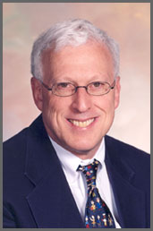
Theories of Intelligence
Sternberg
Emphasized both the universal aspects of intelligent behavior and importance of adapting to a particular social and cultural environment
Proposed successful intelligence involves three distinct types of mental abilities: analytic, creative, and practical.

Slide 36
Robert Sternberg
Analytic intelligence—mental processes used in learning how to solve problems
Creative intelligence—the ability to deal with novel situations by drawing on existing skills and knowledge
Practical intelligence—the ability to adapt to the environment (street smarts)

Slide 37
IN FOCUS Neurodiversity: Beyond IQ
Autism spectrum disorder symptoms cover a broad spectrum.
Autistic individuals may be unresponsive to social interaction, engage in repetitive or odd motor behaviors, and have very narrow interests and inflexible behavior and routines
Two core symptoms
Deficits in social communication and social interaction
Restricted, repetitive behaviors, interests, and activities

Slide 38
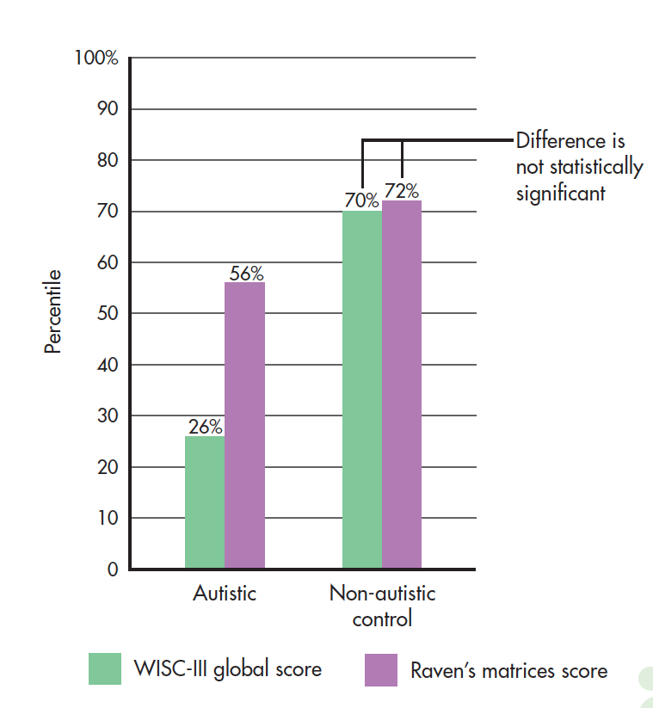
Autism Spectrum Disorder
Dawson and colleagues used the Raven’s Progressive Matrices Test and WISC-III to measure intelligence in children and adults with autism.
WISC-III: 26th percentile
Raven’s: 56th percentile
Findings suggest people with autistic spectrum symptoms process information, communicate, and experience their social and physical environment differently than neurotypical people who don’t have autistic symptoms (neurodiversity).
Measuring Intelligence
Notes:
On the average, autistic children scored fully 30 percentile points higher on the nonverbal Raven’s Progressive Matrices Test than they did on the WISC-III, which depends heavily on oral instruction and responses. In contrast, a matched control group of non-autistic children received scores that were essentially identical. Adult participants showed a similar pattern. Although a small-scale study, such results suggest that traditional intelligence tests may underestimate intelligence in autistic children and adults. In fact, one-third of the autistic children scored above the 90th percentile on the Raven’s, but none did so on the WISC-III. One child raised his score 70 percentile points from 24 to 94 percent—putting him in the “highly intelligent” range rather than the “low-functioning” range.

Slide 39
Roles of Genetics and Environment in Determining Intelligence
Both genes and environment contribute to intelligence, but the relationship is complex.
Bernard Brown
Nature-nurture debate is now informed by current research on molecular biology. The focus is now on how environment influences genetic expression.
Plomin and others
However narrowly intelligence is defined, the genetic range of intellectual potential is influenced by many genes, not by one single gene.

Slide 40
Differences Within Groups Versus Differences Between Groups
Heritability
Degree to which variation in trait stems from genetic, rather than environmental, differences among individuals
Currently accepted heritability estimate is about 50% for the general population
Environment
Degree to which variation is due to environmental, rather than genetic, differences.

Slide 41
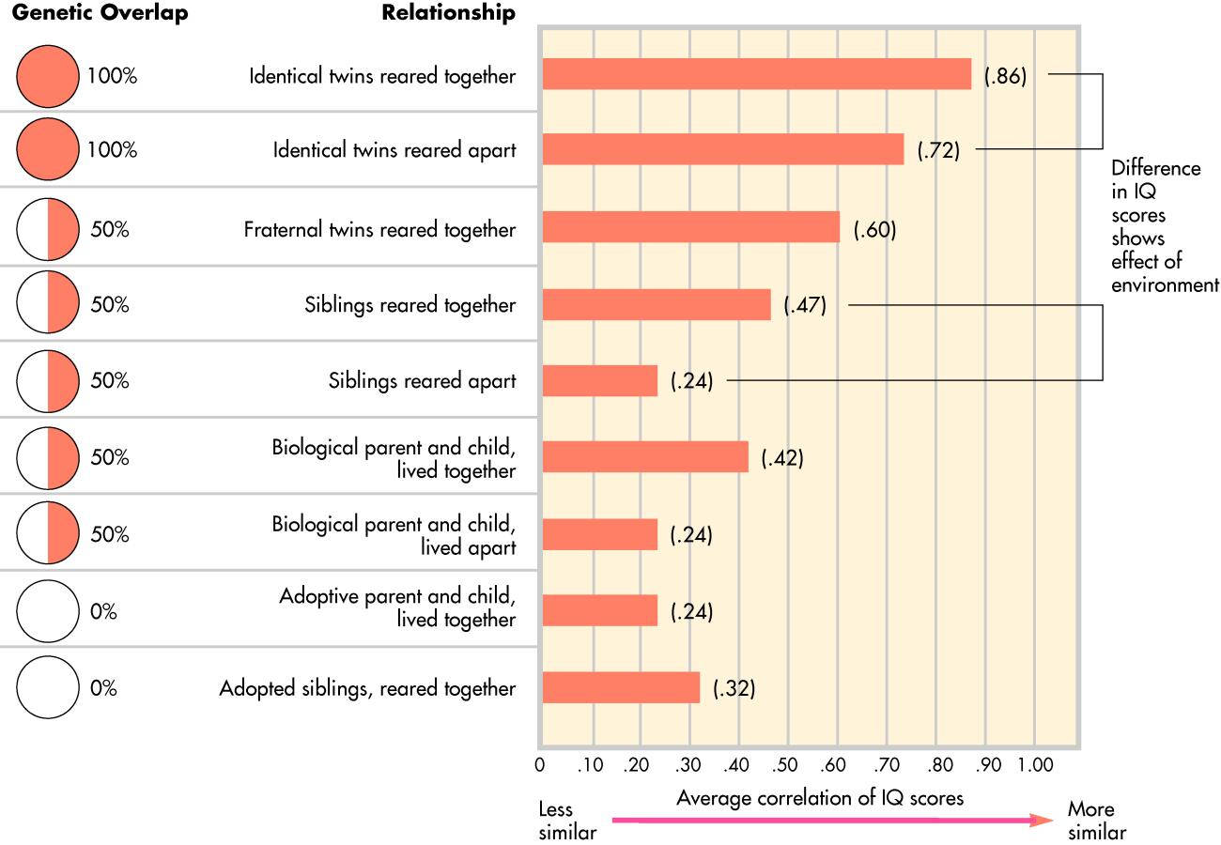

Slide 42
Differences Within Groups Versus Differences Between Groups
Unless the environmental conditions of two racial groups are virtually identical, it is impossible to estimate the overall genetic differences between the two groups.
Other evidence for the importance of the environment in determining IQ scores:
Improvement in average IQ scores has occurred in several cultures and countries during the past few generations.
14 nations have shown significant gains in average IQ scores in just one generation.
Average IQ score in the United States has also steadily increased over the past century.
Such changes in a population can be accounted for only by environmental changes.
Notes:
Improvement in IQ scores across cultures and countries over past few generations suggests environmental influence (Flynn Effect).

Slide 43
CULTURE AND HUMAN BEHAVIOR Performing with a Threat in the Air
Gender and racial stereotypes can be manipulated to affect test performance.
Stereotype threat occurs when members of a group are aware of negative stereotype about (Steele).
Women perform poorly in math, especially advanced math.
Stereotype lift occurs when awareness of a positive expectations improve task performance (Rydell and others).
Asians are good at advanced math.
Notes:
Members of virtually any group can experience a decline in performance due to stereotype threat

Slide 44
Are IQ Tests Culturally Biased?
Standardized intelligence tests may reflect white, middle-class cultural knowledge and values.
Minority-group members may do poorly on the tests not because of lower intelligence, but because of unfamiliarity with the white, middle-class culture.
It is generally recognized that it is virtually impossible to design a test that is completely culture-free.
Cultural differences may also be involved in test-taking behavior.
Cultural factors as motivation, attitudes toward test taking, and previous experiences with tests can affect performance and scores on tests.

