Slide 2
Emotion is a psychological state involving
subjective experience, physiological response, and
behavioral or expressive response.
(Emotion moves us to act, set goals, and make rational decisions.)

Slide 3
The Basic Emotions
Fear
Disgust
Surprise
Happiness
Anger
Sadness

Slide 4
Culture, Gender, and Emotional Experience
Fundamental dimensions of emotion
Degree to which the emotion is pleasant or unpleasant
Level of activation or arousal, associated with emotion
Cultural variations in classification
Japanese: Added interpersonal engagement to other two
Gender: Gender similarity in emotional frequency and experience; difference in expression of emotions
amana images inc./Alamy
Notes:
Gender
Both men and women tend to view women as more emotional
Men and women do not differ in their self-ratings of experience of emotions, but do differ in their expression of emotion
Cultural variations do exist
Interpersonal engagement reflects idea that some emotions result from your connections and interactions with other people
Japanese participants rated anger and shame as being about the same in terms of unpleasantness and activation, but rated shame as being much higher than anger on the dimension of interpersonal engagement; collectivist culture

Slide 5
Neuroscience of Emotion
Emotions are associated with distinct patterns of responses by the sympathetic nervous system and in the brain.
Sympathetic nervous system is aroused by emotions (fight-or-flight response)
Different emotions stimulate different responses
Fear: Decrease in skin temperature (cold feet)
Anger: Increase in skin temperature (hot under the collar)
Differing patterns of sympathetic nervous system activation are universal, reflecting hard-wired biological responses to basic emotions

Slide 6
IN FOCUS Detecting Lies
Does a polygraph detect lies?
No. It measures physiological changes associated with emotions; based on assumption that lying is accompanied by anxiety, fear, and stress.
Potential problems
No unique physiological arousal pattern for lying.
Some people can lie with experiencing anxiety or arousal.
Innocent people may be fearful or anxious when asked incriminating questions.
Polygraph interpretation can be highly subjective.
Microexpressions may produce nonverbal cues.
Notes:
Microexpressions: Fleeting indicators of deceit
Ekman (2003):
Deception associated with a variety of nonverbal cues
Fleeting facial expressions, vocal cues, and nervous body movements
Microexpressions last about 1/25 of a second

Slide 7
The Emotional Brain: Fear and the Amygdala
Amygdala: Part of limbic system
Activates when something threatening, fearful faces, or hear sounds related to fear is seen
Evaluates significance of stimuli and generates emotional responses and generates hormonal secretions and autonomic reactions that accompany strong emotions
Rats with a damaged amygdala cannot be classically conditioned to acquire a fear response.
Humans with a damaged amygdala have “psychic blindness” — an inability to recognize fear in facial expressions and voice.
Notes:
Le Doux’s Model
Two neural pathways for sensory information that project from thalamus
One leads to cortex
One leads directly to amygdala by passing cortex
Thalamus – amygdala pathway – stimulates sympathetic nervous system

Slide 8
Activating the Amygdala
Direct and indirect neural pathways: Le Doux’s Model
Two neural pathways for sensory information that project from thalamus
One leads to cortex
One leads directly to amygdala bypassing cortex
Thalamus –>amygdala pathway stimulates sympathetic nervous system

Slide 9
The Expression of Emotion
Ekman (1980) estimates the human face is capable of creating more than 7,000 different expressions.
Each basic emotion is associated with a unique facial expression.
Facial expressions are innate and “hard-wired”.
Spontaneous facial expressions of children and young adults who were born blind do not differ from those of sighted children and adults.
Innate facial expressions are the same across many cultures.
Notes:
Display rules: Social and cultural rules that regulate emotional expression, especially facial expressions

Slide 10
Culture and Emotional Expression
Ekman (1982) showed photographs of facial expressions to people in 21 different countries.
All participants identified expressed emotions with a high degree of accuracy
Some specific nonverbal gestures (emblems) vary across cultures
Cultural norms influence influence emotional expression and management of facial expressions (display rules).
In many cultures women are allowed a wider range of emotional expressiveness.
From Matsumoto, D., & Ekman, P. (1989) Japanese and Caucasian Facial Expressions of Emotion. JACFEE. Photographs courtesy of David Matsumoto and Humintell, LLC.
Notes:
All participants identified the emotions being expressed with a high degree of accuracy
Some specific nonverbal gestures, which are termed emblems, vary across cultures
When and where we display our emotional expressions are strongly influenced by cultural norms
Cultural differences in the management of facial expressions are called display rules
In many cultures women are allowed a wider range of emotional expressiveness

Slide 11
CRITICAL THINKING Emotion in Nonhuman Animals
Darwin: Capacity to experience emotions is an evolved traits shared by humans and lower animals
No clear way to understand how animals subjectively experience emotions.
Anthropomorphism can hinder progress in understanding animal emotions.
Do rats laugh? Are foxes in love?

Slide 12
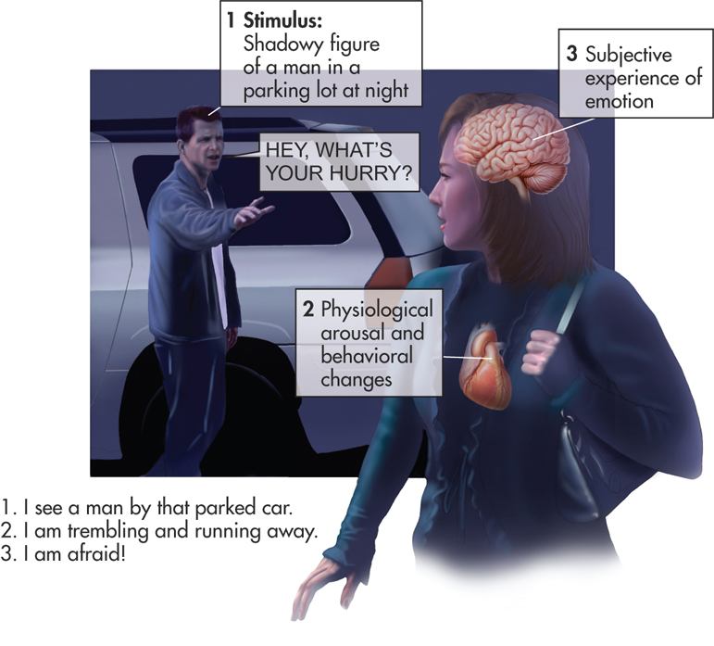
Theories of Emotion
James-Lange theory of emotion
Stimulus is perceived.
Physiological and behavioral changes occur.
These changes experienced as a particular emotion.
Notes:
According to William James, we don’t tremble and run because we are afraid, we are afraid because we tremble and run. James believed that body signals trigger emotional experience. These signals include physiological arousal and feedback from the muscles involved in behavior.

Slide 13
Cannon-Bard Theory of Emotion
Thalamus > experience of emotion
Hypothalamus > expression of emotion

Slide 14
Facial Feedback Hypothesis
Expressing a specific emotion, especially facially, causes us to subjectively experience that emotion.
Botox injections can dampen emotional experience and the ability to perceive it.

Slide 15
Facial Feedback Hypothesis
Say “Cheese!” Here’s a simple test of the facial feedback hypothesis. In a clever study by Fritz Strack and his colleagues (1988), participants who held a pen between their teeth (left) thought that cartoons were funnier than participants who held a pen between their lips (right). How does this finding support the facial feedback hypothesis?

Slide 16
Cognitive Theories of Emotion
Two-factor theory of emotion (Schachter and Singer)
Emotion is the interaction of physiological arousal and the cognitive label that we apply to explain arousal
Cognitive appraisal theory of emotion (Lazarus)
Emotions result from cognitive appraisal of a situation’s effect on personal well-being
Similar to two-factor, but theory’s emphasis is on cognitive appraisal as essential trigger for emotional response.

