Slide 2
Motivation: Biological, emotional, cognitive, or social forces that activate and direct behavior.

Slide 3
Motivation and Emotion
Three basic characteristics commonly associated with motivation
Activation
Persistence
Intensity
Notes:
Activation is demonstrated by initiation or production of behavior.
Persistence is demonstrated by continued efforts or determination to achieve a particular goal.
Intensity is seen in the greater vigor of responding that usually accompanies motivated behavior

Slide 4
Motivational Concepts and Theories
Instinct Theories
People are motivated to engage in certain behaviors because of evolutionary programming.
In the 1920s, instinct theories had fallen out of favor as an explanation of human motivation, primarily because of their lack of explanatory power.
The general idea that human behaviors are innate and genetically influenced remained important.
James’s List of Human Instincts
Attachment | Resentment
Fear | Curiosity
Disgust | Shyness
Rivalry | Sociability
Greediness | Bashfulness
Suspicion | Secretiveness
Hunting | Cleanliness
Play | Modesty
Shame | Love
Anger | Parental Love
Sharon King Grimm
Notes:
Click to reveal bullets and example.

Slide 5
Instinct Theories
Instinct—motives are innate
Fixed Action Patterns—innate instinctual patterns of behavior
Salmon swimming upstream
Migration patterns
Evolutionary Perspective

Slide 6
Motivation and Drive Theories
Sharon King Grimm
According to drive theories of motivation,
behavior is motivated by biological
drives to maintain homeostasis, or an
optimal internal balance. Drive theories of motivation are useful in explaining biological motives like hunger, thirst, and fatigue, but are less useful in explaining psychological motives.
Notes:
Motivation and Drive Theories
After a long soccer practice on a hot day, these high school students are motivated to rest, cool off, and drink water. For example, how could we explain their motivation to play competitive soccer?

Slide 7
Incentive Motivation Goal Objects as Motivators
Incentive theories
Behavior is motivated by “pull” of external goals, such as rewards, money, or recognition.
Incentive theories based learning principles from Pavlov, Watson, Skinner, and Tolman.
Tolman stressed importance of cognitive factors and expectation of goal in motivation.

Slide 8
Arousal Theory Optimal Stimulation as a Motivator
People experience both very high levels of arousal and very low levels of arousal as being quite unpleasant.
When arousal is too low, we experience boredom and become motivated to increase arousal.
When arousal is too high, we seek to reduce arousal in a less-stimulating environment.
People are motivated to maintain an optimal level of arousal.

Slide 9
Humanistic Theory Human Potential as a Motivator
Rogers and Maslow
Emphasized importance of psychological and cognitive factors in motivation
Proposed that people are motivated to realize their personal potential
Developed most famous humanistic model of motivation (Maslow’s hierarchy of needs)

Slide 10
Hunger and Eating Terms to Learn
Hunger: Biological motive
Eating behavior: Complex interaction of biological, social, and psychological factors
Glucose: Simple sugar that provides energy and is primarily produced by the conversion of carbohydrates and fats; commonly called blood sugar.
Insulin: Hormone produced by the pancreas that regulates blood levels of glucose and eating behavior
Basal metabolic rate (BMR): When the body is at rest, the rate at which it uses energy for vital functions, such as heartbeat and respiration
Baseline body weight: Cluster of genetic and environmental factors that cause a person’s weight to settle within a given range
Notes:
Hunger: Biological motive
Eating behavior: Complex interaction of biological, social, and psychological factors
Baseline body weight—cluster of genetic and environmental factors that cause a person’s weight to settle within a given range

Slide 11
Energy Homeostasis CALORIES CONSUMED = CALORIES EXPENDED
Food is broken down by enzymes, absorbed by intestines
Glucose, or blood sugar, is converted as a source of energy
Insulin helps control glucose and regulate eating and weight
When your caloric intake exceeds the amount of calories expended for energy, you experience positive energy balance.
When you diet or fast, a negative energy balance occurs.
Notes:
Basal metabolic rate is resting rate
Adipose tissue (body fat) is main source of stored calories

Slide 12
Short-Term Signals That Regulate Eating Physiological Changes
Slight drop in blood glucose
Slight increase in insulin – 30 minutes before eating
Ghrelin:
Hormone manufactured in stomach lining
Stimulates secretion of growth hormone by pituitary gland in brain
Stimulates appetite
Blood levels of ghrelin rise sharply before and fall abruptly after meals
Increase in body temperature
Decrease in metabolism

Slide 13
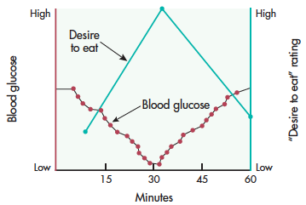
Blood Glucose and the Motivation to Eat
In this graph, the red dots depict the effects of insulin triggering a small decline in blood glucose over the course of about 30 minutes.
As blood glucose decreases, the person’s subjective desire to eat increases sharply, depicted by the green line.
Notes:
Notice that although this person did not eat, his blood glucose level returned to normal within the hour and his desire to eat diminished. In daily life, a small decline in blood glucose level is just one of the many different factors that reliably predict our motivation to eat.

Slide 14
Long-Term Signals That Regulate Body Weight
Three of the best-documented internal signals that monitor and help in the maintenance of stable body weight over time:
Leptin
Insulin
Neuropeptide Y
Notes:
Long-term signals
Leptin
Hormone indicating amount of fat in body; receptors in hypothalamus, stomach, and gut
Leptin level in brain increases, food intake is reduced
Increased leptin levels also intensify satiety-producing effects of CCK
Signals indicating amount of food molecules in blood
Insulin-increased brain levels of insulin associated with a reduction in food intake
Neuropeptide Y (NPY) is a neurotransmitter regulated by leptin and insulin; increased brain levels of neuropeptide Y trigger eating behavior, reduce body metabolism, and promote fat storage

Slide 15
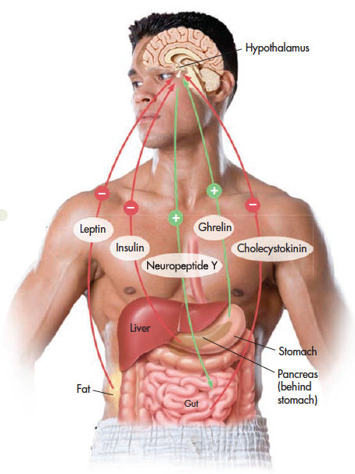
Regulating Appetite and Body Weight
Multiple signals interact to regulate your appetite and energy expenditure so that you maintain a stable body weight over time.
As summarized in this drawing, your appetite is stimulated (+) by increased levels of ghrelin and neuropeptide Y.
On the other hand, your appetite is suppressed (-) by increased levels of leptin, insulin, and CCK.

Slide 16
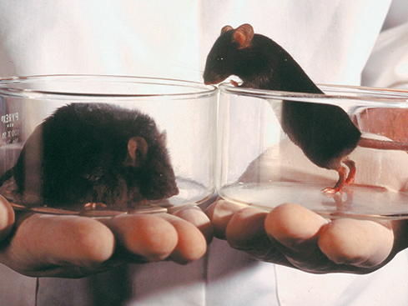
Satiation Signals
When to stop eating
Satiation signals
Stretch receptors communicating sensory information
Signals from stomach (cholecystokinin [CCK]) slowing rate at which stomach empties
Sensory-specific satiety: reduced desire to continue consuming a particular food; now we want dessert!
Remi Banali/Liaison

Slide 17
Excess Weight and Obesity
Set-point theory
Body has optimal body weight that body defends from becoming higher or lower by regulating feelings of hunger and body metabolism.
Settling-point models
Body weight settles at a balance between energy intake and expenditure.
Settling-point weight will stay relatively stable as long as factors influencing food consumption and energy expenditure do not change.

Slide 18
Excess Weight and Obesity
Prevalence
More than two-thirds of American adults and almost one-third of children are above their healthy weight.
Worldwide, one and a half billion adults are overweight.
Percentage of overweight people increases throughout adulthood, peaking in fifth and sixth decades of life.
Healthy weight determined by
Body mass index (BMI): Numerical scale indicating height in relation to weight
Obesity: Condition characterized by excessive body fat and a BMI equal to or greater than 30.0
Overweight: Condition characterized by BMI between 25.0 and 29.9
Notes:
Many different factors contribute to high rates of overweight and obesity
Thin ideal is pervasive in American culture

Slide 19
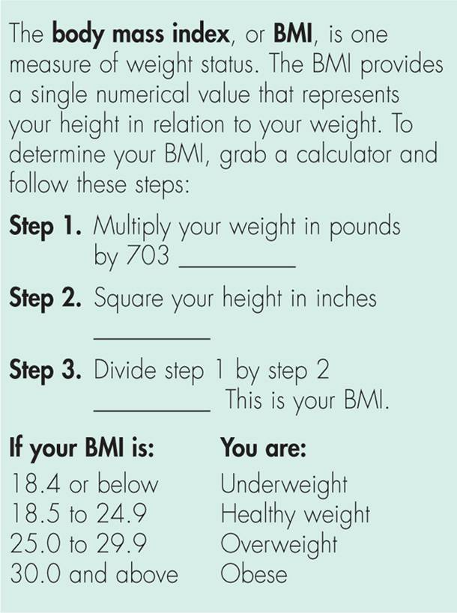

Slide 20
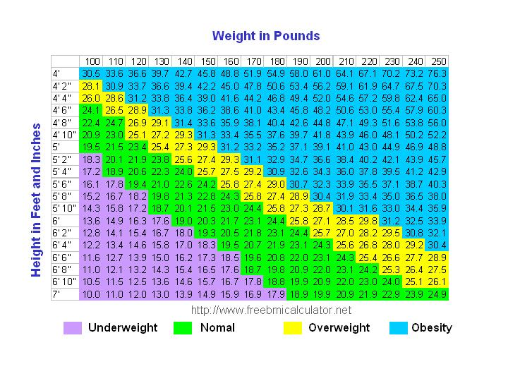

Slide 21
Factors Involved in Becoming Overweight
Multiple factors affect how much people eat and how the calories are metabolized.
“Supersize it” syndrome
Positive incentive value
Cafeteria diet effect
Basal metabolic rate (BMR)
Sedentary lifestyle
Too little sleep
Individual differences and lifespan changes
Notes:
Basal metabolic rate (BMR): individual differences and lifespan change: As BMR decreases with age, less food is required to meet your basic energy needs
Too little sleep:
disrupts hunger hormones;
blood levels of appetite-suppressing hormone leptin fall;appetite-increasing hormone ghrelin soars
Positive incentive value: anticipated pleasures of highly palatable foods
“Supersize It” syndrome:
caloric intake has increased nearly 10 percent for men and 7 percent for women
Cafeteria diet effect:
when offered a variety of highly palatable foods, such as at a cafeteria or an all-you-can-eat buffet, we consume more
Sedentary lifestyles:
1 in 5 persons worldwide leads a sedentary lifestyle
Sedentary lifestyles are more common in urbanized, developed countries
Four out of 10 American adults never exercise
T

Slide 22
Factors Involved in Obesity
Several variables derail the normal mechanisms of energy homeostasis in obesity.
Genetics: Genes on multiple genes on multiple chromosomes involved in creating susceptibility to obesity
Environment: Availability of ample, easily obtainable high-fat, high-calorie, palatable foods.
Metabolism: Leptin resistance
Eating habits: Weight cycling; yo-yo dieting

Slide 23
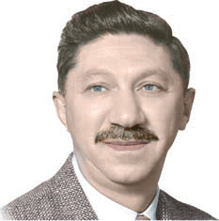
Maslow and Self-Actualization
Contributions
Encouraged psychology to focus on motivation and development of psychologically healthy people
Critiques
Vague and almost impossible to define in a way that would allow it to be tested scientifically
Initial studies on self-actualization were based on limited samples with questionable reliability
Most people do not experience or achieve self-actualization
Courtesy of Robert D. Farber University
Archives at Brandeis University
Abraham Maslow
Notes:
Hierarchy of needs: Maslow’s hierarchical division of motivation into levels that progress from basic physical needs to psychological needs to self-fulfillment needs.

Slide 24
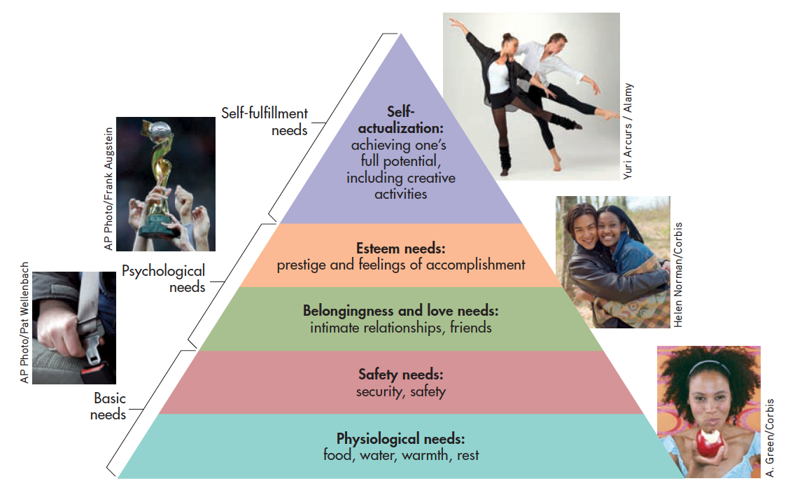
Maslow’s Hierarchy of Needs
Notes:
Abraham Maslow believed that people are innately motivated to satisfy a progression of needs, beginning with the most basic physiological needs. Once the needs at a particular level are satisfied, the individual is motivated to satisfy the needs at the next level, steadily progressing upward. The ultimate goal is self-actualization, the realization of personal potential.
Source: Research from Maslow (1970).

Slide 25
Maslow’s Characteristics of Self-Actualized People
Realism and acceptance | Self-actualized people have accurate perceptions of themselves, others, and external reality.
Spontaneity | Self-actualized people are spontaneous, natural, and open in their behavior and thoughts. However, they can easily conform to conventional rules and expectations when necessary.
Problem centering | Self-actualized people focus on problems outside themselves. They often dedicate themselves to a larger purpose in life.
Autonomy | Although they accept and enjoy other people, self-actualized individuals have a strong need for privacy and independence.
Continued freshness of appreciation | Self-actualized people continue to appreciate the simple pleasures of life with awe and wonder.
Peak experiences | Self-actualized people commonly have peak experiences, or moments of intense ecstasy, wonder, and awe during which their sense of self is lost or transcended.

Slide 26
Deci and Ryan’s Self-Determination Theory (SDT)
SDT proposes that people are actively growth- oriented and they move toward a unified sense of self and integration with others.
Three innate and universal psychological needs must be satisfied.
Autonomy
Competence
Relatedness
Notes:
Need for social relationships is fundamental psychological motive.
A person who has satisfied needs for competence, autonomy, and relatedness actively internalizes and integrates different external motivators as part of his or her identity and values.
Autonomy: Need to determine, control, and organize one’s own behavior and goals so that you are in harmony with one’s own interests and values
Relatedness: Need to feel attached to others and experience senses of belonging, security, and intimacy

Slide 27
Deci and Ryan’s Self-Determination Theory (SDT)
In a supportive environment, people pursue activities that satisfy needs. This enhances psychological growth and intrinsic motivation.
When people have satisfied needs, they actively internalize and integrate different external motivations as part of identity and personal values.
Notes:
Intrinsic motivation: Desire to engage in tasks that person finds inherently satisfying and enjoyable, novel, or optimally challenging
Extrinsic motivation: External influences on behavior, such as rewards, social evaluations, rules, and responsibilities

Slide 28
Competence and Achievement Motivation
Competence motivation is displayed as people strive to use their skills to be capable and exercise control.
Achievement motivation involves the drive to excel, succeed, or outperform others at some task.

