Slide 1
Political Parties

Slide 2
Squad Up
Brainstorm/Discuss the following questions with your squad:
Define Political Party
How many US Political Parties can you name?
What do Political Parties do?
Be prepared to share with the class!

Slide 3
What Are They?
Main Goal: Influence gov by winning elections and holding public office
Three Parts
Party Organization
Party in Government
Party in the Electorate

Slide 4
Do they even do anything?
Link people to the government
Will of the people is known
Nominate Candidates
Select candidates for voters to choose
Inform and Activate
Knowledge and participation
Governing
Partisanship→ winner makes the rules
Watchdog’s
Minority Party→ holds majority accountable, high scrutiny

Slide 5
Squad Up!
Of all of the functions of the Political Party, which do you think is most important and why?

Slide 6
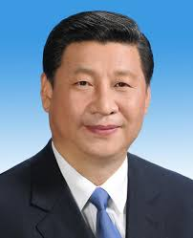
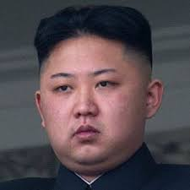
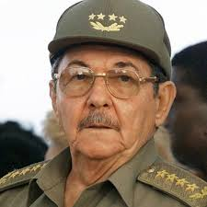
One Party Politics
National Level
Dictatorships
China, North Korea, Cuba, Laos, Vietnam, Eritrea
Local Level
One party consistently wins

Slide 7
Multiparty System
THE MOST COMMON
Germany, Ireland, Italy, Denmark, France, etc.
Argentina, Brazil, Mexico
New Zealand, Australia
Parties based on specific issue
Strengths | Weaknesses
Broader Representation Parties are forced to compromise | Not one party has majority (form coalitions) Instability

Slide 8
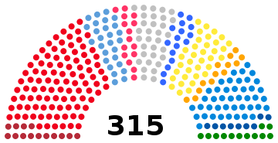
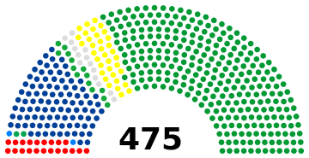
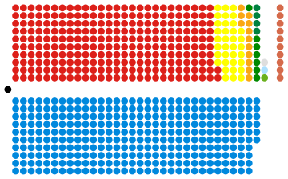
Italian Senate
Japanese House of Representatives
England’s House of Commons

Slide 9
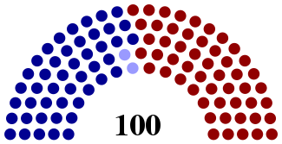
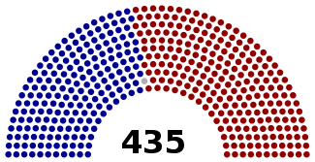
Partisan House membership
on April 15, 2017
194 Democrats 1 Vacant
240 Republicans
Senate membership
52 Republicans
46 Democrats
2 Independents caucusing with Democrats

Slide 10
How Many Parties? TWO PARTIES!
Jamaica and Malta are the only other countries with a two party system!!
Local v. National
Reasons:
History
Tradition
Electoral System
Single member district, winner-take-all
Election Laws
How do you join?
Strengths | Weaknesses

Slide 11
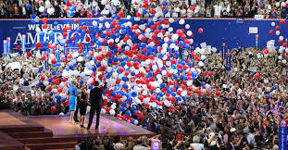
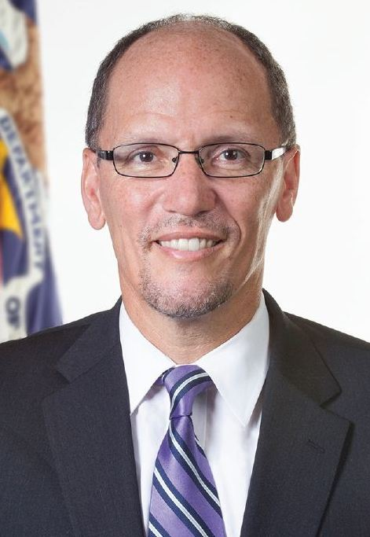
Structure of the Two Parties
National Convention
Officially choose Presidential Candidate
Party Platform
National Committee
National Chairperson
Handles business in between presidential elections
Fundraising, unify
Congressional Campaign Committee

Slide 12
Squad Up!
How many third party political parties can you name?
Can you name any third party presidential candidates?
Would you vote for a third party candidate? Why or why not?

Slide 13
Third Party Candidates
Ross Perot | Independent Reform | 1992 1996 | 18.9% 8.4%
Ralph Nader | Green | 2000 2004 2008 | 2.74% .38% N/A
Gary Johnson | Libertarian | 2012 2016 | 0.99% 3.3%
Jill Stein | Green | 2012 2016 | .36% 1.1%

Slide 14
Tomorrow
Third Parties in the United States
You will need your textbook to complete an activity.

