Slide 1
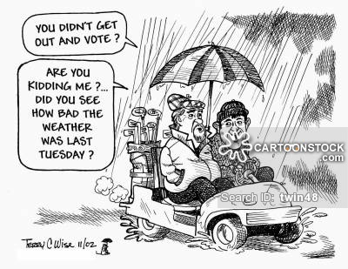

Slide 2
Voting Behavior

Slide 3
Voter Turnout in Elections
Election Year | % Voting Age Population
2004 | 60.4%
2008 | 62.3%
2012 | 57.5%
2016 | 55.5% (Estimated)
Off-Year Elections: Have even lower voter turnouts!!!
Country | % Voting Age Population (2017)
South Korea | 77.9%
France | 67.9%
United Kingdom | 65.4%

Slide 4
Reasons
Ballot Fatigue→ further down you go=less votes
State and Local Elections
Non-Voters
No matter who wins, things will be fine
Distrust the government
Low Political Efficacy
Too Busy
Election procedures
Long lines, long ballots
Bad Weather
Time Zone Fallout
Lack of Interest, Forgot
Week Day Elections, Work Hours, Non-Holiday
Choose 3 of the reasons to write down!

Slide 5
Demographics and Voting
Which demographic groups typically vote for Republicans? Democrats?

Slide 6
Who votes more?
Education
More education>Less education
Age
old>young
Race and Ethnicity
Non-Hispanic whites>Minorities
2008 Election and the African American Vote
Gender
Women>Men
Marital Status
Married>Single
Government Employees

Slide 7
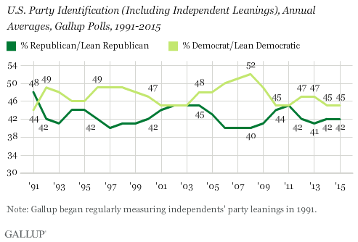
What is the best way to predict how someone will vote?
Party Identification
Straight-Ticket Voting
Independent Voters
Determine elections
Split-Ticket Voting
Political Efficacy
Belief that your voice matters
Candidates and Issues
Difference=turnout

Slide 8
Squad Up!!!
If you had a 20 minute meeting with your federal representatives (HoR and Senate) what issues would you discuss with them? What would you like to see changed?

Slide 9
The Voting Process
Most election law is STATE, not federal
Federal Election Law
Congress chooses time, place, and manner
Regulate presidential election process
Electors, electoral votes, etc
Voting for President
The first Tuesday following the first Monday in November

Slide 10
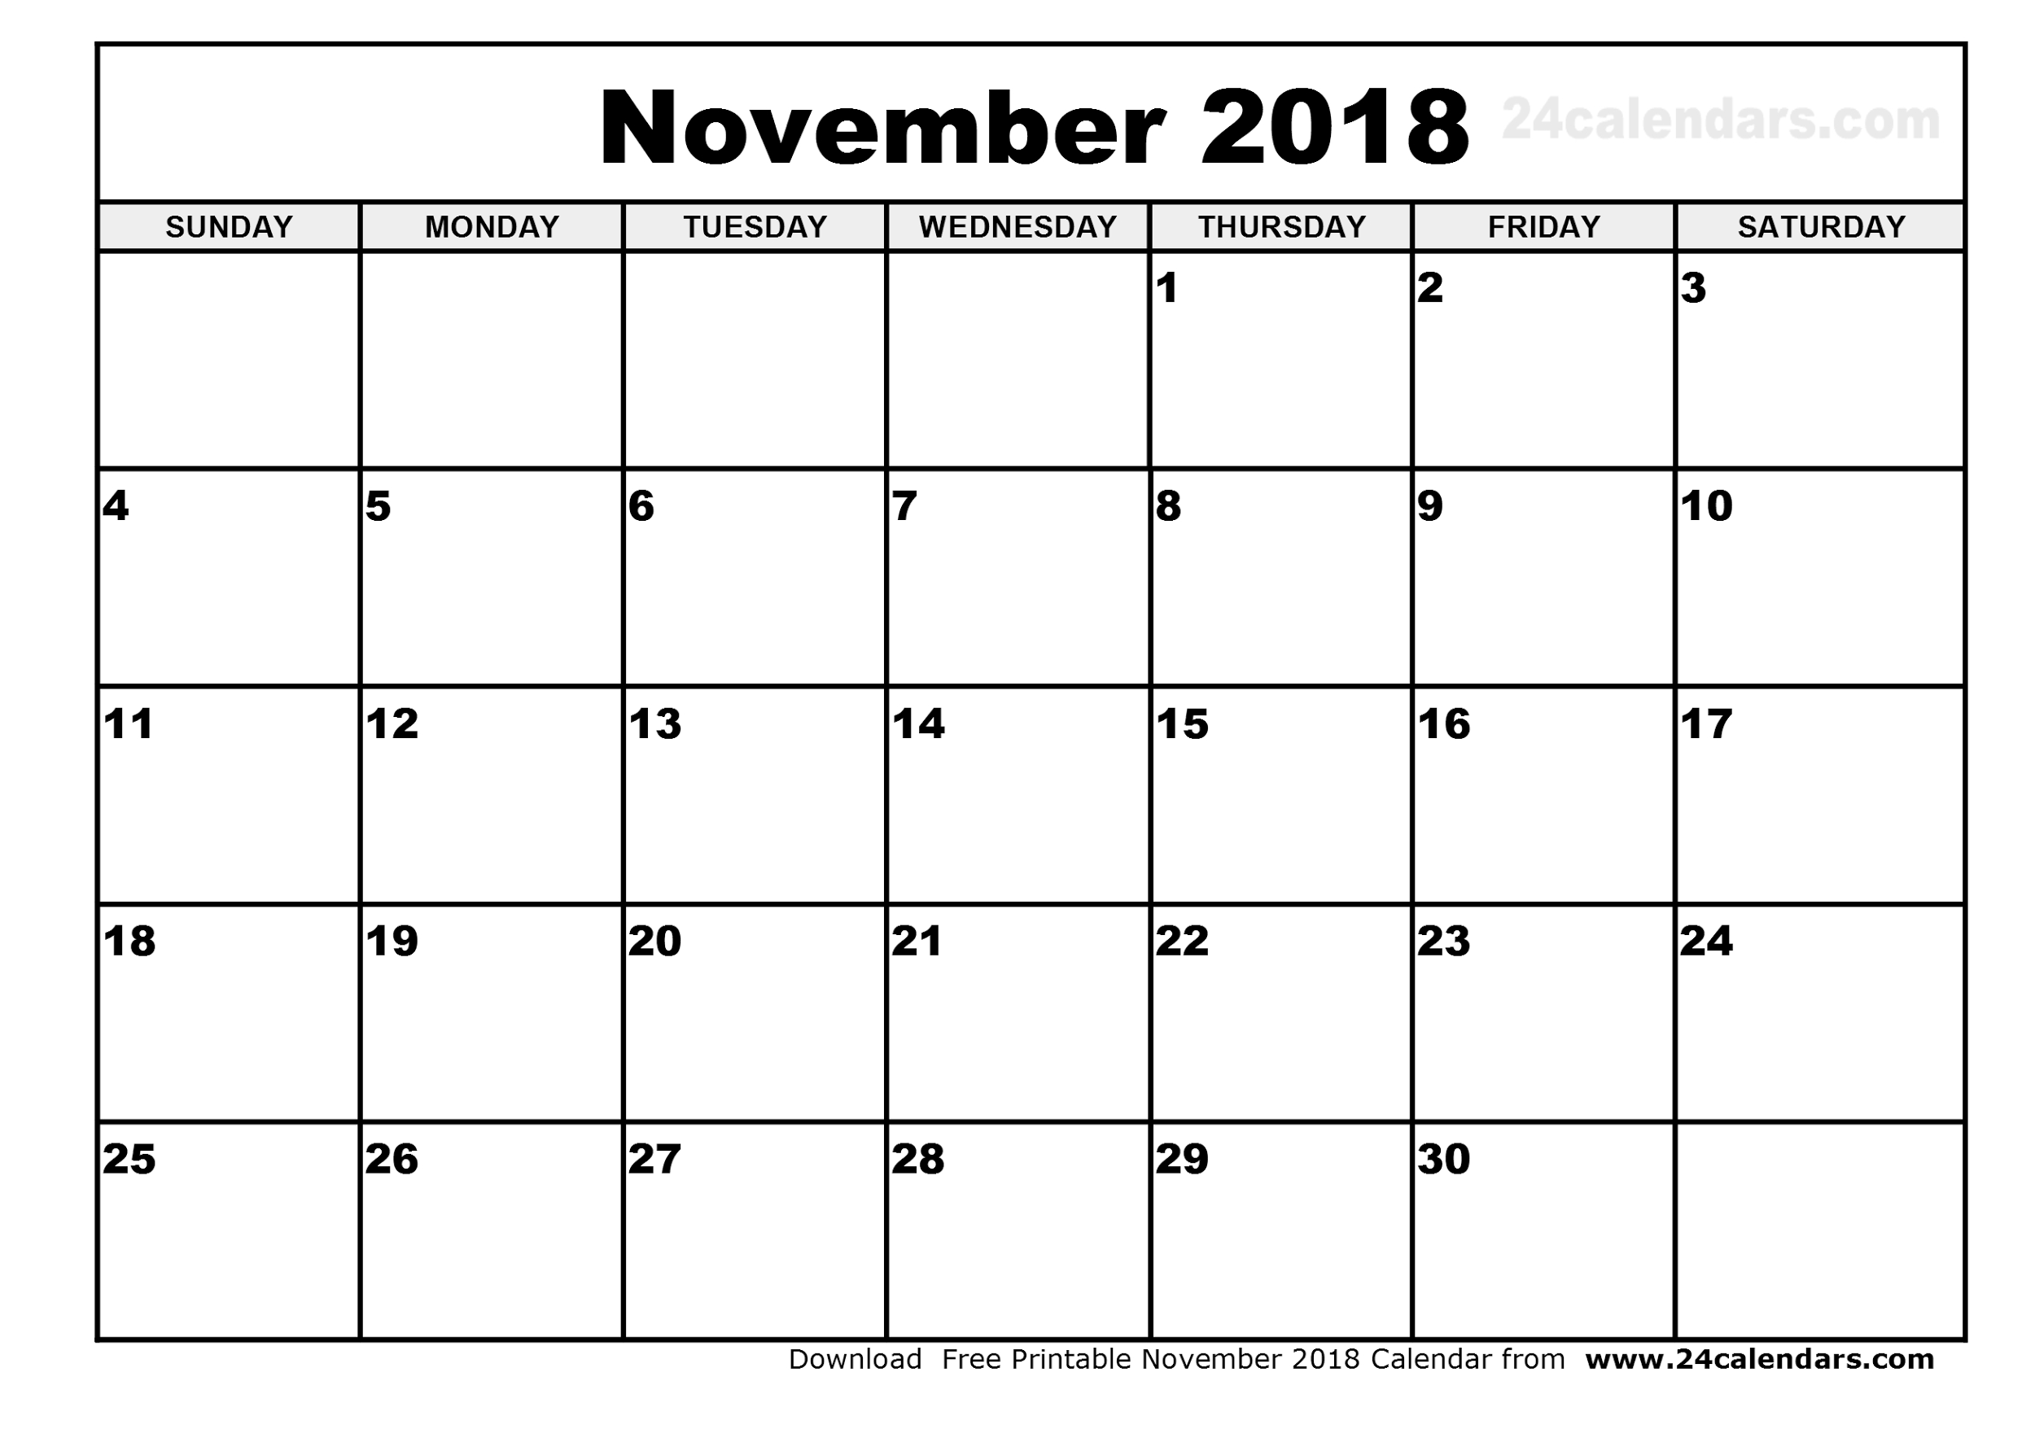

Slide 11
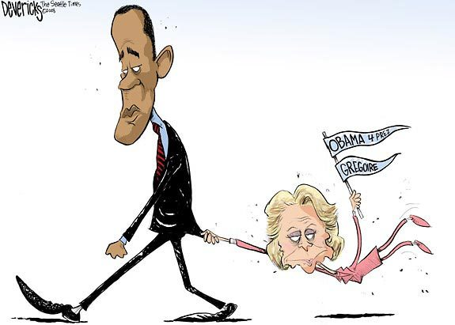
The Voting Process
Early Voting is growing
Absentee Voting
Most states have a “no excuse” ballot
College, Military, traveling, ill, etc.
Formalized early voting
Coattail Effect
Candidates ride the coattails of other candidates

Slide 12
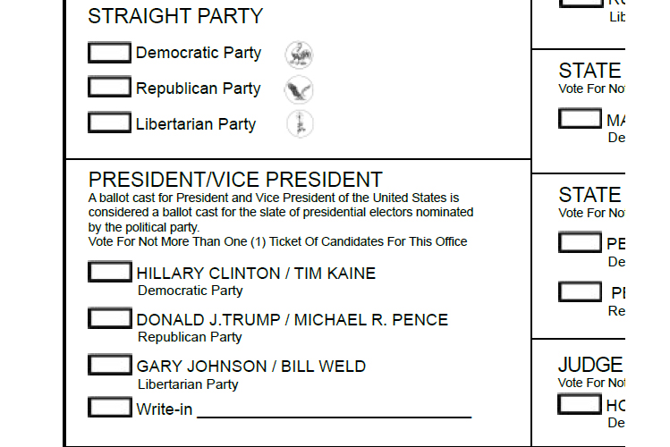
Voting Process
You live in a precinct, you go to your polling place, to cast your ballot.
7 or 8 AM to 7 or 8 PM
Types of Ballots
Paper with Optical Scanners
Electronic/Touch Screen
Malfunction
No paper record of choices
Hacked
Characteristics
Office Grouped
Party Column (Indiana Ballot)
Counting Votes
Electronically
Hanging Chads

Slide 13
Indiana Voting
Indiana Ballot
Nominees are placed in Party Columns
Polls close at 6 (1 of 3 states!)
You can vote in primaries if you are 17!!
Must be 18 on or before general election

