Slide 1
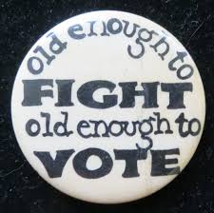
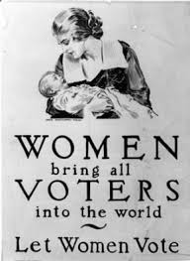
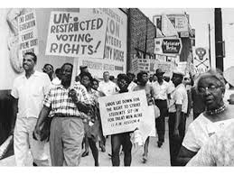
Voting History

Slide 2
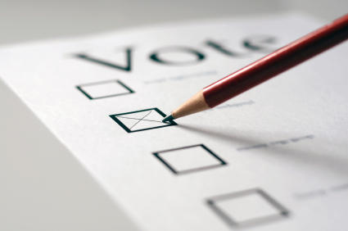
Squad Up!
Do you think it is important to vote? Why or why not?

Slide 3
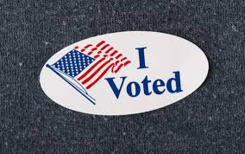
Voting History
Summary: The struggle to extend suffrage to a larger part of the electorate
Shaped politics and political parties
5 stages:
Religious Qualifications, property ownership-1800s
Race→ 15th Amendment-1870s
Sex→ 19th Amendment- 1920s
Race/Economic→ Civil Rights Act, DC can vote, poll tax→ 24th Amendment- 1960s
Age→ 26th Amendment, 1970s

Slide 5
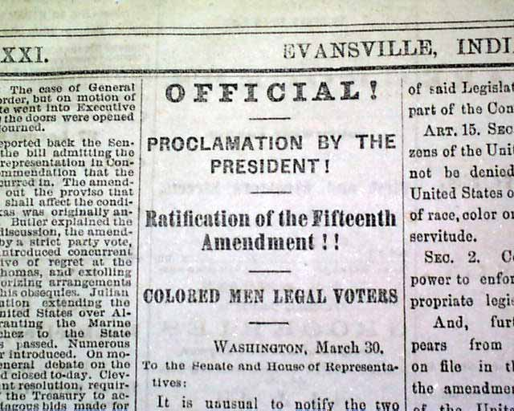
A deeper look...
15th Amendment
“Race, color, or previous condition of servitude”
LACK OF ENFORCEMENT
Grandfather Clause
Violence, poll taxes, literacy tests
Exclusion in primaries
Court Cases made some of these steps illegal!

Slide 6
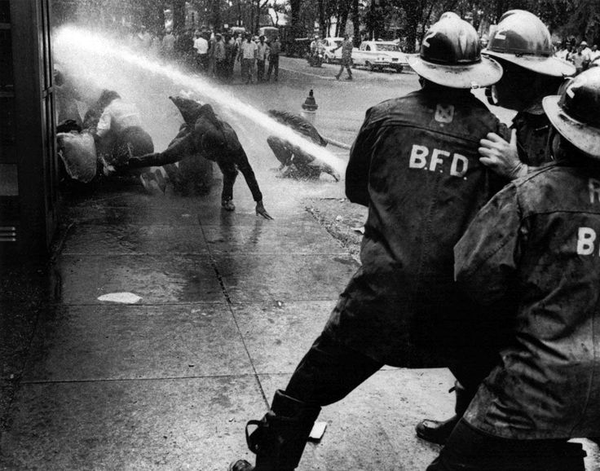
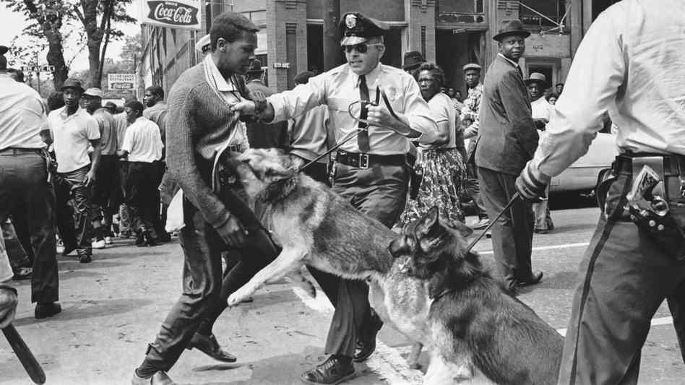
A deeper look...
The Civil Rights Acts
1957 & 1960
Commission to investigate voter discrimination
Federal voting referees
Harsher Laws
1964
Voting, Job related matters,
Literacy Tests illegal Federal Elections
Allowed federal courts to issue injunctions→ not effective
Selma, Alabama
1965
15th amendment=enforced
ALL ELECTIONS

Slide 7
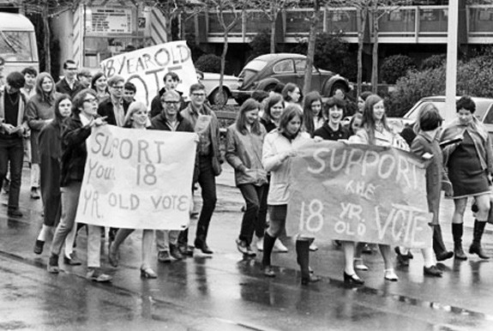
Who can vote?!
US Constitution
If you can vote in state elections you can vote in Federal Elections
15th Amendment
19th Amedment
24th Amendment
26th Amendment
States→ HAVE THE POWER
Citizenship
Must be a citizen, or applied for citizenship
Residence
Legally living in state for at least 30 days
Transients (College, Sales Agents, Military(some situations))
Age
Old enough to fight, old enough to vote
Convicts
10 States permanently lose, 24 after parole/probation, 14 after released, 2 unrestricted
Developmental Disabilities = can not vote

Slide 8
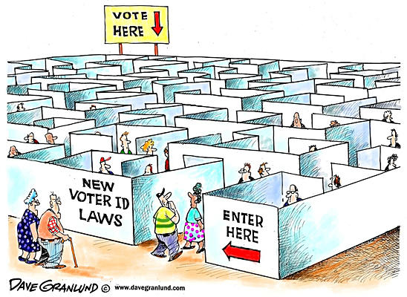
Registration
Voter Fraud
49 States (North Dakota)
Purging of Records
Motor Voter Act
Apply/renew driver’s license
Mail
Social Service Agencies
Controversies
Stops voting for poor & less educated
US only country to choose to register
Voter ID Laws
Started in Indiana!

Slide 9
Squad up!
Do you think registration deadlines and voter ID laws are infringing on voter rights? Why or why not?
How would you change them?

