Slide 1
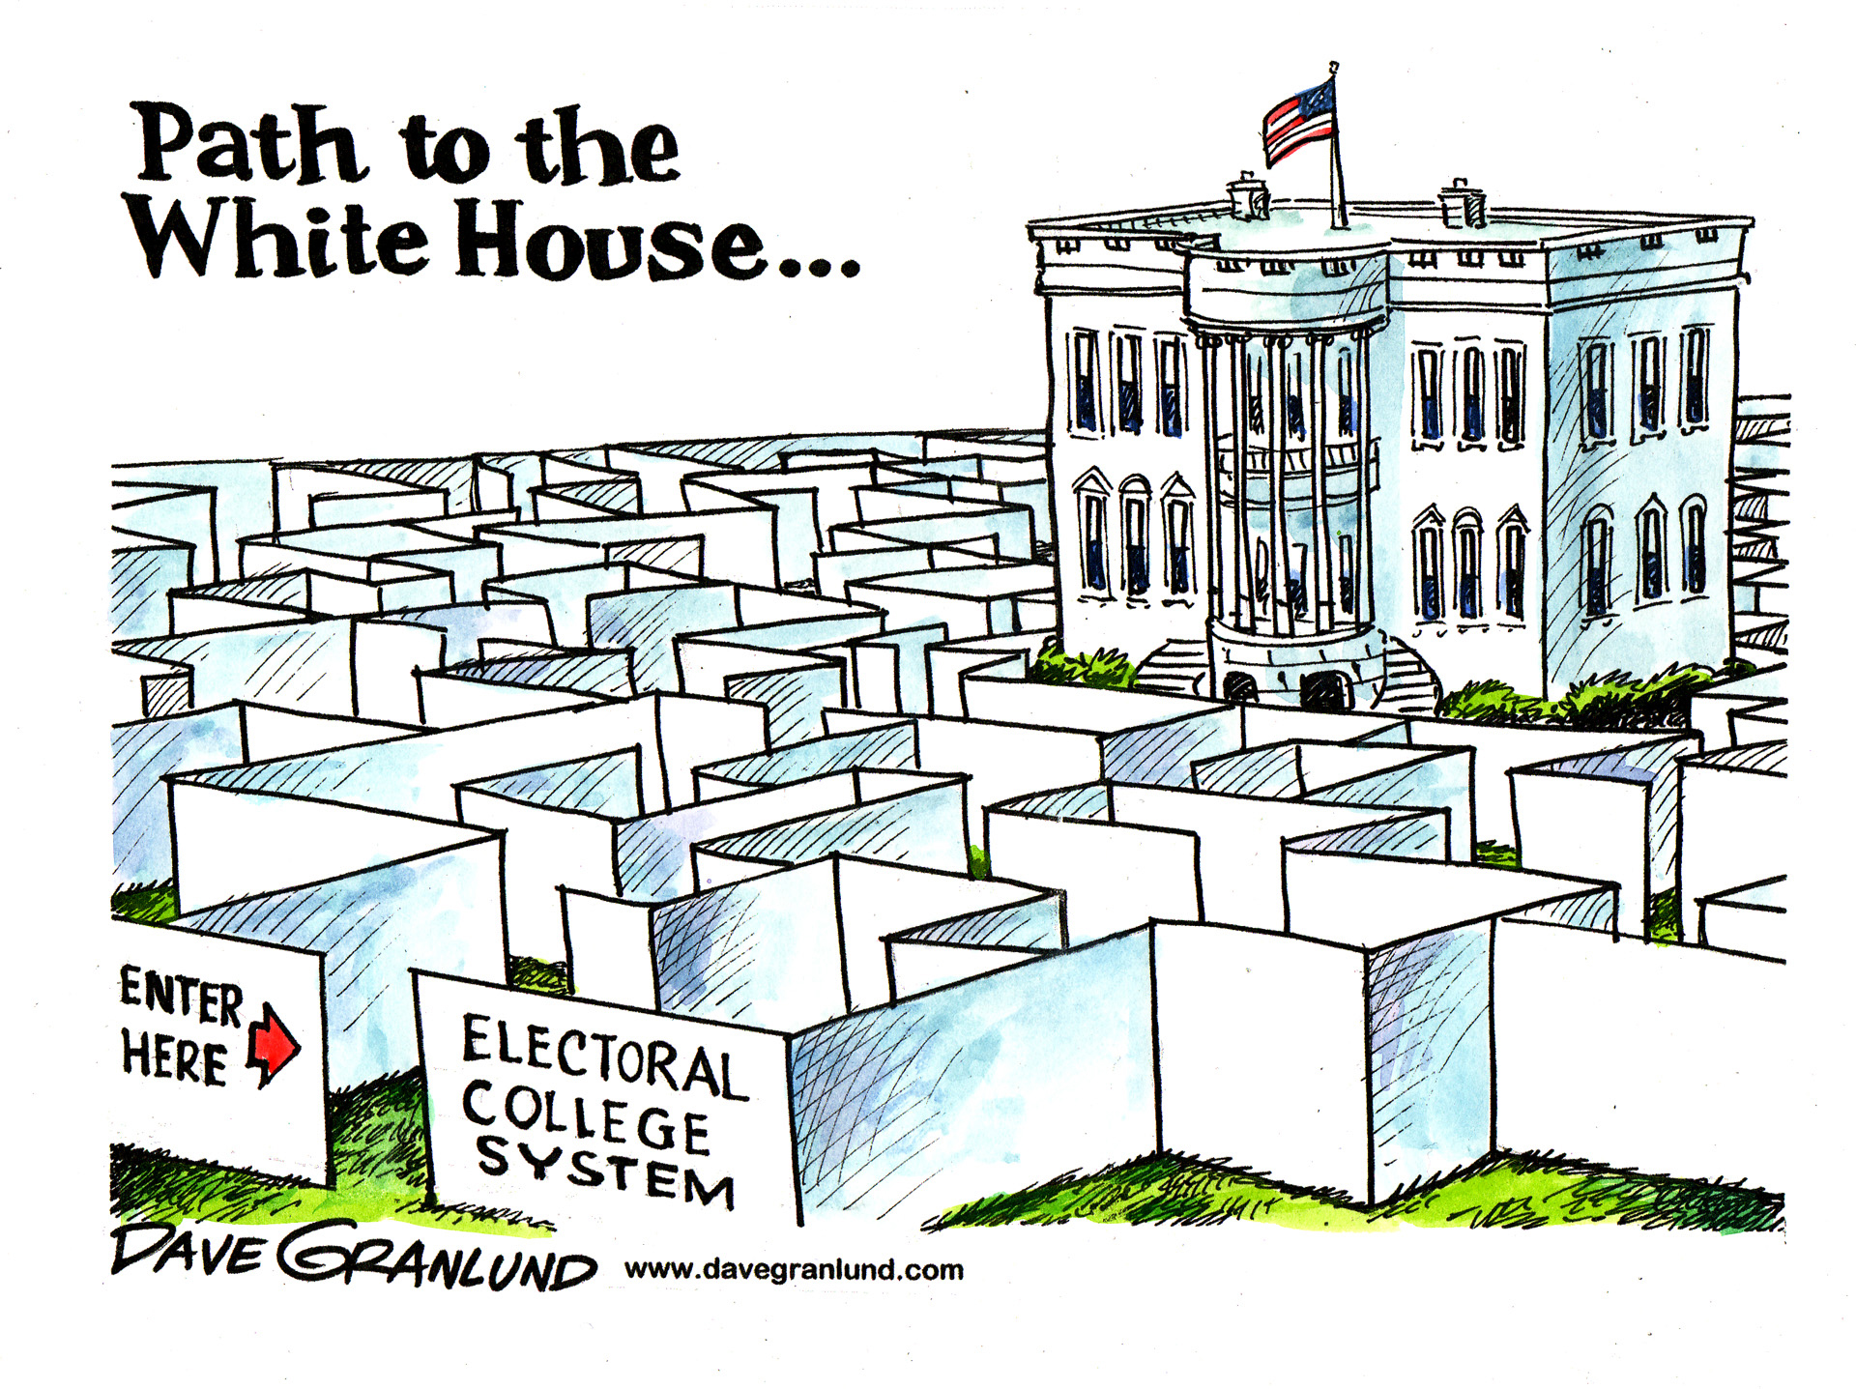

Slide 2
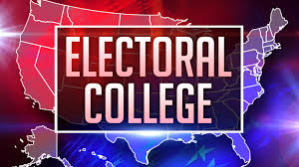

Slide 3
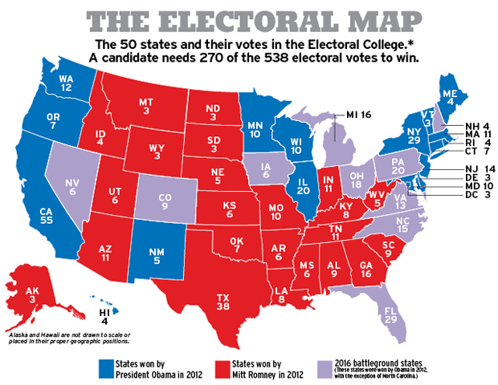

Slide 4
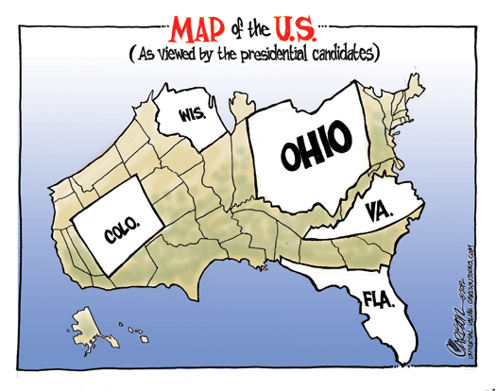

Slide 5
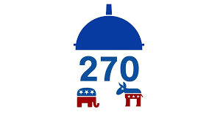
The Basics
The Electoral College technically elects the president, NOT the people
When you vote, you vote for the electors of the electoral college
You need 270 votes to win!
# of electoral votes = # of people in Congress
Indiana = 11, California = 55, Wyoming = 3
WINNER-TAKE-ALL SYSTEM
Why was it created?
Framers feared direct election
Electors voted for best candidate
Time
Appease the smaller states

Slide 6
How it works
Electors are nominated and voted on by the public
Election Day
Slate of Democrats, Slate of Republicans
Electors meet at State Capitol
Monday after the 2nd Wednesday in December
Each have two votes (1=President 1=VP)
Used to have general vote
President and VP from different parties!!!
Adams and Jefferson 1796
Vote, Sign, Sealed and sent to the President of the Senate (VP)
Opens in January in front of Congress

Slide 7
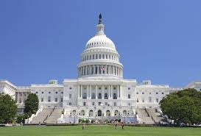
What if no one wins?
How many votes do you need to win?
HoR decides President
Votes between top three candidates
1800, 1824
Each state has one vote
Must get 26 votes
January 20 is the deadline
No President? VP becomes President
20th Amendment
Senate chooses VP
1837

Slide 8
Squad Up!
Do you think we should keep the electoral college? Why or why not?
What could we have to replace/change it?

Slide 9
Pros and Cons
Opponents
Winner of popular vote is guaranteed
Winner take all, ex: 2012 51% Obama he got all 13 votes VA
Electors don’t have to vote with their state
Faithless electors
Vote could become void
MN 2016
Elections decided by HoR
State could lose vote if no majority
Supporters
Dangers are exaggerated
Decided by HoR-2
Win w/o popular vote 5/57
It’s a known process
Know who the President is almost instantly
Helps keep stability

Slide 10
District Plan | 2 electors (entire state) must vote with popular vote of state Remaining electors, elected by each district, vote the way the district votes EX: Indiana District 7, 1 In place in ME and NE | Doesn’t guarantee popular vote winner becomes President
Proportional Plan | Share of popular vote = share of electoral vote Thousandths of Decimals | Doesn’t guarantee popular vote winner becomes President
Direct Election | Abolishes the Electoral College Requires Constitutional Amendment | States lose power in election process Increase campaign time and money

