Slide 1
Public Opinion
Public Opinion, Polling, Mass Media

Slide 2
Public Opinion
What is it?
Attitudes held by a significant number of people on matters of government and politics

Slide 3
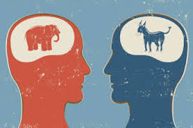
Factors that influence Public Opinion
Family
Most important→ monopoly of time
News, discussions, events
School
Formal Learning
Informal Learning
Media
Celebrities
Friends
Peer pressure
Reinforcement
Trust, share experiences
Historic events
EX: 9/11

Slide 4
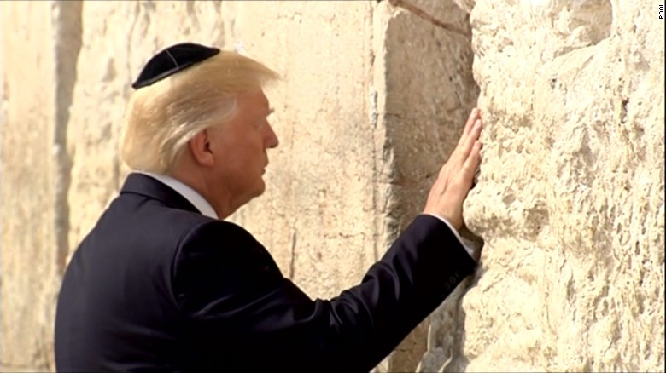
Media Influence
Public agenda
Determines what issues are important
Think and talk about
People and policy makers
Electoral Politics
Replaced Parties as main source of info
Candidates rely less on Parties
Personality, Looks, Characteristics, etc
Soundbites

Slide 5
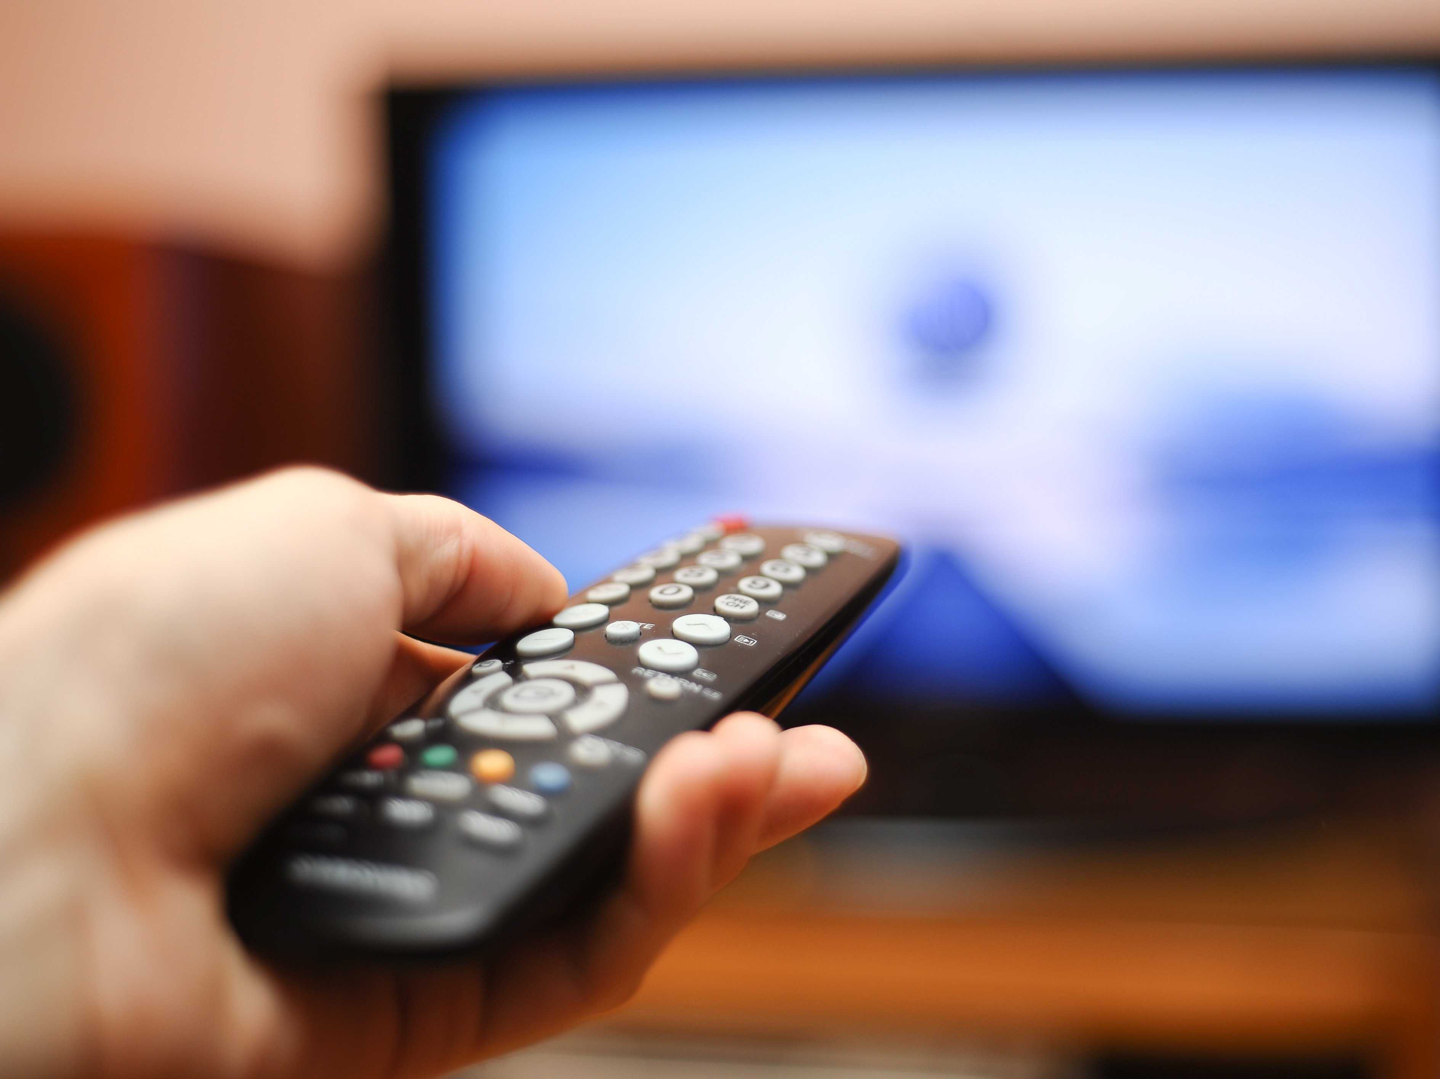
Media Limits
Selection Bias
You choose what you want
Full picture
“Skim” the news- TV, SM, Radio
Briefly discuss
60-90 sec

Slide 6
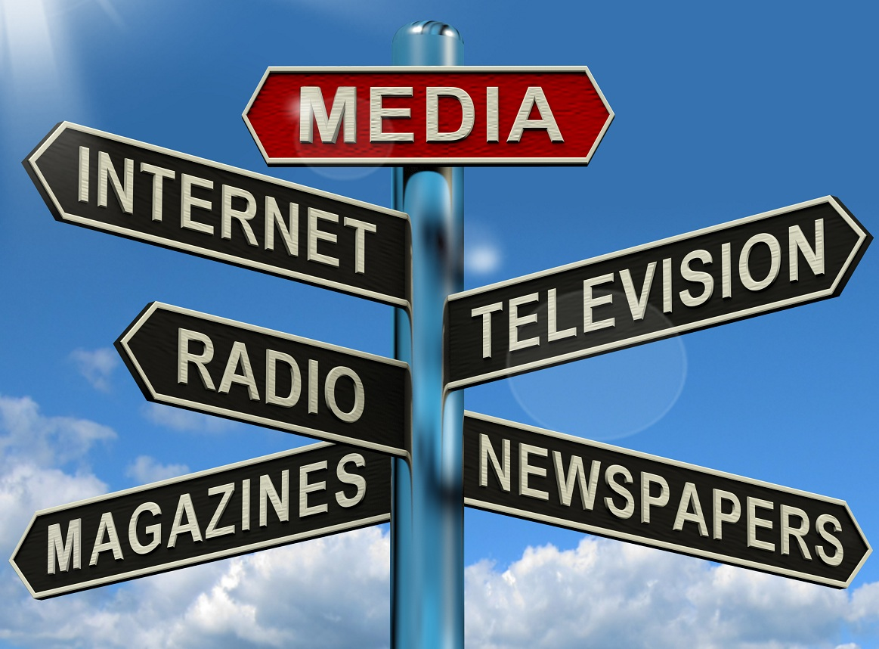
Mass Media: Influence Through the Ages
Almost all privately owned and operated
Television
At least 1 television in 98% of homes
Principal Source of news
CBS, ABC, NBC, CNN, FOX
Newspapers
More in Depth
Radio
Talk Shows→ Rush Limbaugh, Rachel Maddow
Internet
Social media

Slide 7
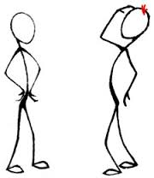
5 Steps to a Scientific Poll
Define the Universe
Whole population the poll is measuring
EX: All voters in Westfield, IN
Construct a Sample
Representative slice of the Universe
Random Samples
Everyone has the same chance of getting picked
How can it go wrong?
Prepare Valid Questions
Way questions are phrased
Leading questions
Should we increase the police force to stop the rising crime rate?
Select How the Poll Will be Taken
Door-to-Door, Face-to-Face, telephone, etc.
Analyze Data and Report Findings

Slide 8
How Reliable are Polls?
Hard to measure key characteristics
Intensity
Strength of feeling
Stability (fluidity)
How permanent is the opinion? How long will it last?
Relevance
How important is it to someone that holds that opinion?

Slide 9
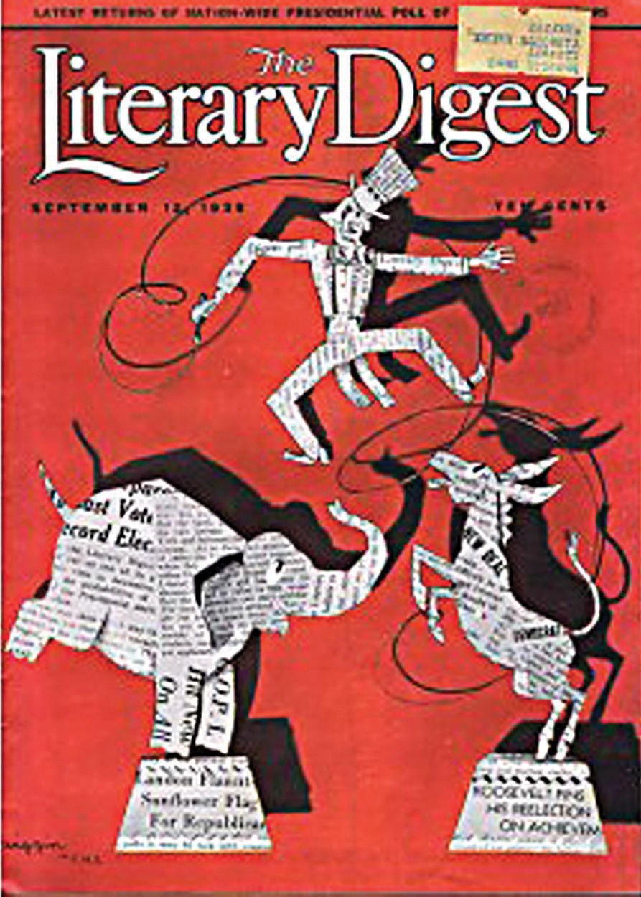
How to Measure Public Opinion
Ineffective
Elections/Mandates
People vote for a variety of reasons
Candidates don’t support entire platform
Must win popular vote to have mandate
Interest Groups
How many people do they actually represent?
Media
Reflects only certain part of population
Straw Votes → same question to a lot of people
Respondents are self-selected
Quantity or quality
Election of 1936
Effective
Scientific Polls

