Slide 1
Clauses You Need to Know

Slide 2
Interstate Compact
What is it?
States must have approval of Congress
Agreements between states
200 today
Examples:
NY and NJ Port Authority
Supervision of Parolees and Juveniles
Coordination of resources

Slide 3
Full Faith and credit
What is it?
States must respect each others laws, records, court decisions
Only civil law, not criminal
Examples
Marriage licenses, birth certificates, driver’s licenses
I sue you for $50,000 in IN. I win. You can’t escape payment by moving to Ohio.
Interracial Marriages
Doma

Slide 4
Extradition
What is it?
Any criminal who flees state of prosecution has to be returned per prequest of prosecuting state
Also, international agreements
Example:
Flee IN to KY. IN governor asks KY governor for return.
Edward Snowden

Slide 5
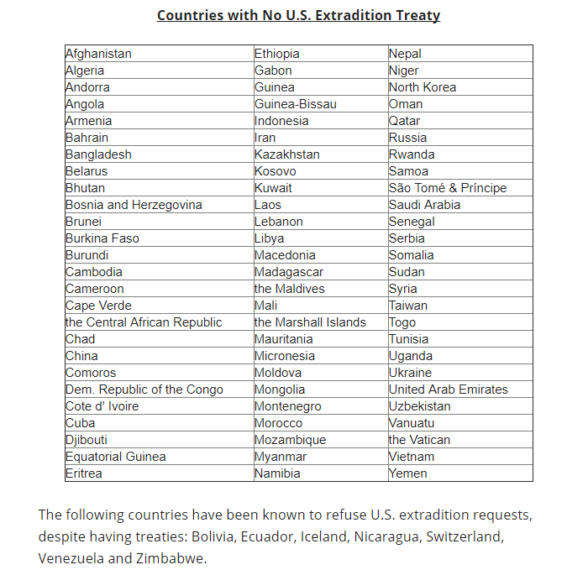

Slide 6
Necessary and Proper
What is it?
All people must be treated reasonably similar by each state
No large distinction between residents and nonresidents
Examples:
Resident requirement for voting
Out of state tuition
Alaskan pipeline

Slide 7
Supremacy
What is it?
Constitution, Federal Laws trump state and local laws
Examples:
McCulloch v. Maryland
Legalization of Marijuana
Legalization of Same-sex marriage

